Slide 1
Update from the National Vaccine Program to the Advisory Commission on Childhood Vaccines (ACCV) September 2, 2022
Valerie Marshall, MPH, PMP
Deputy Director, National Vaccine Program
Office of Infectious Disease and HIV/AIDS Policy
Office of the Assistant Secretary for Health

Slide 2
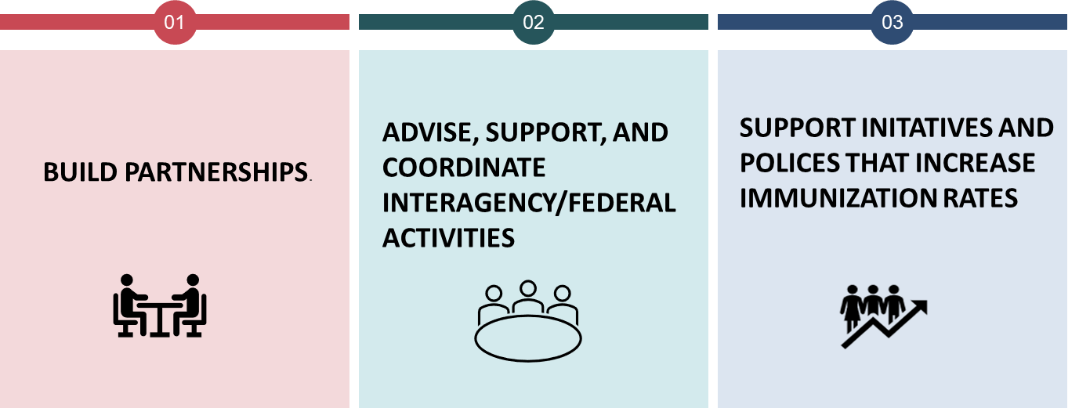
NVP Mission
Mission of the National Vaccine Program
To achieve optimal prevention of human infectious diseases through immunization
To achieve optimal prevention of human infectious diseases through immunization

Slide 3
National Vaccine Advisory Committee (NVAC)
Last Meeting
June 15-16, 2022
Day 1 Discussion
Help Eliminating the Silent Epidemic In America: New Adult Hepatitis B Immunization Recommendations
Injection-free Inoculations
The Vaccine Confidence Subcommittee Report Out
Day 2 Discussion
Covid-19 Vaccine Safety Review
Easing Cold Chain Considerations
Next Meeting
September 22-23, 2022; watch online at hhs.gov/live

Slide 4
Vaccines: Federal Implementation Plan
Accompanies and aligns with Vaccines National Strategic Plan and has the same goals, objectives, and strategies
Outlines the roles of Federal departments and agencies and their specific contributions to achieving vaccine goals
Guidance of Interagency Vaccine Workgroup

Slide 5
Sample Actions and Strategies Vaccines Federal Implementation Plan

Slide 6
National Adult Influenza and Immunization Summit (NAIIS)
Improving Adult Immunizations to Sustain Progress
Accomplished During the Pandemic
The NAIIS is dedicated to facilitating the implementation of vaccine recommendations of the Advisory Committee on Immunization Practices.
The 2022 National Adult and Influenza Immunization Summit (NAIIS) will be held on November 2–3, 2022 at the Crowne Plaza Atlanta Perimeter at Ravinia in Atlanta, Georgia.
2022 National Adult and Influenza Immunization Summit in Person Meeting - National Adult and Influenza Immunization Summit (izsummitpartners.org)

Slide 7
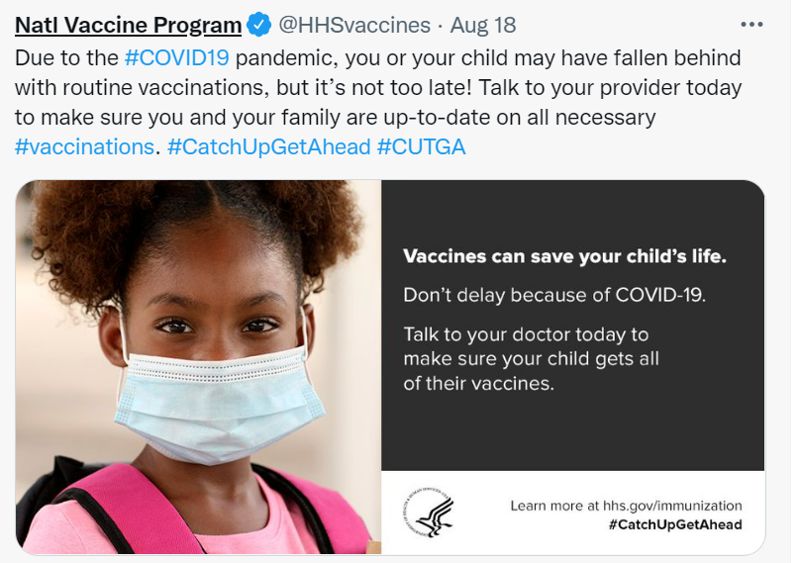
August - National Immunization Awareness Month
OASH Promotional Efforts
https://www.hhs.gov/immunization/get-vaccinated/for-parents/five-reasons/index.html

Slide 8
Thank you!

