Slide 1
MISSION Act SECTION 403 Council on Graduate Medical Education (COGME) March 4, 2024
John M. Byrne, DO
Senior Advisor
VA Office of Academic Affiliations

Slide 2

Introduction
Section 403 Summary
Rulemaking Process
Regulation
Request for Proposals
Section 403 - Reporting Requirements

Slide 3

Trainee Allocation
Finances
Affiliations
Support and Education
Policies and Guidance
38 USC Section 7302

Slide 4

Graduate Medical Education in VA
“To Educate for VA and the Nation”
VA Medical Facilities
Do not hold the accreditation of GME programs
Establish affiliation agreements with ACGME sponsoring institutions
Provide faculty supervision and learning environments
Reimburse affiliated sponsoring institutions for resident rotations at VA

Slide 5
Federal Graduate Medical Education Funding

Slide 6



Current VA GME Funding Mechanism
VA Facility Reimburses GME Sponsor
VA Facility and GME Sponsor Establish Affiliation Agreement and Disbursement Agreement
GME Sponsoring Institution
VA Facility
Hires and Pays Residents
Residents Rotate to VA Facility

Slide 7
Introduction
Section 403 Summary
Rulemaking Process
Regulation
Request for Proposals
Section 403 - Reporting Requirements

Slide 8
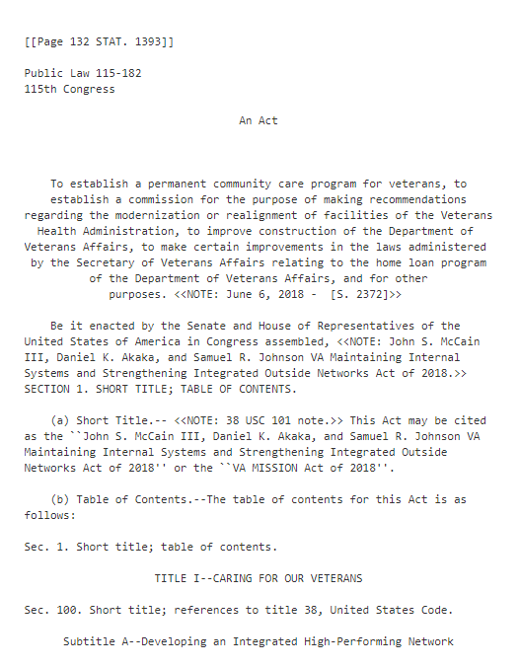
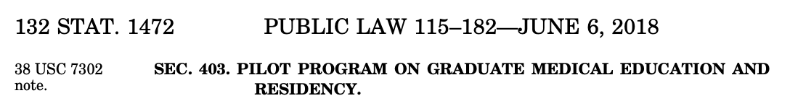
MISSION Act Section 403
VA Maintaining Internal Systems and Strengthening Integrated Outside Networks (MISSION) Act Section 403

Slide 9

MISSION Act Section 403
Pilot program
Include no fewer than 100 resident physicians at covered facilities
Operated by Indian tribe or tribal organization
Indian Health Service
Federally-Qualified Health Centers
Department of Defense
Reimbursement of costs
Initiative ends August 7, 2031

Slide 10

MISSION Act Section 403
Selection criteria for covered facilities
Need for providers in areas surrounding facility(ies)
Local community designated as underserved by Secretary of VA
Facility located in health professions shortage area or rural/remote areas
Priorities
Operated by Indian Health Service
Operated by Indian tribe or tribal organization
Located in communities designated by Secretary of VA as underserved

Slide 11
Introduction
Section 403 Summary
Rulemaking Process
Regulations
Requests for Proposals
Section 403 - Reporting Requirements

Slide 12

MISSION Act Section 403: Purpose and Scope
Purpose
Implement the Pilot Program
[Reimburse costs for] placement of residents in existing or new residency programs in covered facilities
Reimburse certain costs for establishing new residency programs in covered facilities
Scope
Rulemaking applies only to the Pilot Program; not VA’s administration of GME programs under 38 USC 7302(e)

Slide 13






MISSION Act Section 403: Development of Regulations
Federal Rulemaking
AUTHORIZING LEGISLATION PASSED
AGENCY PUBLISHES FINAL RULE
AGENCY RECIEVES COMMENTS
AGENCY PUBLISHES PROPOSED RULE
PUBLIC COMMENT
AGENCY DEVELOPS PROPOSED RULE

Slide 14
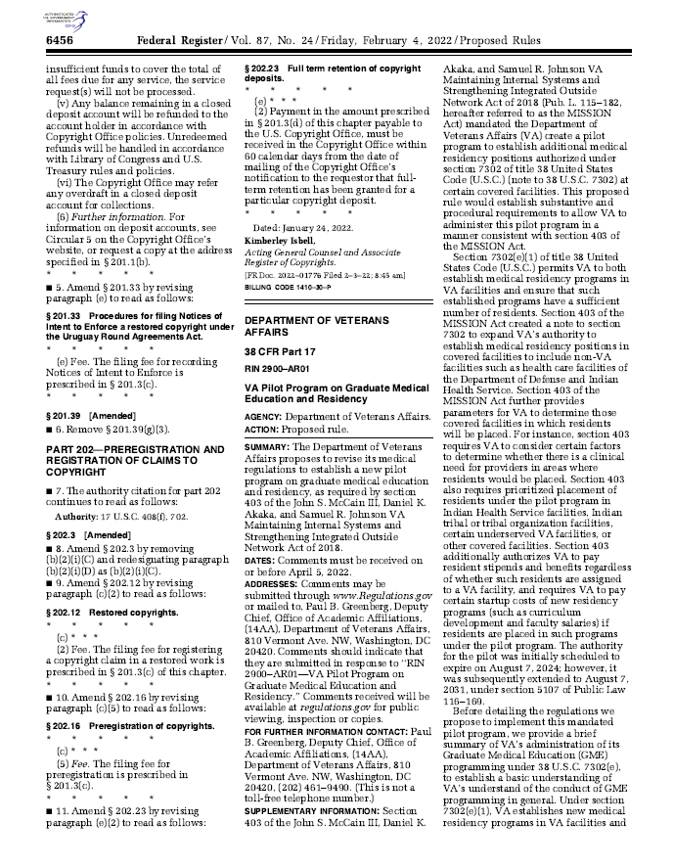
MISSION Act Section 403: Rule Making
Federal Register
Proposed Rule
Published February 4, 2022
Public comment closed July 5, 2022
Paperwork Reduction Act (PRA)
Published in FR November 1, 2022
Public comment closed January 3, 2023
Office of Management and Budget (OMB)
Review of PRA
Publication of Final Rule
November 13, 2023

Slide 15
MISSION Act Section 403: Development of Regulations
Two New Authorities
Reimbursement for resident time (salary & benefits) for delivering non-Veteran care in non-VA facilities
Reimbursement of startup costs for new residency programs at non-VA facilities

Slide 16
Introduction
Section 403 Summary
Rulemaking Process
Regulations
Requests for Proposals
Section 403 - Reporting Requirements

Slide 17




VA Reimburses GME Sponsor
VA reimburses GME sponsor for salary and benefits of residents rotating to covered facilities
Model A
US Dept. of Veterans Affairs
Affiliated GME Sponsor
Residents rotate to covered facility
Hires and pays residents
Covered facility

Slide 18

VA Reimburses Covered Facility GME Sponsor
VA reimburses covered facility GME sponsor for new program startup costs
+
salary and benefits of residents
Model B
US Dept. of Veterans Affairs
Covered facility sponsors new GME program
Faculty & residents from new GME program at covered facility

Slide 19
MISSION Act Section 403: Two Pilot Models: VA Reimbursement
Model A
Costs of resident stipends + benefits only
Costs of new GME programs and resident stipends + benefits
Model B

Slide 20
MISSION Act Section 403: Two Pilot Models
Model A
Residents
- Residents from existing accredited GME programs rotate at 403-covered facilities
VA
- Covers costs of resident stipends and benefits
Model B
Residents
- Residents enrolled in NEW GME programs at 403-covered facilities
VA
- Covers new GME program costs
- Covers cost of resident stipends and benefits
GME Sponsor
- Provides residents to 403-covered facilities
403-Covered Facility
- Accepts residents
403-Covered Facility
- Serves as GME sponsor and
provides residents
- Attains provisional accreditation
status for GME program

Slide 21
New Residency Programs
Costs Covered
Curriculum development
Program Requirements
Reimbursement authorized for new residency programs that have
Recruitment and retention of faculty
Accreditation costs
Faculty salary costs
Resident education expense costs (e.g., medical equipment for training or residency program management software)
Initial ACGME accreditation or
Continued ACGME accreditation without outcomes and have not graduated an inaugural class

Slide 22
Consideration Factors for Placement of Residents
Ratio of Veterans to VA providers
Higher ratio = higher need for provider
Range of clinical specialties of VA and non-VA providers
Fewer clinical specialties = higher need for providers
Health professional shortage
Remote or rural area
Notes:
Ratio of Veterans to VA providers in county surrounding a covered facility
higher ratio = higher need for providers
Range of clinical specialties of VA and non-VA providers in county surrounding covered facility
Fewer clinical specialties = higher need for providers
Covered facility in community designated as health professional shortage area by Secretary of HHS (42 USC 254e)

Slide 23

Priorities for Placement of Residents
Covered facilities
Operated by Indian Health Service
Operated by Indian tribe or tribal organization
Located in communities in the same areas as VA facilities designated by VA as underserved (Section 401 PL 115-182)

Slide 24

Determination of Process for Placement of Residents
Not a grant program
VA will issue and evaluate responses to a Request for Proposal (RFP)
Determine the covered facilities where residents may be placed
Determine the costs to be reimbursed

Slide 25
Introduction
Section 403
Rulemaking Process
Proposed Rule
Request for Proposals
Section 403 - Reporting Requirements

Slide 26


Request for Proposals (RFP) Process
VA issues a Request for Proposal (RFP)
VA reviews RFPs
VA selects 403-covered facilities
VA and GME Sponsors enter contracts, agreements
or other arrangements
Resident Placement in Covered Facilities
RFP submitted to OAA

Slide 27
MISSION 403 Request for Proposals (RFP)
Relationship Building
Strategic Communications
October 2023 – Summer 2024
RFP Issued for
Model A
Summer 2024
Applications Due to OAA
Fall 2024
Resident Start Date for AY 2025-2026
July 2025

Slide 28
MISSION 403 RFP Strategic Communications
ACGME Medically Underserved Areas and Populations
AAMC Learn Serve Lead
AAMC Group on Resident Affairs Webinar
VA Tribal Advisory Council Subcommittee for Health
Affiliated Tribes of Northwest Indians
VA Advisory Committee on Tribal and Indian Affairs (ACTIA)
Tribal Self Governance Conference
National Council of Urban Indian Health
National Indian Health Board (NIHB) 2024 Tribal Health Conference
National Indian Health Board (NHIB)

Slide 29


Request for Proposals
Release Spring 2024
Model A only
Sponsoring institutions apply to OAA
Rotations at covered facilities
Indian Health Service
Tribe and tribal organizations
Federally Qualified Health Centers
Department of Defense
Priority on Indian Health Service
Academic Year
2025-2026

Slide 30
MISSION ACT 403 RFP Application Requirements
Eligible Sponsoring Institution
Accredited GME sponsoring institutions
Send residents to covered facilities
Adult populations (no pediatrics)
Eligible Covered Facilities
IHS, tribes and tribal organizations
FQHCs, DoD
VA facilities not considered
Funding
100 residents (not FTEE)
Reimbursement (not a grant)
Contract for reimbursement
Proportionate share of salary and benefits only
One-year funding period
Subsequent RFPs may be issued

Slide 31

MISSION Act 403 RFP Covered Facility Requirements
County with low ratio of veterans to VA providers
County with low range of specialists
HHS HPSA
Community designated as rural by US Census Bureau
Zip code designated as frontier or remote by the Economic Research Service
Located in a community of underserved VA health facility

Slide 32
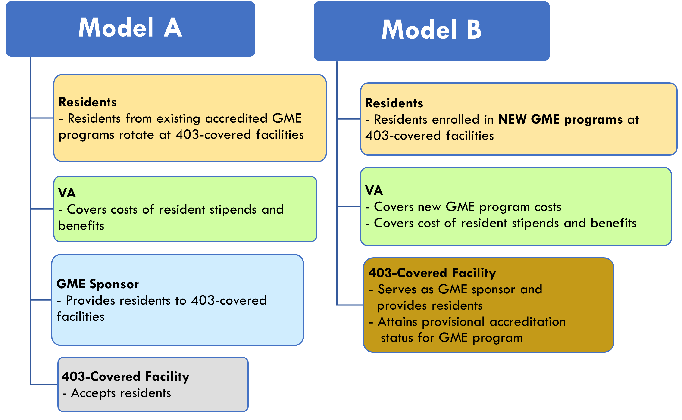
Future MISSION Act Section 403 RFPs & Considerations
Potential additional RFPs for Model A
Potential Model B RFP
Timeline depends on response to Model A
Program must be self-sustaining when program expires
Legislative authority ends August 2031

Slide 33
Introduction
Section 403
Rulemaking Process
Proposed Rule
Request for Proposals
Section 403 - Reporting Requirements

Slide 34

MISSION Act Section 403 Required Data Reporting
Number of Veterans receiving care from residents
Number of clinical appointments for Veterans
Number of resident positions at each covered facility
Medical specialties pursued by the residents
Resident time
Program costs
Number of residents hired by VA
Internal VA Use Only

Slide 35

Questions/ Discussion
John M. Byrne, D.O.
john.byrne3@va.gov

