Slide 1
Navigating the Future of Healthcare
Unveiling the Potential of AI in Health Workforce Development, Mental Health, Eldercare & Beyond.

Slide 2
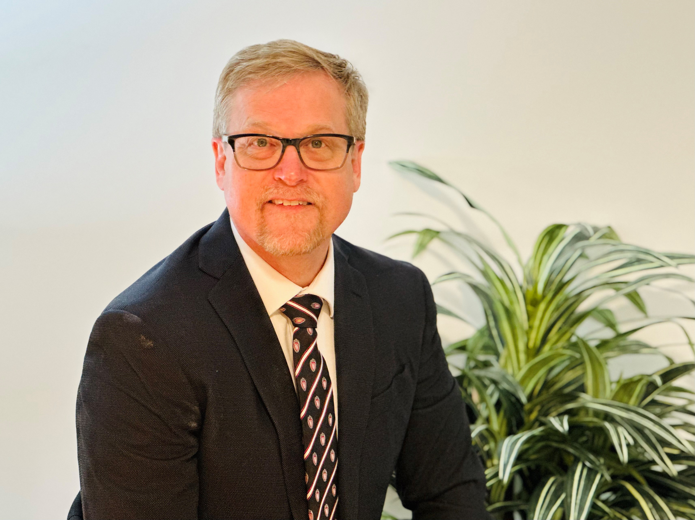
Disclosures:
Joel Gordon, MD
Chief Medical Information Officer, UW Health
Associate Professor, Department of Family Medicine & Community Health
University of Wisconsin School of Medicine & Public Health
Relevancy:
Relevant Financial Relationships:
I have no relevant financial relationships nor is there a substantive conflict of interest from any research, royalties, honoraria or any form of compensation within the discipline of AI in Informatics. Similarly, there are no financial relationships for any relative or my spouse.
Relevant Nonfinancial Relationships:
I have no relevant non-financial relationships within the discipline of AI in Informatics. There are no non-financial relationships for any relative or spouse.
There will be no relevant topics that can be considered as off-label utilization.
Not an AI expert
April 2023: World’s first Chat GPT patient message management implementation
On prem, prompt engineering
Faculty of Informatics and data science lecturer at postgraduate and Medical School level.
CMIO at UW-M, prior CMIO at Mayo Clinic Community Practice
Primary care provider with 30 years experience, (10 in remote rural medicine, 17 integrated (BH/FQHC), 1 academic)

Slide 3
Presentation Objectives:
Consider the incentive for healthcare’s preoccupation with cutting edge technology. Contrast this against the harsh realities of adaption, ethics, and change capacity.
Understand the two current general types of Health Care AI – with each unique application and drawback.
Describe the specific methods consumers, healthcare organizations, and the government can use to protect ourselves and augment productive development and utilization of the promising Healthcare AI.
Post-presentation Work:
Consider the five fundamental tenants of biomedical ethics: Autonomy, justice, fidelity, Non-maleficence, beneficence and rank these from highest to lowest order. Review the paper by Obermeyer & the Digital Mental Health Toolkit (in resources of this PowerPoint).
Stay alert for ways that digital healthcare, EHR, and AI use can magnify inequity within the work we do.
Dr. Everett Rodgers describes the “investment niche” within the diffusion of innovation - most resources are spent on only a few of the members of the spectrum (early adopters and early majority). Is this inequity of resource allocation ethical? Why or why not?

Slide 4
Agenda
Why all the fuss about AI in Healthcare?
What is AI in Healthcare (simplified)?
How can Health Tech enable Healthcare workforce development?
How does AI relate to mental health and elder care?
What are the dilemmas we will face (ethical and adaption)?
Tying it all together – summary statements.
Discussion

Slide 5
Why all the fuss?

Slide 6
C
R
I
S
I
S
>½
of all primary care providers suffer from Burn Out.¹
<½
of all physicians recommend the profession to their children.²
>1/3
of all nurses say they are likely to leave the profession in <5 years.³
>1/3
more messaging is occurring to care teams prior to pandemic.⁴
1. Medscape Physician Burnout & Depression Report 2022. https://www.medscape.com/slideshow/2022-lifestyle-burnout-6014664#1 Accessed 2/9/2023.
2. Corbett, Jennie, Camilla d'Angelo, Lorenzo Gangitano, and Jon Freeman, Future of Health: Findings from a survey of stakeholders on the future of health and healthcare in England. Santa Monica, CA: RAND Corporation, 2017. https://www.rand.org/pubs/research_reports/RR2147.html.
3. American Nurses Association (2019) Fact sheet: Nursing shortage. Available at: https://www.aacnnursing.org/Portals/42/News/Factsheets/Nursing-Shortage-Factsheet.pdf accessed 12 February 2021.
Notes:
Pause for 7 seconds and let people soak in “the problem statement”

Slide 7
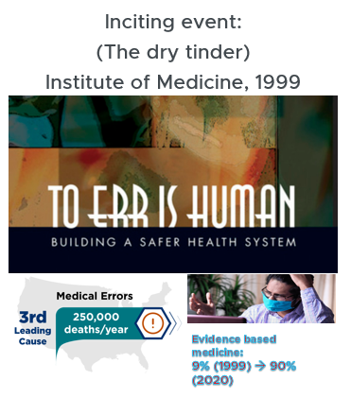
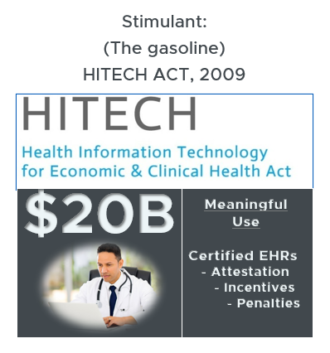
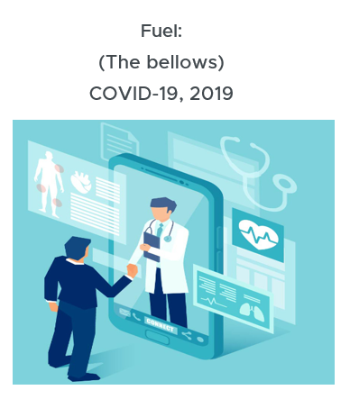
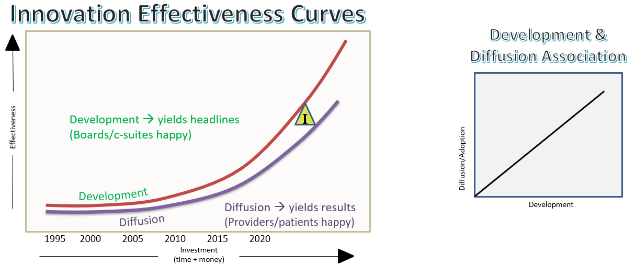
Historical Context to Health Tech Growth
Notes:
Some people and some experts attribute some of the causation to technology within the workspace. I’m going to spend the rest of my 5 minutes contextualizing that statement. What are the three major historical events that have shaped health care technology? I will describe the role of an applied informaticists within this space? The “Golden Triangle” between development and diffusion is the work of informatics. Pointing out that there is a relationship between development an diffusion.

Slide 8
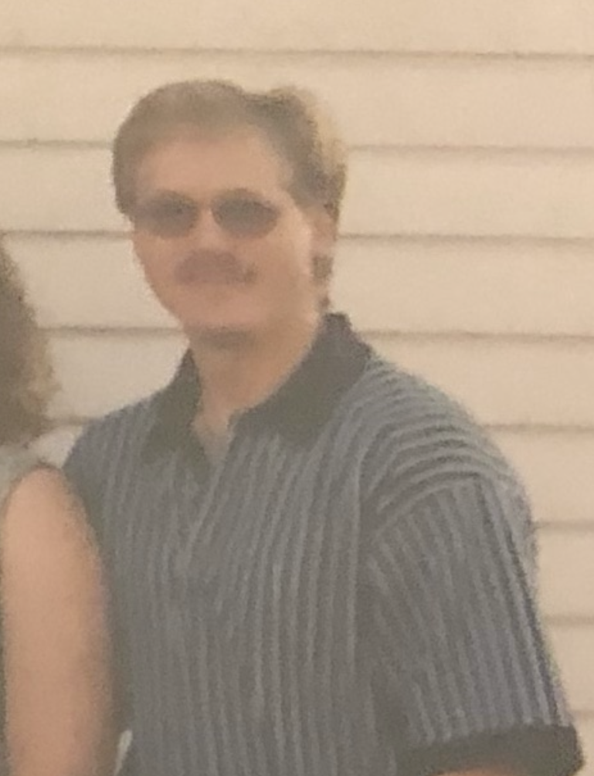
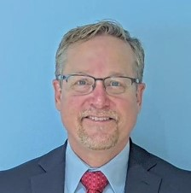
Medical Success = Escalating Work
Diabetic Work = Cognitive burden… 30-fold increase within 1 generation of workers
#
meds
# Evidence
based actions
% PCP
Visits
120
0
82
0
SGLPT-2
23
0
Bile Acid Sequest.
DPPP-4
Megltinides
Oral GLP-2 antag.
a-gluconidase inhib
TZDs
Biguanides
Dietary modification
Insulin
Sulfonylureas
3K BC
1920
1980
1994
2000
2015
2020
2024
LEGEND:
Novel treatment discovery (FDA med class)
Evidence based action (goal/standard)
Amount of relative cognition
4 meds,
3 goals,
4% visits
120 meds,
82 goals,
23% visits
AND INFORMATICS
Notes:
As I reflect on the concern that Health Tech is the causation of “stress” for some people. I ask is it computers and electronics within the care areas that is the problem, or is it what we’re expecting people to do with those tools while they take care of people. What if it is a reaction to effort. I equate effort to work to cognitive burden – particularly true for the “cognitive medicine folks” (non-proceduralists). One disease as an example – Diabetes… how that has changed over my career? I entered the workforce after residency in 1994 – there were 4 different medicines and 3 standardized goals. Diabetics made up 4% of my visits (due to under diagnosis, under appreciation of medical interventions, and mortality rates limiting how long I’d have a diabetic person on my panel). Through the success of medicine, science and society we’ve had a remarkable growth in treatment options. Today, I need to understand and utilize 120 different medications and account for 82 goals, subgoals attributed from various regulatory, payor and industry standards. I cannot do all of this without a computer in the room. Because of our success with these efforts, and because of factors that repurpose other work to other “healthcare services” this markedly more complicated cognitive burden – of taking care of a diabetic patient – makes up nearly a ¼ of the visits within a day. This is a massive increase of total daily cognitive challenge within the 30 years of my career. This is particularly true if the computerized system I’m using is storing, organizing, and presenting the information – but isn’t actually computing (relating, summarizing, automating, and aiding in decision making).

Slide 9
The cognitive challenge effects the diffusion curve
The Development + Diffusion of Innovation Effectiveness
Innovation Effectiveness Curves
Development &
Diffusion Association
Development → yields headlines
(Boards/c-suites happy)
I
Effectiveness
Diffusion/Adoption
Development
Diffusion
Diffusion → yields results
(Providers/patients happy)
Development
2000 2005 2010 2015 2020
Investment
(time + money)
Notes:
To make this

Slide 10
What is Healthcare AI?
(Over)simplified

Slide 11
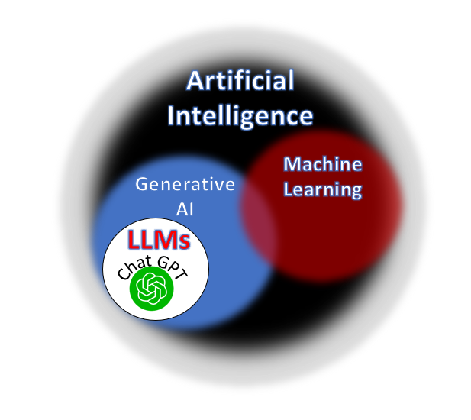
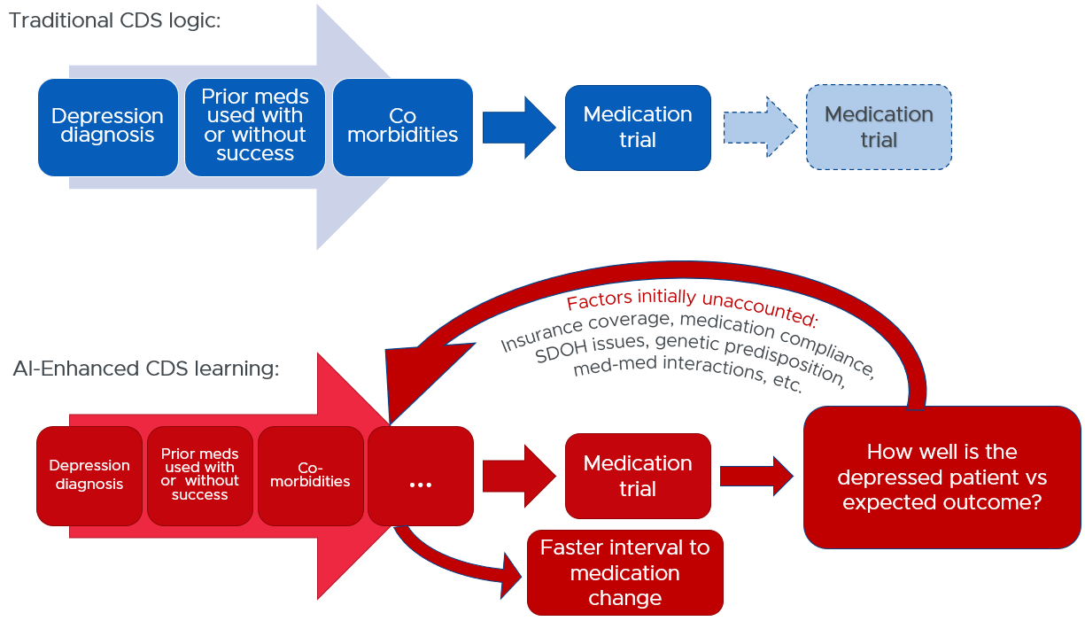
Types of Healthcare AI: Machine Learning vs Generative AI
LLM: “Dashing through the snow, in a one-horse open _____ “

Slide 12
Augmenting workforce development.
with health tech tools

Slide 13



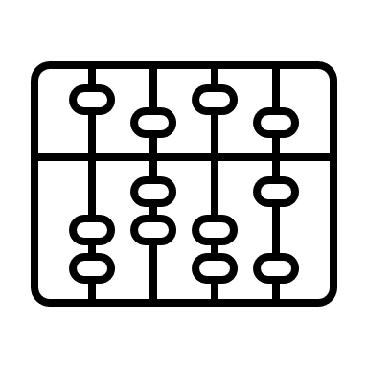
Adult learning opportunities with AI/health tech:
Virtual & Augmented Reality
Novel Computing & Metadata Capture
Machine Learning & Predictive Analytics
LLM & NLP – Text Generation

Slide 14
Enabling mental health and elder care
via the AI toolset

Slide 15
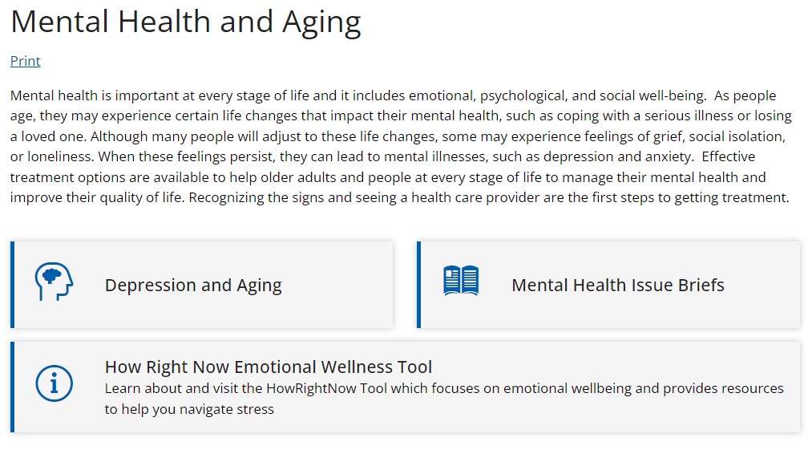

Mental Health – Elder Care
Synonymous:

Slide 16
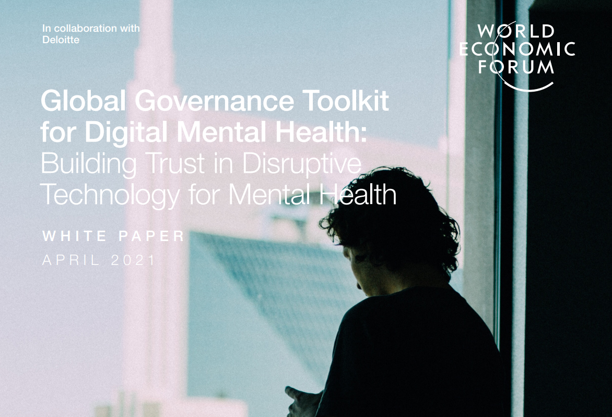
Global Governance Toolkit for Digital Mental Health | World Economic Forum (weforum.org)

Slide 17



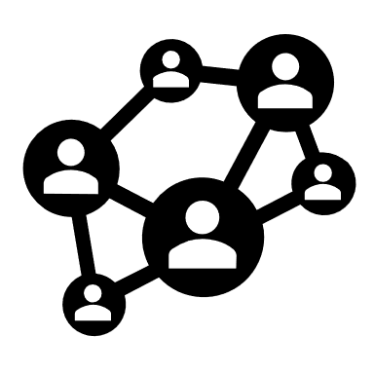
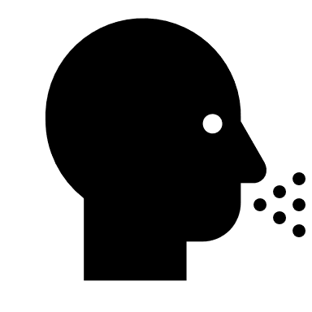



Challenges to achieving better mental health outcomes:
Stigma, discrimination and absence of frameworks.
Chronic underspend, inaction, & lack of access.
Subscale and siloed healthcare systems.
Gaps in clinical and scientific knowledge.
Changing determinants of mental health.

Slide 18
Risks of disruptive technology within mental health:
Untested efficacy or misleading claims of mental health benefits.
Privacy breaches of health data.
Harm to patient through malfunction, incorrect advice or misuse.
Lack of accountability or incentives for prioritizing consumers’ best interests.
Widening the digital divide of techquity.
Long-term social and behavioral consequences.

Slide 19

Ethics in AI:
- What ethical issues do we need to consider?

Slide 20
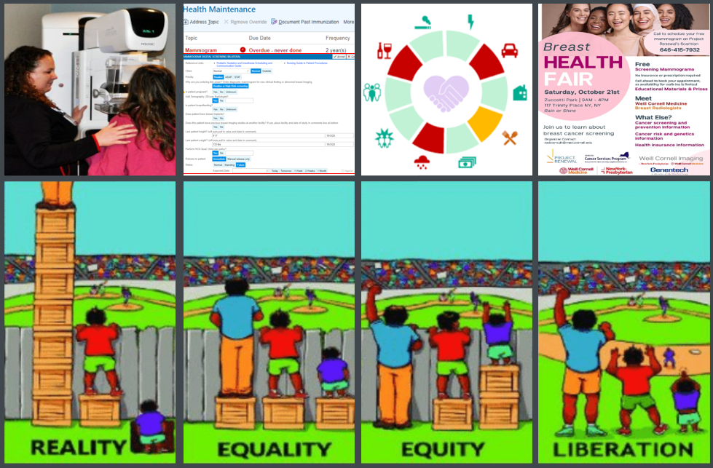
The five fundamental principles of ethics include:
  Autonomy
  Justice
  Fidelity
  Nonmaleficence
  Beneficence

Slide 21
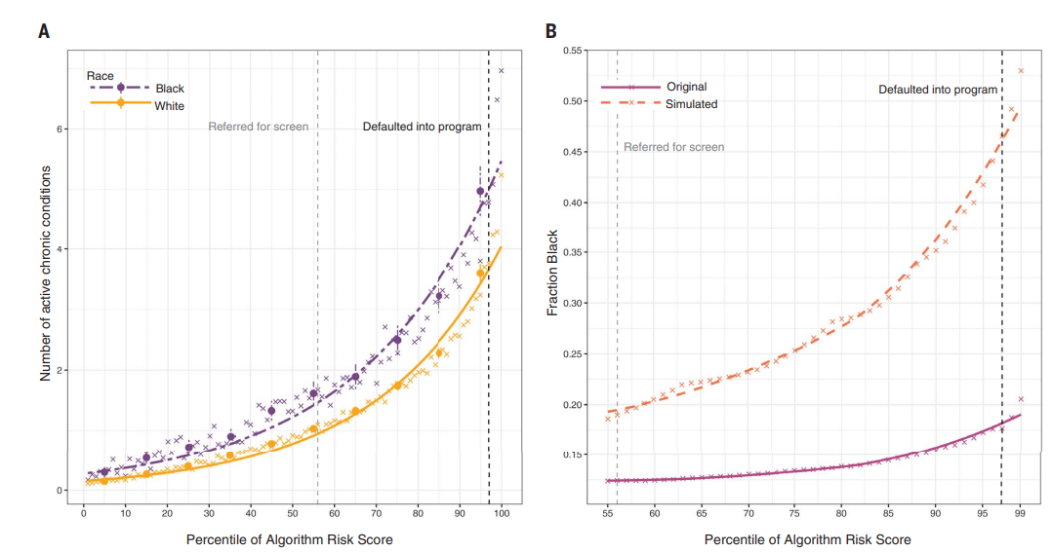
Ethics within AI
Obermeyer, Z., Powers, B., Vogeli, C., Mullainathan, S., Science, Volume 366 | Issue 6464; 25 October 2019

Slide 22
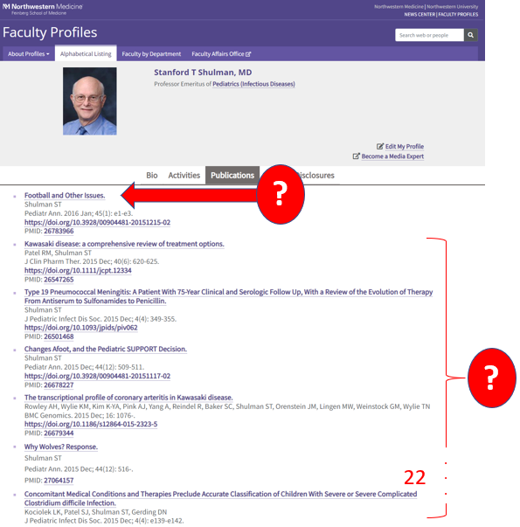
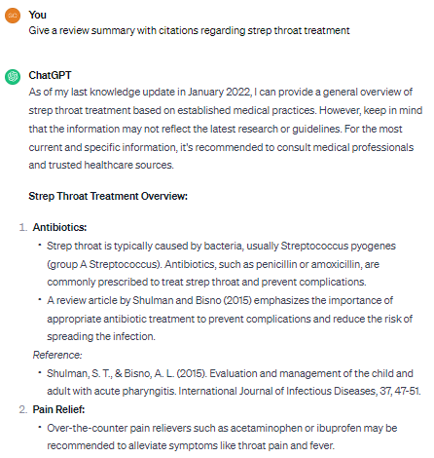


Slide 23
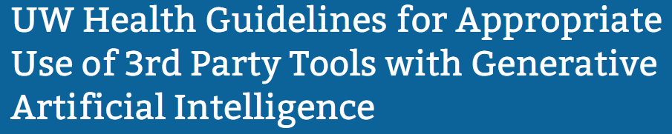




?
USE
CHAT GPT (etc.)?
For
Clinical Care
For
Clinical Clerical
For
Health Business
Create preliminary diagnoses, treatments, plans, patient ed, etc.
Compose draft LORs, create documents, Rev Cycle work, reword a draft.
Compose draft letters, create replies, write broad communications, etc.
Do you know anything about this topic***?
Do you know anything about this topic***?
Do you know anything about this topic***?
NO
YES
NO
YES
NO
YES
Do not use LLM/AI.
Use traditional clinical-knowledge tools (textbooks, reviews, peer-to-peer discussion, academy level information, CCKM)
Are you using an endorsed** interface to the LLM/AI tool?
Do not use LLM/AI.
Use traditional clinical-knowledge tools (textbooks, reviews, peer-to-peer discussion, academy level information, CCKM)
Are you using an endorsed** interface to the LLM/AI tool?
Do not use LLM/AI.
Use traditional business-knowledge tools (textbooks, policies, peer-to-peer discussion)
NO
YES
NO
Are you using an endorsed** interface to the LLM/AI tool?
Does this require ingestion of PHI by the tool?
Does this require ingestion of PHI by the tool?
NO
YES
YES
NO
YES
Does this require ingestion of PHI or business sensitive information by the tool?
NO
*
Use: Use with careful curation, you’re responsible for output. Additional steps of patient/population/data regulation likely will inject eventually – stay aware.
Endorsed: Is it embedded in HealthLink and/or other fundamental framework of our infrastructure and workflows?
Knowledge: You must have enough background to identify hallucinations within the output to protect our patients, our organization, and yourself.
YES
**
NO
***
USE*
YES

Slide 24
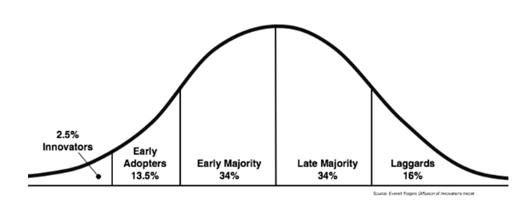

Everett Rogers
Diffusion of Innovation Theory
Where are the valued doctors/nurses/teachers?
Where is the need for support?
Is the support model the same across the spectrum?
When do we start?

Slide 25
Tying it all together…

Slide 26
Take away points
The 1st and 2nd rules of automation apply to AI:
  First rule: “Automation applied to an efficient system will magnify the efficiency”
  Second rule: “Automation applied to an inefficient system will magnify the inefficiency”
A predictable and known diversity of health tech readiness is in our care teams, educators and populations.
The first stage of AI readiness is AI literacy. There are very few formal, specific, and enduring training programs in traditional healthcare learning pathways.
Mental healthcare chasms and disparity will enlarge globally if we do not understand and leverage healthcare technologies ethically.

Slide 27
Questions & Discussion

Slide 28
Resources
obermeyer bias.pdf
noodle.com/articles/ethics-in-health-informatics
JMIR Formative Research - A 3-Item Measure of Digital Health Care Literacy: Development and Validation Study Patient limitations for digital services.
Global Governance Toolkit for Digital Mental Health | World Economic Forum (weforum.org)

