Slide 1

Artificial intelligence in Healthcare and health professions education
Federal Advisory Committee on interdisciplinary, community-based linkages
Ryan Kingsley and Shant Ayanian
January 25, 2024

Slide 2

Ryan Kingsley
MPAS, PA-C
Assistant Professor of Medicine
Mayo Clinic College of Medicine & Science
Department of Hospital Internal Medicine
Assistant Professor of Medical Education
Mayo Clinic College of Medicine & Science
Education Administration
©2024 Mayo Foundation for Medical Education and Research | slide-2
Image copyright Shutterstock

Slide 3
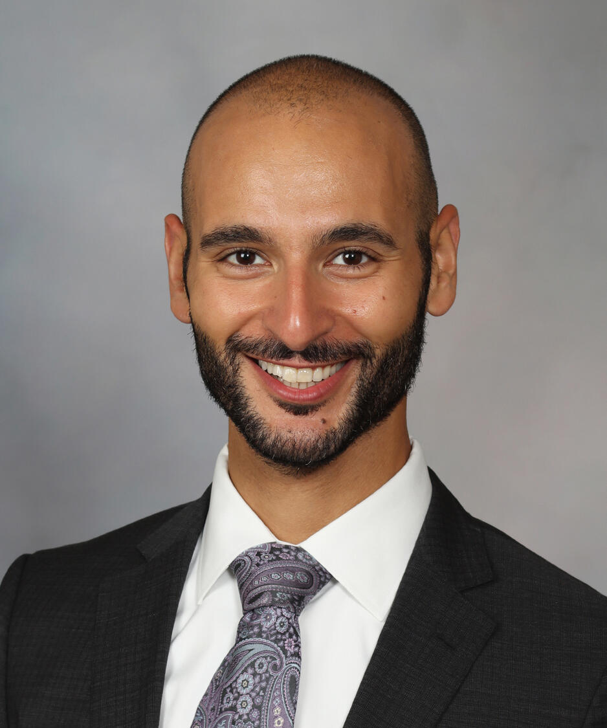
Shant Ayanian
M.D., M.S.
Assistant Professor of Medicine
Alix School of Medicine, Mayo Clinic
Department of Hospital Internal Medicine
Image copyright Shutterstock

Slide 4
We have no financial conflicts of interest to disclose
The opinions expressed here are our own, and not those of our employer

Slide 5
Outline
Introduction to Artificial Intelligence (AI) and Machine Learning (ML)
ML subtypes
Applications in Medicine
Generative AI

Slide 6
Definitions
1

Slide 7
Artificial Intelligence and machine learning
Model: A mathematical framework that takes in data (“features”), performs many calculations and outputs useful information (prediction/classification/cluster/next word etc.)
Informatics: The processes and science of data movement, storage and display.
Machine learning: A process for developing models that can serve predictive or analytical functions
  Defined by:
    Random initialization
    A cost function
    Learning algorithm and learning steps
  Train-test split of data
  May include automated retraining/updating (continuous ML)
Artificial Intelligence: Computers simulating human thinking
Notes:
Query if we want to elaborate on initialization, cost function, steps
Should we remove retraining?

Slide 8
Artificial Intelligence and machine learning
OLS Linear Regression
ML Linear Regression
1 learning “step”
1 learning “step”
Solved in one step, same solution every time (“deterministic”)
Random initialization
Calculation of a penalty using cost function, revision of parameters according to a learning algorithm
Machine learning makes analysis
More generalizable
More scalable
Less prone to error
Why use ML?
Detect more complex patterns in data
Analyze unstructured data
Ask different questions of data
Notes:
Overview of why ML is diff from regression
This slide will lead in to the two main categories of classical ML

Slide 9
ML Subclasses
ML can be subdivided into a few categories
Supervised vs unsupervised learning
Regression vs Classification vs Clustering
Classical vs Neural Networks

Slide 10
Supervised and Unsupervised learning
Supervised learning
  Majority of use cases and economic value to date
  Requires “labeled” training data. Labeling can be expensive.
  Can be used for regression and classification tasks
Unsupervised leaning
  More limited uses for now
  More exploratory rather than predictive
  Clustering algorithms

Slide 11
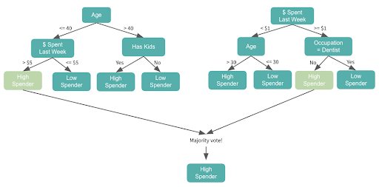
Regression vs classification
ML Linear Model
Random Forest Model
y = a(x) + b
Trainable parameters: a, b
Trainable parameters:
Which features to split on
Values of split points
How likely is it that this patient has delirium?
Will this patient respond to this medication?

Slide 12
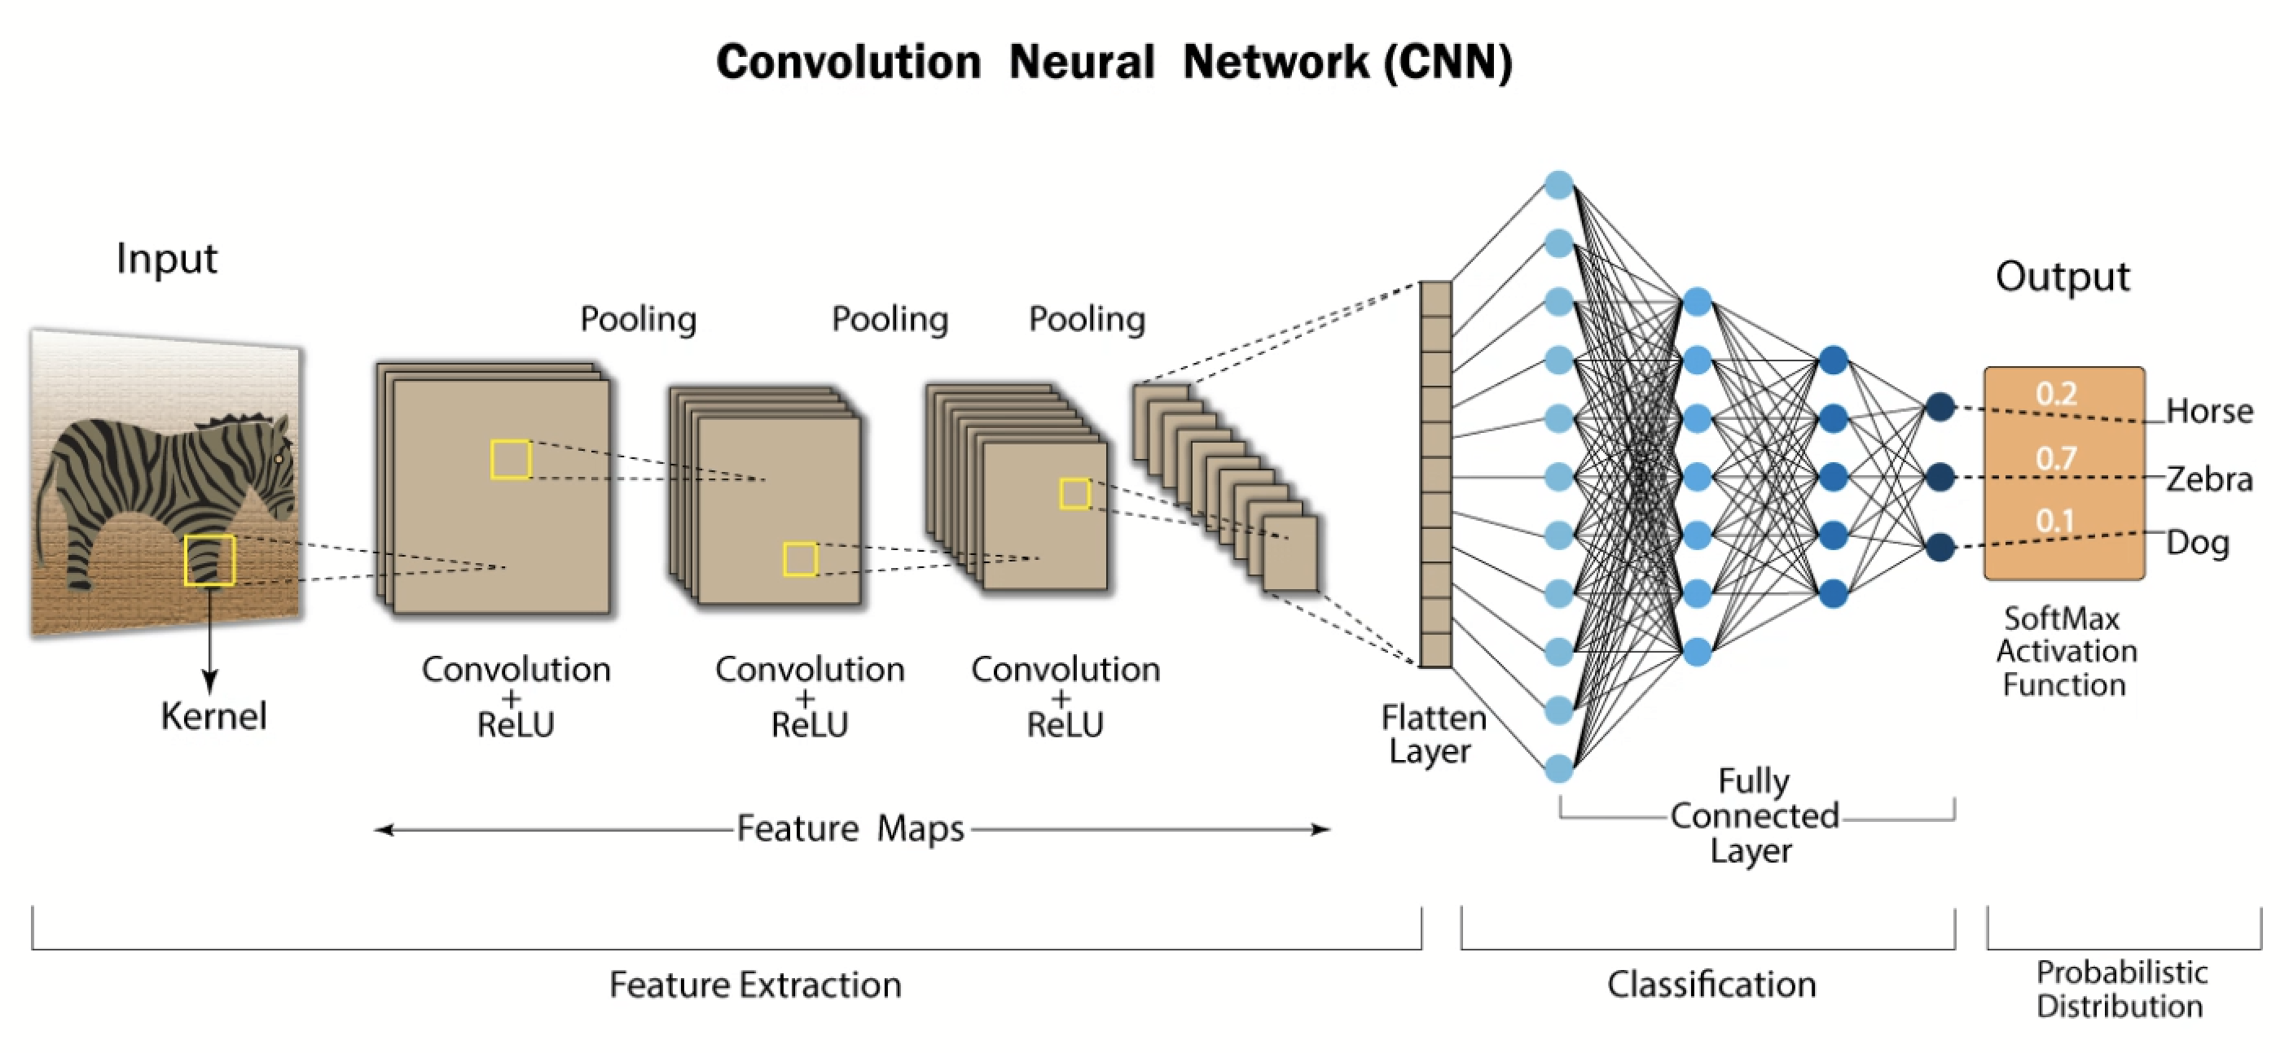
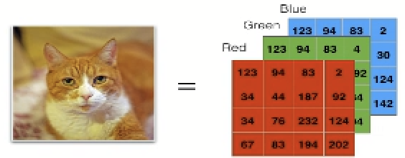
Deep learning and Neural Networks
Trainable parameters:
Thousands or millions or billions ☺

Slide 13
Applications
2

Slide 14


AI Project Lifecycle
& resource needs
Data wrangling
Get quality data in a usable format
Data analyst / data science analyst, Informaticist
What’s the clinical and/or business question?
Is an ML model the right tool for the job?
  Alternatives include scoring systems, conventional regression, others
If so, what type of model?
Model training, validation
Select a model, train, tune, validate
Data scientist
Model deployment
Connect the model to live data pipelines, design a user interface
ML engineer, MLOps engineer, Informaticist, Software development team
maintenance, monitoring
Ensure fair, consistent, reliable model performance
Data scientist
End-user input at every step will help ensure that an impactful tool is developed

Slide 15
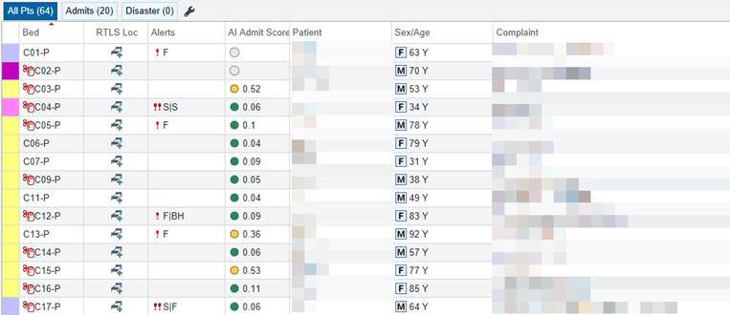
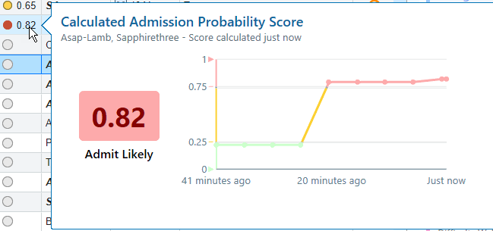
Predicting hospital admission from the ed
1
2
3
What problem?
Need AI?
Feasible?
Can we predict which ED patients will require hospital admission early in their ED course?
Improve efficiency of ED-based hospitalist team, Improve ED throughput
Multiple peer-reviewed studies demonstrate more accurate predictions using AI as compared to conventional logistic regression. AI augments human efficiency
Excellent access to necessary ED data; live deployment enabled by EHR-native data pipelines
Details of implementation are crucial!

Slide 16
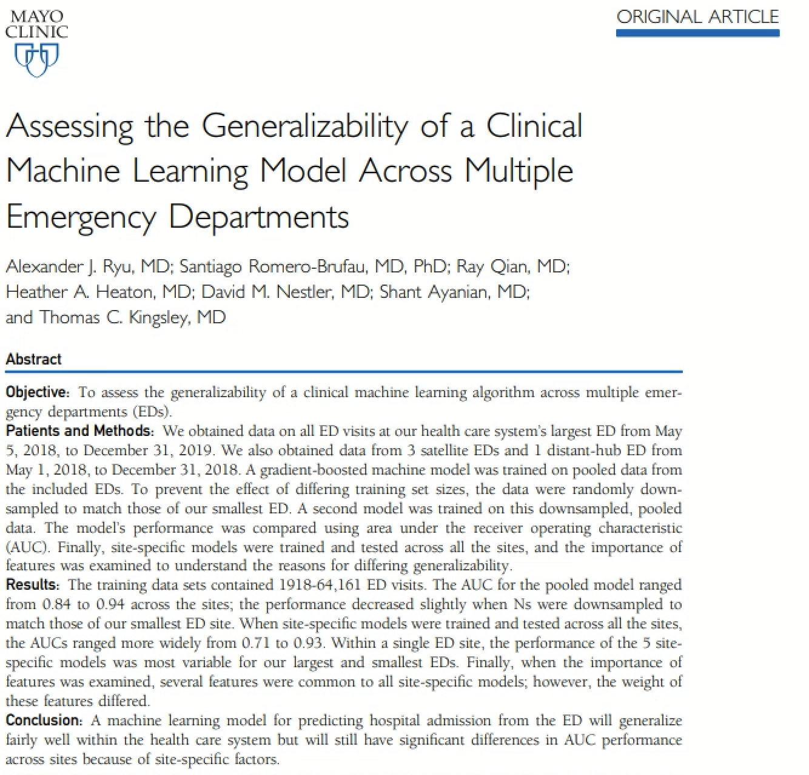
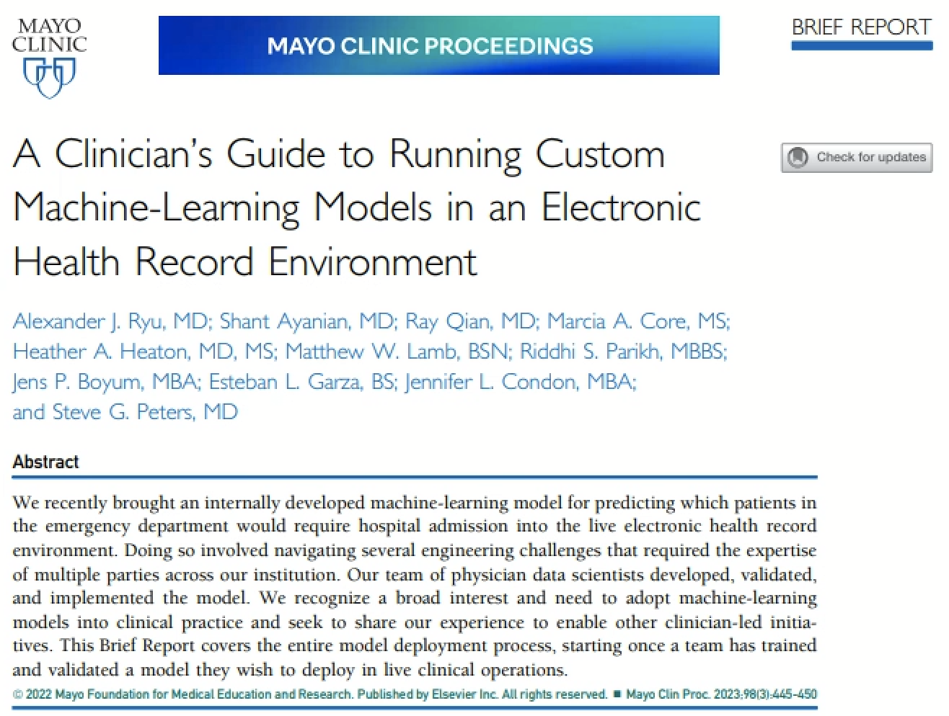

Slide 17
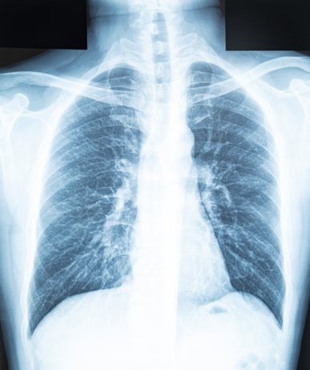
Enhancing efficiency and accuracy of medical imaging
1
2
3
What problem?
Need AI?
Feasible?
Can we make interpretation of medical imaging more efficient and accurate?
Access to rapid and accurate radiology interpretation can be limited, especially in underserved areas
Demand for healthcare imaging will continue to grow and outpace supply of radiologists, especially in underserved areas. AI has proven to be quite capable
Multiple peer-reviewed studies demonstrate more accurate interpretation, with less time required by a radiologist
Humans are still needed in the process

Slide 18
Predicting Delirium in Hospitalized patients
1
2
3
What problem?
Need AI?
Feasible?
Can we predict delirium in hospital?
Improve patient safety, prevent falls, prevent suffering
Reduce length of stay
Improved resource allocation
A nudge towards polypharmacy management in elderly sick patients

Slide 19
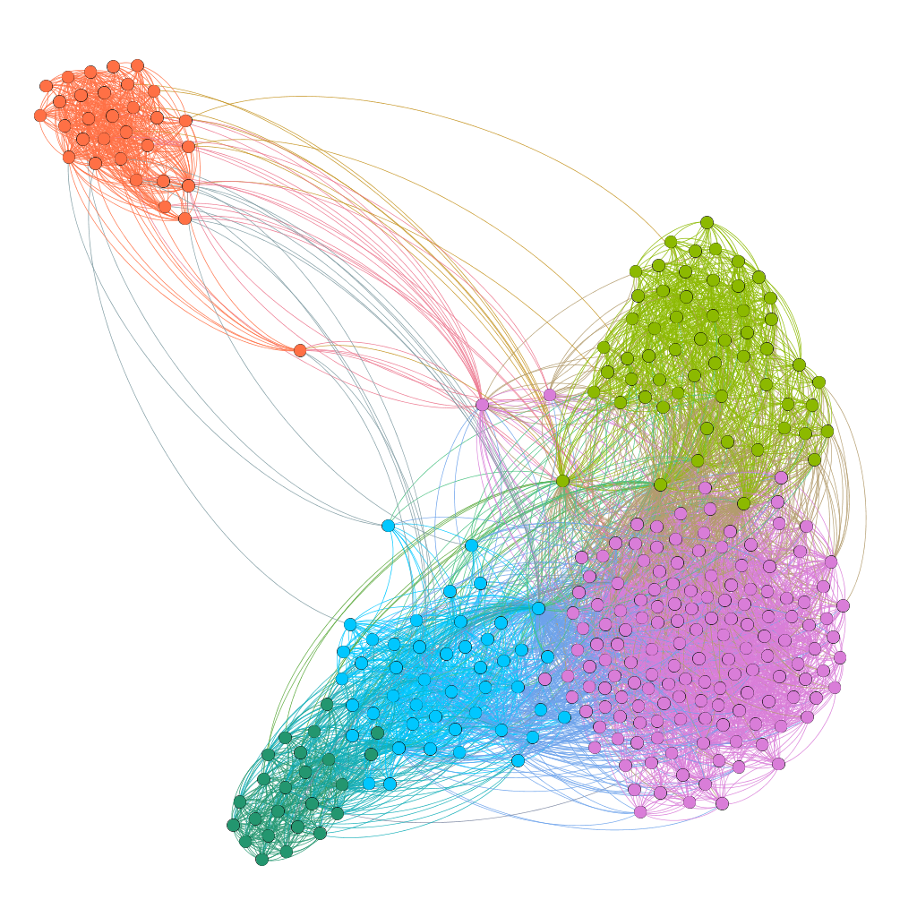
Differential outcomes in Type II Diabetes Mellitus
1
2
3
What problem?
Need AI?
Feasible?
How can we improve post hospitalization DMII outcomes in rural populations?
Designing large clustering models to identify subpopulations
Target interventions to specific populations

Slide 20
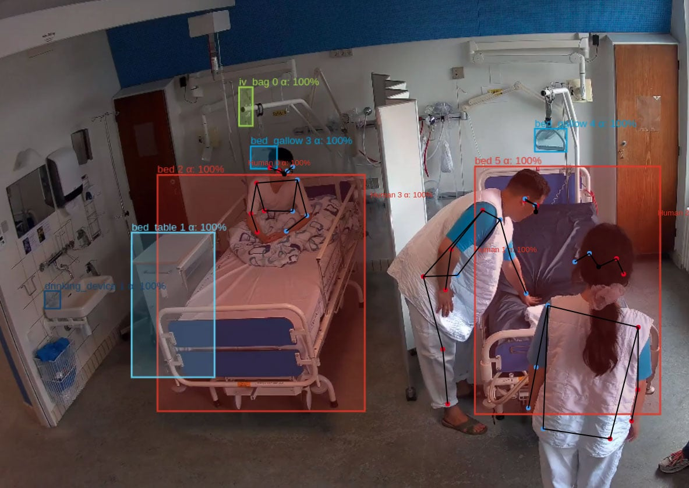
Inpatient automated video monitoring
1
2
3
What problem?
Need AI?
Feasible?
Can we use AI to automatically track inpatients’ activity (walking, sleeping, bed exit etc.) using in-room cameras?
Improve scalability of monitoring given staffing shortages. Collect new data. Reduce adverse events.
Requires multiple computer vision models
Technologically feasible but many complex concerns about data access and privacy
Data access issues may make certain worthwhile ideas a non-starter

Slide 21
Generative AI
3

Slide 22
Generative ai and llms
Uses cases for today
Medical records summarization
Reformatting text for patient comprehension level, or native language
Drafting of emails or patient inbox responses
Huge models trained on massive amounts of data for the task of generating high-quality text, chats, images, videos etc.
Enabled by computing and model architecture breakthroughs
Language “understanding” in LLMs is limited to mapping probabilistic relationships between words
cases To be determined
Uses requiring medical knowledge synthesis – diagnosis, treatment plan recommendation
Patient Q&A chatbot – may work for reference-based responses, unclear if needed for data collection

Slide 23

Timely & effective behavioral health interventions
1
2
3
What problem?
Need AI?
Feasible?
Can we use AI to effectively augment management of behavioral health disorders?
Improve scalability given increasing demand and ease of use on accessible platforms
Well-developed LLM applications
Demonstrated efficacy, randomized trials will be needed in the future
Aggarwal A, Tam CC, Wu D, Li X, Qiao S. Artificial Intelligence-Based Chatbots for Promoting Health Behavioral Changes: Systematic Review. J Med Internet Res. 2023 Feb 24;25:e40789. doi: 10.2196/40789. PMID: 36826990; PMCID: PMC10007007.

Slide 24
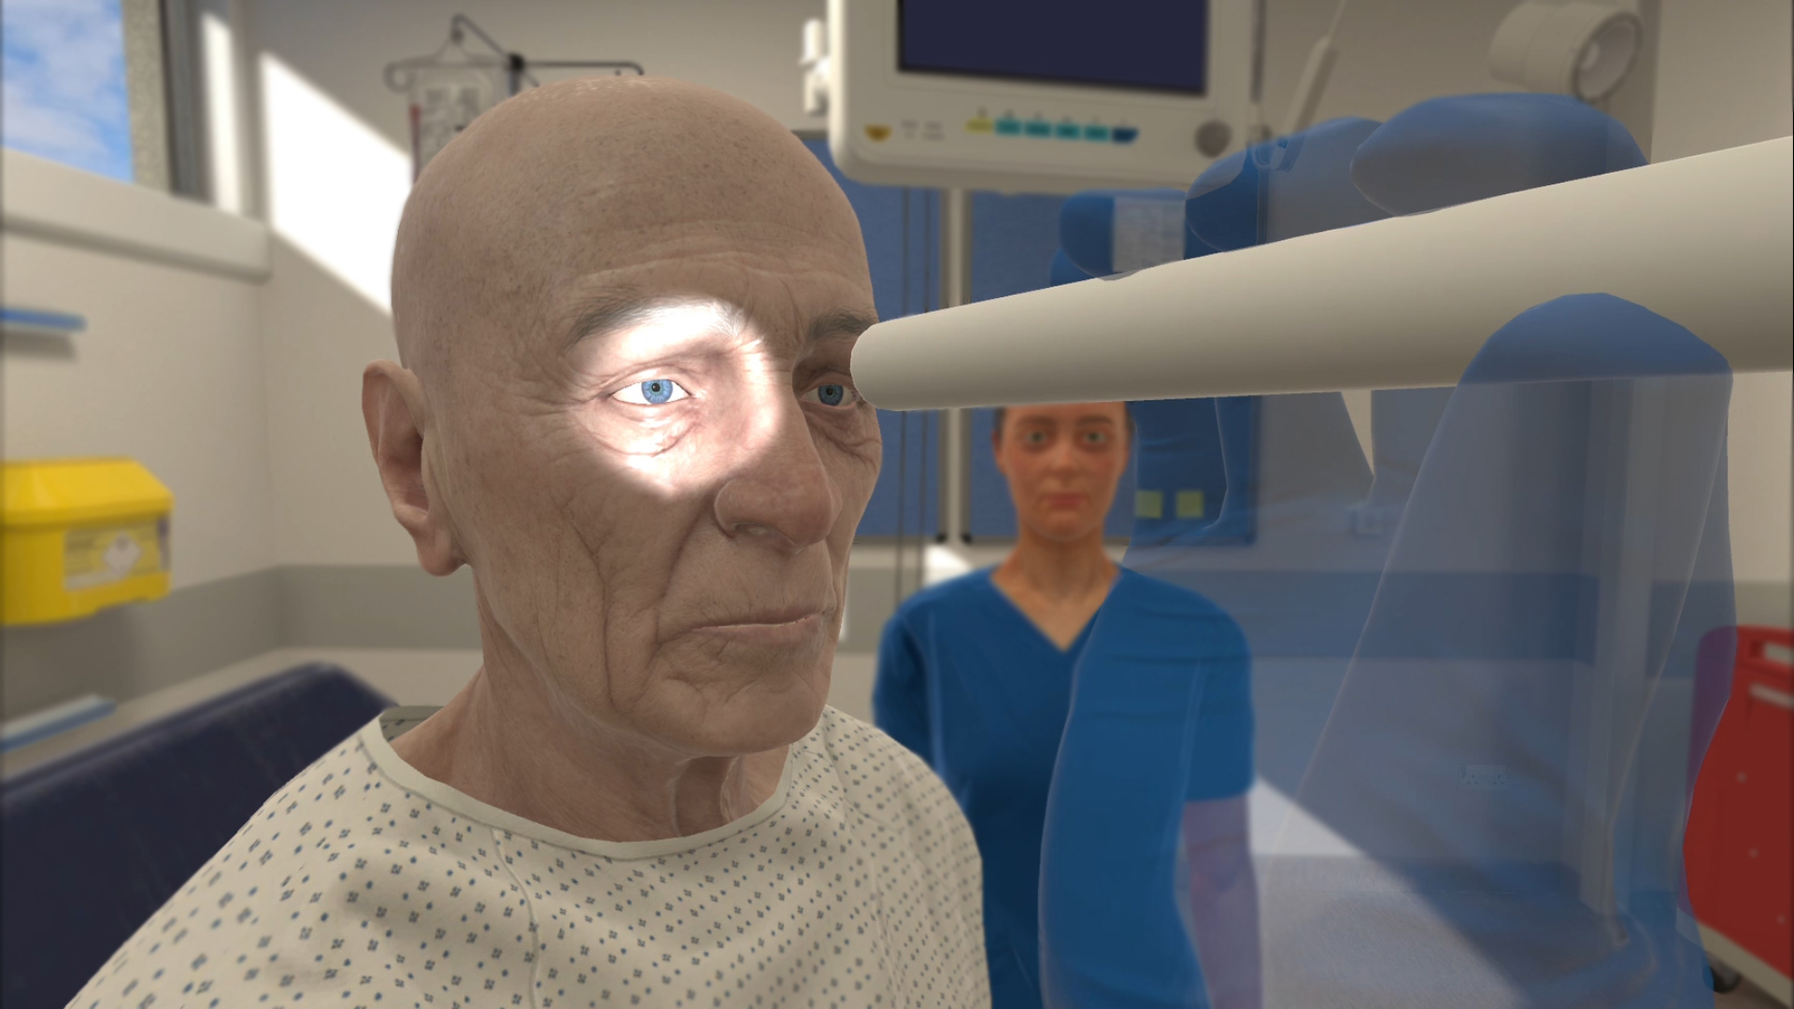
Enhanced simulation in medical trainees
1
2
3
What problem?
Need AI?
Feasible?
Can we use AI to enhance the training of medical professionals?
Increase access to high-quality simulation for populations that are difficult to replicate and underserved
Established LLM integration into virtual patient scenarios increases fidelity
Early adopters seeing impressive results, more research and access needed

Slide 25
Multimodal AI
Combining multiple data types to make predictions
Recent model architecture breakthroughs enable use cases
Passes intuition test, and indeed SOTA is showing superior results to older models
Still requires specialized expertise
Exploring use cases at Mayo
Data types usually categorized as:
Structured: vitals, labs, diagnosis codes, problem lists
Unstructured: images, text/notes

Slide 26
Summary
Applications of AI and ML are particularly well-suited to reduce clinical healthcare disparities by virtue of their impact on the healthcare workforce and scalability
AI and ML use in healthcare training has the potential to improve learner outcomes and increase supply of workers

Slide 27
QUESTIONS
& ANSWERS

