Slide 1
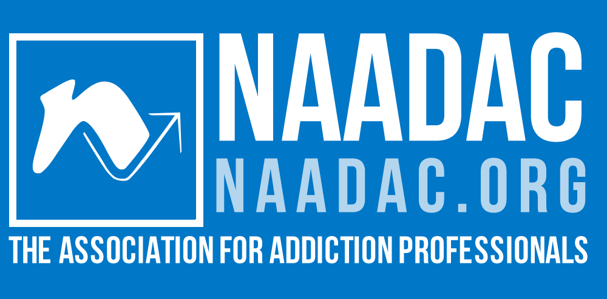
Integrated, Multi-Level Interdisciplinary Addiction Medicine and Substance Use Disorder Training: The Addiction-Focused Professionals Perspective
Terrence D. Walton, MSW
Executive Director
NAADAC, the Association for Addiction Professionals
twalton@naadac.org
Presentation to the HRSA Advisory Committee on Interdisciplinary, Community-Based Linkages
September 14, 2023

Slide 2
Overview
Who Treats Addiction in America
Who Educates Those Who Treat Addiction in America
What Impedes Effective Education of Healthcare Professionals Who Treat Addiction in America
What Works?
What Needs to Change?

Slide 3
Who Treats Addiction?
Addiction Professionals
Medical Providers
Allied Health

Slide 4
Who Educates?
Schools of Medicine
Nursing Schools
Colleges and Universities
Trade Associations and other Non-Profits
Addiction Studies Centers
Public Sector

Slide 5
What Impacts Education?
Cost/Benefit
Quality
Access

Slide 6
What Works?
Examples
National Addiction Studies Accreditation Commission (NASAC)
NAADAC and International Coalition for Addiction Studies Education (INCASE)
Minority Fellowship Program
NAADAC and National Board of Certified Counselors (NBCC)
Training, Testing, and Certification Programs
NAADAC, American Society of Addiction Medicine

Slide 7
What Needs to Change (or be clarified)?
Addiction professionals as approved trainees for the Title VII, Part D Programs
  Peer recovery professionals as approved trainees
  Prevention professionals as approved trainees
Designate institutions or organizations that train non-medical addiction professionals and meet certain criteria as “eligible entities”
Lessons from Medicaid

Slide 8

Thank you!
NAADAC/NCC AP
44 Canal Center Plaza, Suite 301
Alexandria, VA 22314
phone: 703.741.7686 / 800.548.0497
fax: 703.741.7698 / 800.377.1136
naadac@naadac.org
Terrence D. Walton, MSW
Executive Director
twalton@naadac.org

