Slide 1
Advisory Committee on Heritable Disorders in Newborns and Children
Peter Kyriacopoulos, Chief Policy Officer
Amanda Cosser, Manager, Public Policy & Regulatory Affairs
November 14, 2024

Slide 2
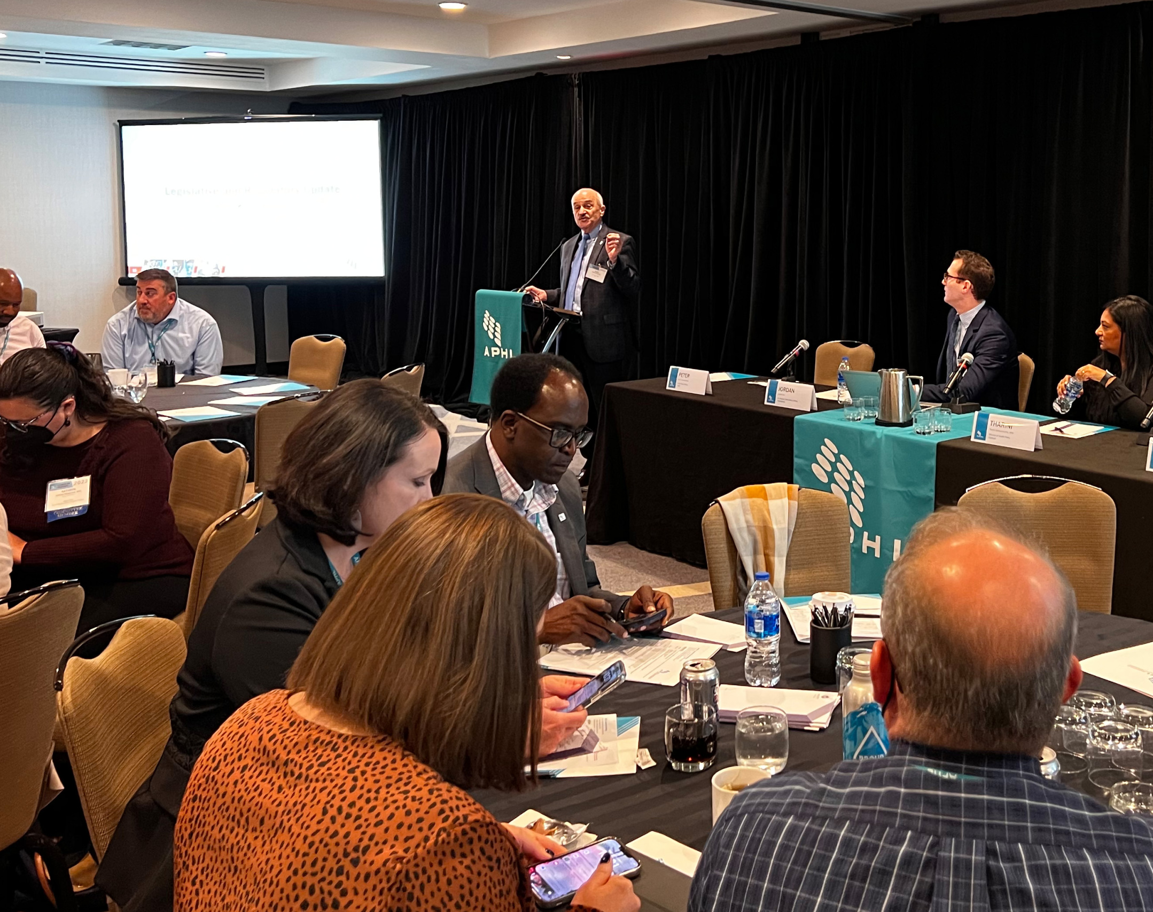
APHL Comments on the LDT Proposed Rule
Agreed that FDA has a role in oversight of LDTs.
Must consider unintended consequences that could limit access or burden the public health system.
PHLs must continue to operate and fulfill their unique mission under the final rule.
APHL comments on the LDT proposed rule
Notes:
Proposed rule released 10/3/23, ends the era of LDT enforcement discretion by making it explicit that IVDs are devices subject to regulation by the FD&C Act, including when the manufacturer is a lab. These IVDs include LDTs.
APHL strongly believes in accurate and quality testing and agrees that the FDA has a role in oversight of LDTs to ensure they are producing reliable results for patients and providers; however, the proposed rule and any associated guidance must be carefully crafted and consider all possible impacts to avoid unintended consequences that could limit access to certain tests and place an undue burden on the public health system

Slide 3
Final Rule Concerns
Enforcement discretion for unmet needs testing – does not apply to PHLs.
Rarely are there FDA-approved NBS tests when conditions are added to the RUSP.
States are mandated to implement NBS tests for RUSP conditions in defined timeframes.
Proposed Solutions
NBS tests are immediate health response tests that need additional considerations (APHL comments on FDA draft guidance).
NBS is a system within which risk mitigation is inherently built.
Notes:
Final rule has targeted enforcement discretion for LDTs for unmet needs manufactured and performed by a lab integrated with a healthcare system for patients receiving care at that healthcare system (hospital labs, most academic medical centers).
“Inappropriate to extend to PHLs or labs not integrated in a healthcare system because they lack similar risk mitigation measures.”
“There is shared responsibility and potential liability for patient outcomes, which helps mitigate risk.”
State mandates – several RUSP-aligned states, plus many early adopters. Learned states were stopping validations, ceasing imminent release of newly validated tests (MPS II, GAMT).
From our comments: An immediate public health response is needed once these conditions are added to the RUSP because testing options and treatments have been identified and newborns and children will suffer devastating health outcomes if not tested and appropriately referred for care. A pathway for PHLs utilizing LDTs for assessing newborns should be included in this guidance. Arizona, Florida, Connecticut and California are all screening currently for MPS II. California is also screening for GAMT. Texas will start early next year (February 2025). Test development for guanidinoacetate methyltransferase (GAMT) deficiency is to start soon (January 2025) for Arizona, Florida, and in January 2026 for Arkansas and North Carolina. These higher tier tests are more sensitive and specific than many first-tier and FDA-approved assays and are necessary to respond to the immediate needs of the most vulnerable population. The time from addition of a condition to the RUSP to marketing of an FDA-approved assay by a commercial manufacturer is regularly 3-5 years; this is too long for disorders that need an immediate health response. Additionally, NBS is more than a test, it is a system with active engagement between the PHL, clinicians, and the healthcare community. Healthcare providers in the NBS system work in conjunction with laboratorians, analyzing test results and quickly identifying and referring at-risk infants to the follow-up care that is critical to their survival. The close partnership between providers and the laboratory mitigates the risk of inaccurate results from NBS LDTs.

Slide 4
APHL Activities
Pre-Final Rule
Post-Final Rule
Comments
Inquiries
Webpages
Task Force
Position statement: Inflexible Oversight of LDTs Would Adversely Impact Public Health
Proposed rule
LDTquestions@aphl.org
Member needs range
Emails developed into FAQs
Information sharing (ex. comments on May 2024 draft guidances)
LDT Resources (key facts, enforcement discretion phaseout, FAQs, test resources, & definitions)
Approved August 1, 2024; ongoing meetings
Identify needs
Provide input on work products

Slide 5
Additional Actions
Monthly reports to the Board of Directors
Member updates – Newsletter, email, ColLABorate, meetings
Provide guidance on FDA templates
Continue to share information with FDA
Following litigation
Overall approach is to keep our members informed and move forward.

Slide 6
Resources
APHL webpages (LDT resources and members-only page)
APHL webinar and slides
FDA webinars – CDRH Learn
FDA final rule, FAQs, and enforcement discretion phaseout policy
Litigation and other activities
American Clinical Laboratory Association vs. FDA
Association for Molecular Pathology vs. FDA
House appropriations report language

Slide 7
Contact Information
LDTquestions@aphl.org
Peter Kyriacopoulos Mandi Cosser Chief Policy Officer Manager, Public Policy & Regulatory Affairs peter.kyriacopoulos@aphl.org amanda.cosser@aphl.org

