Slide 1
Newborn Screening by Whole Genome Sequencing
A proposed NIH Pilot Project to Assess the Feasibility of Adding a
WGS Component into the US NBS Program
Led by NCATS, NICHD, and NHGRI

Slide 2

New Venture Initiative– Newborn Screening by Whole-Genome Sequencing (NBSxWGS)
Objective: Demonstration project for a collaborative approach to using WGS as a first-tier screen for NBS
$5M annual investment over 3 years
Can a single WGS pipeline support implementation of NBSxWGS across multiple states?
Consented, research study
Demonstrating feasibility would be an important advance:
More equitable access to WGS
Better able to keep pace with therapeutic developments for rare diseases

Slide 3




Venture Initiative Goals for NBSxWGS
Overarching Aim: Demonstrate feasibility of a collaborative model for NBS by WGS across 5-10 states - provide a roadmap to a national newborn genetic screening program.
Support a centralized lab for analysis and interpretation of genomic sequencing results.
Achieve equitable access to genomic sequencing in the newborn period.
Focus on a limited gene panel of serious / life-threatening rare diseases with early treatment options available.
Examine ethical, legal & social implications (ELSI) of population-wide genomic sequencing in the newborn period.
GOALS

Slide 4
Strength in Diversity
NBSxWGS proposes to:
Establish a Community Advisory Board (CAB)
Solicit opinions on WGS for newborns from underrepresented communities and community leaders, interest groups and subject matter experts, including those from public health laboratories, federal NBS partners, industry, advocacy groups, genomics, gene-targeted therapeutics, bioethics, parents and families, and others
Advise on community engagement approaches, informed consent strategy, data sharing, research design, implementation barriers for study, community education, dissemination strategies, and return of results
Attract new expertise to the NBS field
Subject matter expertise to inform implementation of NBSxWGS at scale
Provide opportunities to ensure NBSxWGS is inclusive
Require Plans for Enhancing Diverse Perspectives

Slide 5
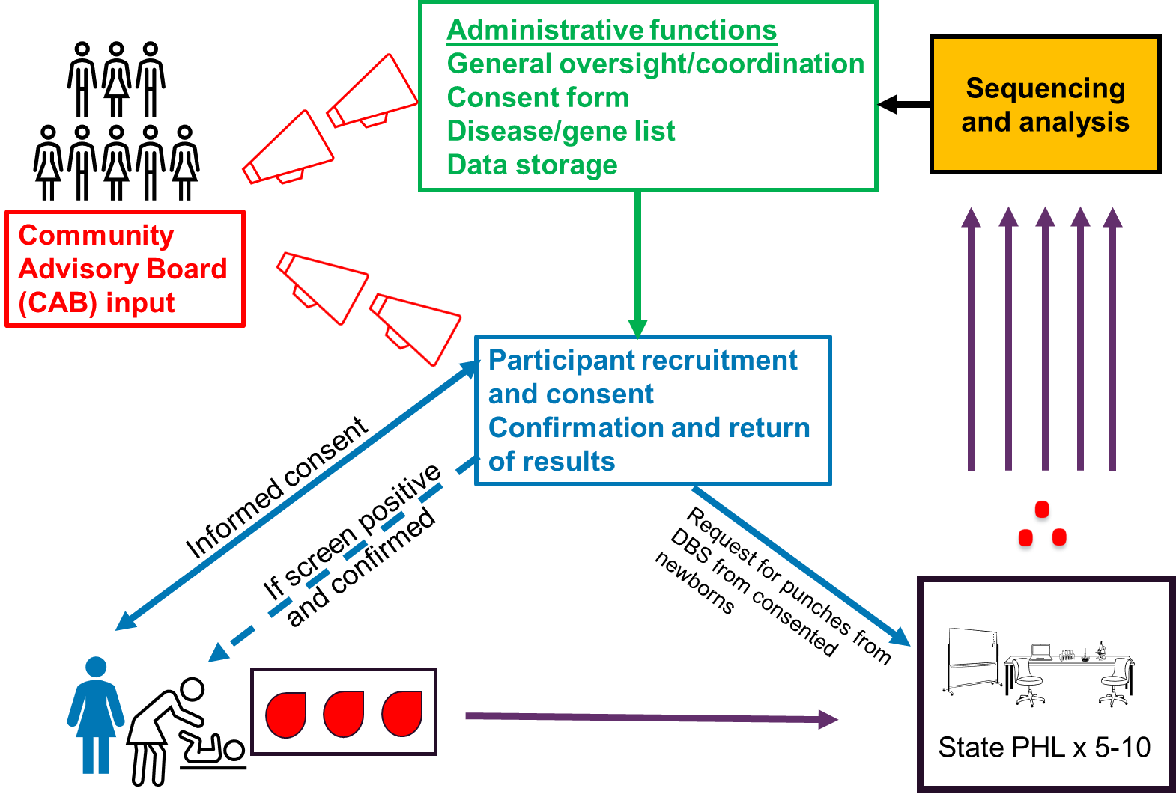
Potential structure of the program

