Slide 1

NIH Research Funding Opportunities to Document Lived Experience of Patients and Families
Melissa A. Parisi
Eunice Kennedy Shriver National Institute of Child Health and Human Development
ACHDNC, November 14, 2024

Slide 2
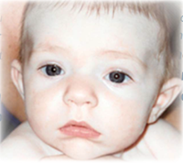
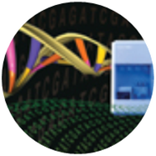

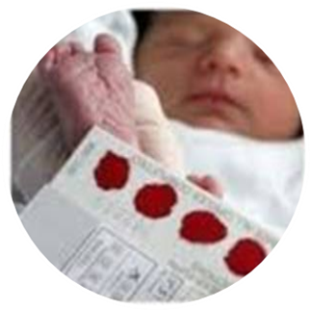
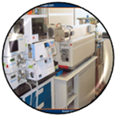
NICHD’s Hunter Kelly NBS Research Program Legislatively mandated by the Newborn Screening Saves Lives Act of 2007 and its 2014 reauthorization to carry out, coordinate, and expand research in NBS
Identify, develop, and test the most promising new screening technologies
Develop experimental treatments and management strategies for conditions detectable through NBS
Provide research findings and data for newborn conditions under review by the ACHDNC to be added to the RUSP
Conduct pilot studies on conditions recommended by the ACHDNC
Dedicated grant funding opportunities
Contracts for pilot studies
ACHDNC: Advisory Committee on Heritable Disorders in Newborns and Children
RUSP: Recommended Uniform Screening Panel
Notes:
The Newborn Screening Saves Lives Act established the Hunter Kelly Newborn Screening Research Program at NICHD, named in honor of Hunter Kelly who had Krabbe disease. This important legislation also helped define the roles of the various federal agencies involved in newborn screening. NIH’s role is to fund research.
There are four components to the Hunter Kelly Program: supporting new screening technologies, developing novel treatments, providing research findings to be used by the ACHDNC when considering addition of new conditions to the RUSP, and conducting pilot studies to ensure conditions are ready for nationwide implementation.
We use both grants and contracts to support newborn screening research. We have dedicated funding opportunities for grants, and use contracts to support large-scale pilot studies.

Slide 3
NBS research supported by NICHD
Investigator-initiated research projects: Includes funding opportunity announcements (FOAs) for NBS-related proposals
Innovative Screening Approaches and Therapies for Screenable Disorders in Newborns (R01/R03/R21, Clinical Trial Optional):
PAR-21-354, R03: https://grants.nih.gov/grants/guide/pa-files/PAR-21-354.html
PAR-21-353, R01: https://grants.nih.gov/grants/guide/pa-files/PAR-21-353.html
PAR-21-355, R21: https://grants.nih.gov/grants/guide/pa-files/PAR-21-355.html
Can include embedded studies that explore the ELSI of novel screening technologies or therapeutic approaches.
Natural History of Disorders Screenable in the Newborn Period (R01, Clinical Trial Optional) Just Reissued!
PAR-25-227: https://grants.nih.gov/grants/guide/pa-files/PAR-25-227.html
}
Being reissued
Notes:
Innovative screening approaches and therapies PARs encourage research relevant to the development of novel screening approaches and/or therapeutic interventions for potentially fatal or disabling conditions that have been identified through newborn screening, as well as for "high priority" genetic conditions where screening may be possible in the near future
Natural history studies PAR encourages applications that propose to develop studies that will lead to a broad understanding of the natural history of disorders that already do or could potentially benefit from early identification by NBS

Slide 4
Contract support for NBS pilot studies
Newborn Screening Pilot Studies: for conditions recently nominated or added to the Recommended Uniform Screening Panel (RUSP) to ensure these conditions are ready for nationwide implementation
Pool of contractors who run pilot studies for conditions selected by NICHD
High-throughput NBS laboratories (state or private)
Capacity to screen at least 100,000 newborns within 2 years
Ability to develop, implement, and demonstrate proof-of-concept for new NBS technologies
Contractor pool will be recompeted in 2027
Notes:
In addition to grants, NICHD also uses contracts to support large-scale, state-wide pilot studies for conditions recently nominated or added to the RUSP. It requires a lot of work to bring an assay for a new condition into a state’s newborn screening panel, so these pilot studies help work out the kinks and provide lessons learned to make it easier for states to adopt that assay. NICHD selects the conditions used for these pilot studies.
Contractors who conduct these pilots must demonstrate that they have the high-throughput capacity needed to screen at least 100,000 newborns within a two year period, run a novel assay in a state newborn screening setting, validate that assay’s performance, and connect the infants who screen positive with referrals for confirmatory diagnostic testing.
Pilot studies:
Describe how well the condition’s screening process works, including its accuracy
Describe the benefit of detecting the condition with screening versus in the clinic after symptoms appear
Find at least one case of the condition through screening using methods relevant to the U.S.

Slide 5
NICHD-supported pilot studies
New York
Wisconsin (Waisman)
Georgia (Emory)
North Carolina (RTI)
Georgia (Emory)
Georgia (Emory)
North Carolina (RTI)
New York (HRI)
Pompe disease
X-linked adreno-leukodystrophy
Proximal Urea Cycle Disorders
Mucopoly-saccharidosis II
Metachromatic leukodystrophy
2015
2018
2020
2022-2023
2024
2014
2016
2019
2021
Mucopoly-saccharidosis I
Spinal Muscular Atrophy
Expanded Homocystinurias
Congenital cytomegalovirus*
North Carolina (RTI)
Georgia (Emory)
North Carolina (RTI)
Georgia (Emory)
Georgia (Emory)
New York (HRI)
* Pilot study and follow-up study
Notes:
Here you can see a timeline of all the large-scale pilot studies we have supported for 8 different conditions, many of which are now part of the RUSP.
In 2023 we tried something new: we are funding a follow-up study for congenital cytomegalovirus, or cCMV, to track the health outcomes of infants who screen positive during a pilot study for cCMV in the state of New York. Over 80% of infants with cCMV never develop symptoms, so it is difficult to predict which infants should receive antiviral treatment at birth. Through the follow-up study, we are hoping to learn more about why some infants have symptoms while many others do not.

Slide 6
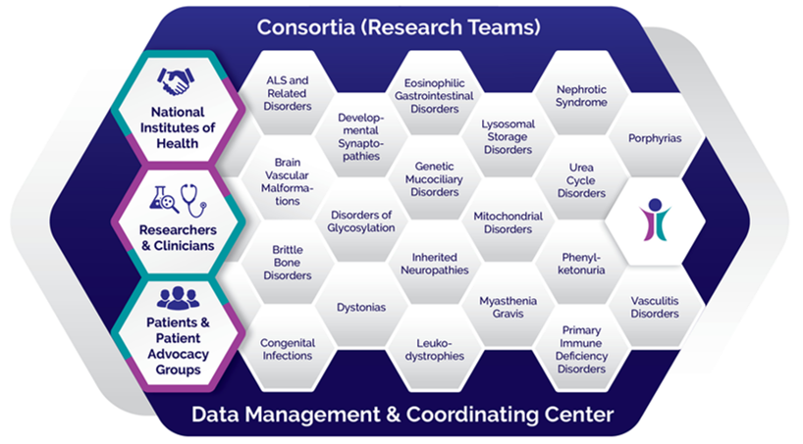
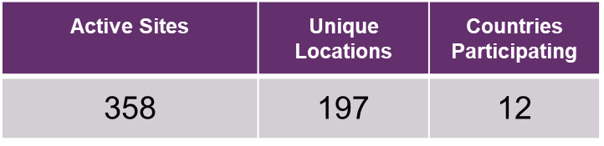
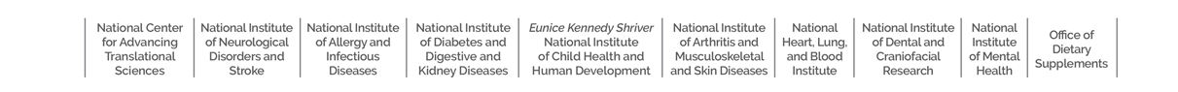
Rare Diseases Clinical Research Network (RDCRN)
Established by Rare Diseases Act of 2002
(Public Law 107-280)
20 RDCRN Consortia supported by 10 NIH Institutes and Centers
Being recompeted in 2025 (see PAR-24-206)
Each Consortium must:
Study three or more rare disorders
Have multiple sites
Conduct 2-4 clinical studies
One natural history/longitudinal study
Have a pilot study program
Have a career enhancement program
Have fully integrated patient/patient advocacy groups as part of the consortium
Focus – Clinical Trial Readiness
Notes:
The RDCRN is a network of research consortia that aim to achieve faster diagnosis and better treatments for rare diseases. The RDCRN is recompeting its network in 2024, so the end of the NBSTRN contract is coming at an ideal time to integrate newborn screening research into the RDCRN.
The most important feature of the RDCRN is that each consortium is required to have significant participation from patients and advocacy groups.

Slide 7
Consortium Acronym | Consortium Name | RDCRN1 2003-2008 | RDCRN2 2009-2013 | RDCRN3 2014-2018 | RDCRN4 2019-2023
GDMCC | Genetic Disorders of Mucociliary Clearance Consortium | X | X | X | X
UCDC | Urea Cycle Disorders Consortium | X | X | X | X
VCRC | Vasculitis Clinical Research Consortium | X | X | X | X
PC | Porphyrias Consortium |  | X | X | X
NAMDC | North American Mitochondrial Disease Consortium |  | X | X | X
DC | Dystonia Coalition |  | X | X | X
BVMC | Brain Vascular Malformation Consortium |  | X | X | X
NEPTUNE | Nephrotic Syndrome Study Network |  | X | X | X
PIDTC | Primary Immune Deficiency Treatment Consortium |  | X | X | X
INC | Inherited Neuropathy Consortium |  | X | X | X
LDN | Lysosomal Disease Network |  | X | X | X
CReATe | Clinical Research in ALS and Related Disorders for Therapeutic Development |  |  | X | X
BBDC | Brittle Bone Disorders Consortium |  |  | X | X
CEGIR | Consortium of Eosinophilic Gastrointestinal Disease Researchers |  |  | X | X
DSC | Developmental Synaptopathies Consortium |  |  | X | X
PHEFREE | Phenylalanine Families and Researchers Exploring Evidence |  |  |  | X
MGNet | Myasthenia Gravis Rare Disease Network |  |  |  | X
CPIC | Congenital and Perinatal Infections Consortium |  |  |  | X
FCDGC | Frontiers in Congenital Disorders of Glycosylation |  |  |  | X
GLIA-CTN | Global Leukodystrophy Initiative Clinical Trials Network |  |  |  | X
RTT | Rett Syndrome, MECP2 Duplications, and Rett-related Disorders Consortium | X | X | X
RKSC | Rare Kidney Stone Consortium |  | X | X
STAIR | Sterol and Isoprenoid Diseases Consortium |  | X | X
ADC | Autonomic Disorders Consortium |  | X | X
RLDC | Rare Lung Diseases Consortium | X |  | X
ARTFL | Advancing Research and Treatment for Frontotemporal Lobar Degeneration Consortium |  |  | X
CINCH | Clinical Investigation of Neurologic Channelopathies | X | X
SGCC | Salivary Gland Carcinomas Consortium |  | X
cGVHD | Chronic Graft Versus Host Disease Consortium (cGVHD) |  | X
BMFC | Bone Marrow Failure Consortium | X
RGSDC | Rare Genetic Steroid Disorders Consortium | X
RTDC | Rare Thrombotic Diseases Consortium | X
CLiC | Cholestatic Liver Disease Consortium | X
Notes:
By the end of the current cycle the RDCRN will have had 33 different consortia studying a variety of rare diseases.
In 2018 it was decided that each consortium would only be allowed up to three cycles of funding.

Slide 8

RDCRN Translational Impact
Clinical Trials directly funded by U54 grant
Predominantly small Phase 1/Phase 2
Currently 18 trials funded in RDCRN4
Primarily repurposed drugs, diets, supplements, procedures, devices, some novel drugs
RDCRN-associated Clinical Trials
Predominantly Phase 2/Phase 3
Funded by industry, IC-specific grants, FDA, PAGs
Leveraging disease phenotype, patient population, clinical sites, endpoints, biomarkers, early phase safety and efficacy data
12 FDA-approved treatments for 11 rare diseases
Consortium | Drug | Other Name | Indication | Company | Approval Date
UCDC | CARBAGLU® | carglumic acid | N-acetylglutamate synthetase (NAGS) deficiency | Orphan Europe | March 2010
VCRC | RITUXAN® | rituximab in combination with corticosteroids | Wegener’s granulomatosis (WG) and microscopic polyangiitis (MPA) | Genentech and Biogen | April 2011
UCDC | RAVICTI® | glycerol phenylbutyrate | urea cycle disorders (UCD) | Hyperion Therapeutics | February 2013
RLDC | RAPAMUNE® | sirolimus | lymphangioleiomyomatosis (LAM) | Pfizer | May 2015
PC | SCENESSE® | afamelanotide | erythropoietic protoporphyria (EPP) | Clinuvel | October 2019
PC | GIVLAARI® | givosiran | acute hepatic porphyria (AHP) | Alnylam Pharmaceuticals | November 2019
RKSC | OXLUMO® | lumasiran | primary hyperoxaluria type 1 (PH1) | Alnylam Pharmaceuticals | November 2020
CEGIR | DUPIXENT® | dupilumab | eosinophilic esophagitis (EoE) | Regeneron | May 2022 Jan 2024 (pediatric)
RTT | DAYBUE™ | trofinetide | Rett syndrome | Acadia Pharmaceuticals | March 2023
MGNet | RYSTIGGO® | rozanolixizumab-noli | generalized myasthenia gravis (gMG) | UCB | June 2023
RKSC | RIVFLOZA™ | nedosiran | primary hyperoxaluria type 1 (PH1) | Novo Nordisk | October 2023
CEGIR | EOHILIA™ | budesonide oral suspension | eosinophilic esophagitis (EoE) | Takeda | February 2024

Slide 9
Ethical, Legal, and Social Implications (ELSI) NOFOs
ELSI Research Grants
“…solicit applications for research projects that identify, examine, and address the ELSI of advances in genomics for individuals, families, communities, groups, institutions, and society.”
PAR-23-293 ELSI Research (R01)
PAR-23-294 ELSI Exploratory/Developmental Research Grant (R21)
PAR-23-295 ELSI Small Research Grant (R03)
New Program to Advance ELSI Research
“…partnerships with relevant communities affected by and with an interest in the proposed research..”
RFA-HG-24-026 Limited Competition: Building Partnerships and Broadening Perspectives to Advance ELSI Research (BBAER) Program (UM1)
Lead Institute: NHGRI
Notes:
Broad scope:
ELSI research at NHGRI encompasses a wide range of topics including genetic privacy, informed consent, equitable access to genetic testing, social and cultural implications of genomics, and the impact of genetic information on healthcare decision-making.
Multidisciplinary approach:
NHGRI encourages ELSI research projects that involve multiple disciplines like law, ethics, sociology, and public health, to provide a comprehensive understanding of complex issues.
Community engagement:
Researchers are expected to actively engage with relevant communities when conducting ELSI research to ensure their perspectives are considered and incorporated.
Funding mechanisms:
NHGRI provides various funding mechanisms for ELSI research, including standard research grants (R01), small grants (R03), and specialized funding opportunities focused on specific ELSI areas.

Slide 10
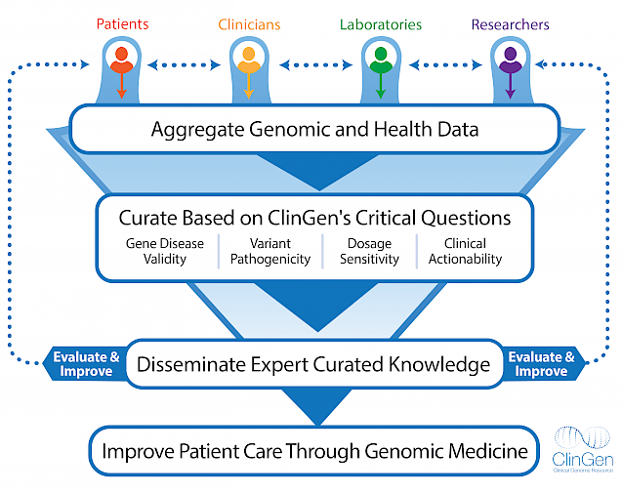
The Clinical Genome Resource (ClinGen)
Mission: To build and support authoritative central resources that define the clinical relevance of genes and variants for use in precision medicine and research
Lead Institute: NHGRI (NCI)
https://bit.ly/ClinGenGene
Notes:
so that's where clingen comes in the clinical genome resource or clingen is an nih-funded project that's dedicated to building an authoritative central resource that defines the clinical relevance of genes and variants for use in precision medicine and research ultimately what this mission boils down to is that clingen hopes to understand what genes and variants are associated with disease and how genomic information can inform clinical care there are a number of pieces of clingen that are all sort of summarized in this graphic and so we'll use this to walk through the different efforts within clingen and how all of that is important to ultimately improve patient care

Slide 11
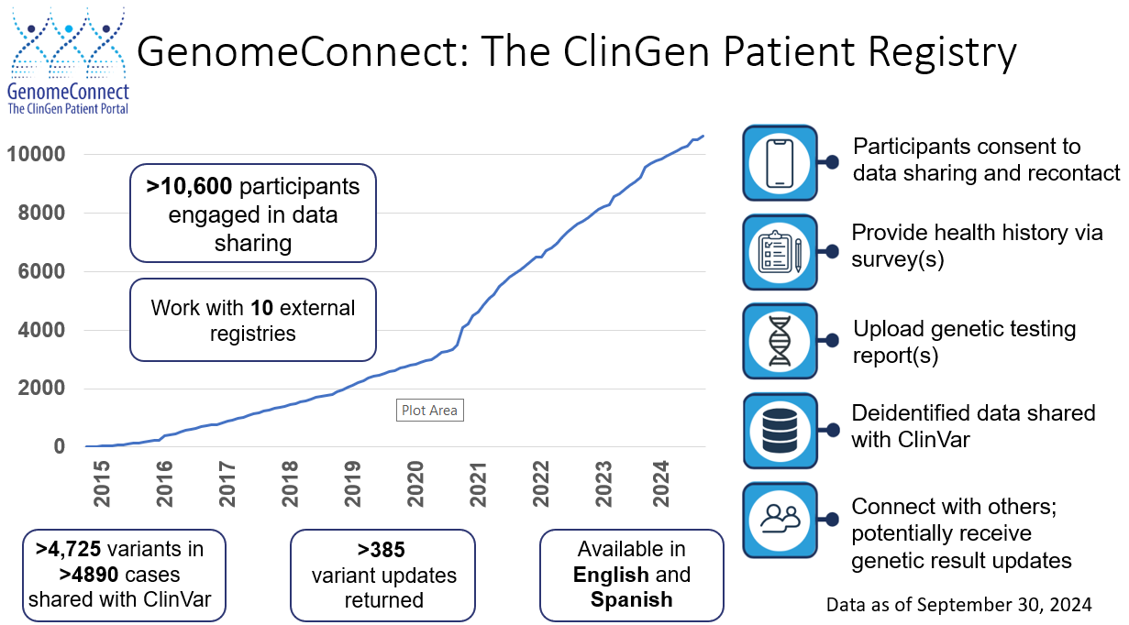
Notes:
Laboratories, researchers, and clinicians have been sharing genomic and health data for some time, but ClinGen felt strongly that patients can also serve as an important source of additional information. Patients are often experts about their own health history and can provide much more detail about their symptoms over time, diagnoses, and health. ClinGen felt that access to this additional health information could help increase our understanding of genes and genetic variants.
As a result, in 2014, the ClinGen team launched a patient registry called GenomeConnect to empower patients to share their deidentified genetic and health information with publicly available databases. GenomeConnect is open to anyone who has had genetic testing regardless of results or diagnosis so it is not gene or disease specific. Participants enroll online, consent to de-identified data sharing and recontact, provide their health history through a patient surveys, and upload a copy of their genetic test results.

Slide 12
Thank you
parisima@mail.nih.gov

