Slide 1
Funding Opportunities for Rare Disease Research at the Patient-Centered Outcomes Research Institute
November 2024 ACHDNC Virtual Meeting
Nora McGhee, PhD
Associate Director, Clinical CER
PCORI.org
Notes:
Good afternoon. Thank you so much for the opportunity to speak to you today about the Patient-Centered Outcomes Research Institute, PCORI, and our funding opportunities relevant to those working in the rare disease space.

Slide 2
Agenda
What PCORI Is and What We Do
Funding Opportunities
Rare Disease Portfolio
Notes:
I’m going to spend a few minutes telling you about PCORI, our funding opportunities, and our rare disease portfolio.

Slide 3
What PCORI Is and What We Do
Notes:
First, a bit about PCORI.

Slide 4

Patient-Centered Outcomes Research Institute
Leading Funder of CER in U.S.
PCORI®
Leading funder of patient-centered comparative clinical effectiveness research (CER)
Independent, nonprofit, research institute
Funds research designed to help people make better informed healthcare decisions
Notes:
PCORI is an independent, nonprofit research organization that seeks to empower patients and others with actionable information about their health and healthcare choices.
We fund comparative clinical effectiveness research or CER, which compares two or more medical treatments, services, or health practices. The findings from these studies help patients and other stakeholders make better informed decisions.

Slide 5

Patient-Centered Outcomes Research Institute
Research Done Differently®
Key Features of Our Funded Research & Research-Related Projects
Engages patients and other stakeholders throughout research process
Compares at least 2 medical treatments, services or health practices, each of which has established efficacy and/or is in widespread use​
Focus on compelling real-world decision dilemma being faced by patients, clinicians, family members, or other stakeholders
Aims to produce evidence that can be applied in real-world settings
Notes:
Key features of our funded research and research-related projects
We engage patients and other stakeholders throughout the research process, and are committed to ensuring they have a seat at the table throughout the lifecycle of the award—helping to prioritize research topics, design and conduct the studies, and share the results.
We fund comparative clinical effectiveness research, which compares two or more medical treatments, services, or health practices to help patients and other stakeholders make better informed health and healthcare decisions. These comparators must have evidence of efficacy or use.
Our funded work focuses on answering questions most important to patients and those who care for them. We believe patients deserve to know whether some approaches work better than others for certain populations, and caregivers, clinicians, and all of our stakeholders benefit from having better information about different care options.
Finally, our funded work aims to produce evidence that can be applied in real-world practice settings – this is often not a focus within health research.

Slide 6
Patient-Centered Outcomes Research Institute
Engagement Makes Meaningful Differences
Engagement Influences…
Study conceptualization, execution, materials and dissemination products
Carrying out study tasks
Engagement design and practice
Researchers’ understanding of patients, clinicians, & health care organizations
Engagement Influences all Aspects of CER Projects
Research focus
Research design
Intervention tailoring/delivery
Recruitment/retention
Data collection/measures
Data analysis
Dissemination
Notes:
We have been requiring engagement in our studies for over ten years now. And, we have found that true engagement makes meaningful differences, as it influences study conceptualization, execution and materials, as well as the way study tasks are carried out, how engagement is designed and practiced, and researchers’ understanding of the needs of people and organizations.​
​Engagement not only benefits patients, whose care may ultimately improve based on study findings, it also benefits research teams, one way is by helping them refine their research questions, thus enhancing the relevance of their results​.
Next slide
​

Slide 7
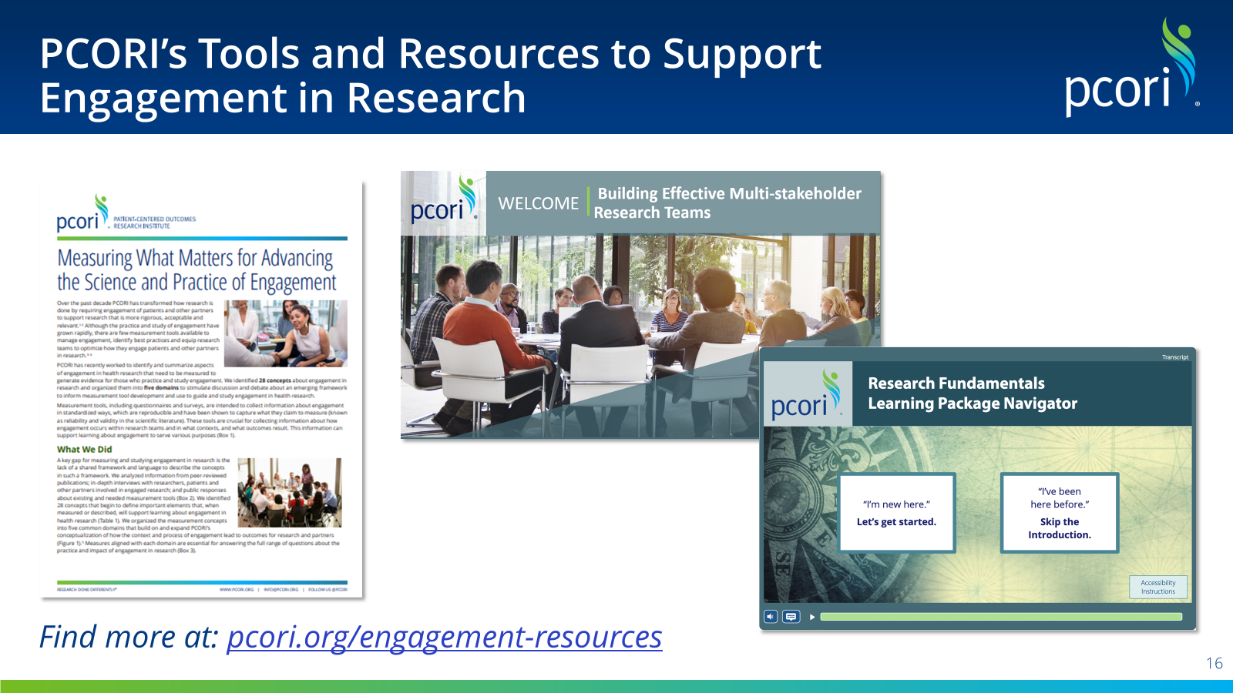
Notes:
We have recently developed new Foundational Expectations for engagement that I urge you to read through on our website. These lay out the requirements and provide guidance for engaging patients and other important stakeholders during each stage of the research process.
We also have a wealth of other resources there, some of them developed as part of PCORI awards, that I think you will find helpful. Some of the resources include information on measuring what matters, guidance on building effective multi-stakeholder research teams, and a research fundamentals course that is very helpful for research partners. This is also available in Spanish.
Next slide

Slide 8
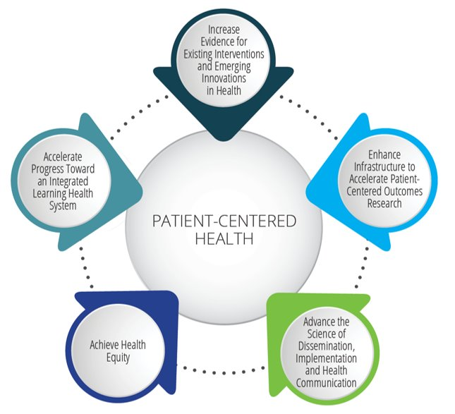
Patient-Centered Outcomes Research Institute
National Priorities for Health
National Priorities for Health
Five ambitious long-term goals
Interconnected and mutually reinforcing
Purpose:
  Anchor PCORI’s research funding and other initiatives
  Make a positive and significant impact on health and healthcare outcomes
Notes:
At the core of what we do are our five National Priorities for Health. These are ambitious, long-term goals that will guide PCORI’s funding of patient-centered CER and other initiatives related to engagement, dissemination and implementation, and research infrastructure. I won’t read through them, but you can find them on the right-hand side here.

Slide 9
Patient-Centered Outcomes Research Institute
Topic Themes for Focused Funding
Topic Themes
Improving outcomes for people with intellectual and developmental disabilities
Promoting health for older adults
Promoting healthy children and youth
Addressing substance use
Addressing violence and trauma
Addressing COVID-19
Addressing rare diseases
Improving cardiovascular health
Improving mental and behavioral health
Managing pain
Preventing maternal morbidity and mortality
Promoting sleep health
Inform funding opportunities
High burden, high-impact health conditions facing millions of people every day
Funding applications encouraged to align with topic themes
Notes:
PCORI has interest in research across a range of areas, but we have a particular focus on Topic Themes of interest that will inform focused funding opportunities over the next several funding cycles.
We have had a long-standing legislatively-mandated Rare Disease Advisory Panel that has affirmed our interest in work on rare disease. Our Board has amplified that by confirming Addressing Rare Diseases as a topic theme of interest.

Slide 10
Funding Opportunities
Notes:
I want to give you a sense of the types of PCORI funding opportunities available, any of which might be a possible avenue for work in rare disease.

Slide 11
Patient-Centered Outcomes Research Institute
2025 Research Award Funding Opportunities
Up to $5M
$5–12M
Up to $12M
Broad Pragmatic Studies
Investigator-initiated awards in alignment with the National Priorities for Health
Category 3 requires use of PCORnet
Up to $750K
Methods
Improve use of AI and ML, Improve study design, Support data
research networks, Ethical and human subject protections in CER
2025
Funding Cycle LOI Deadlines
Cycle 1: Jan 14
Cycle 2: May?
Cycle 3: Sept?
Up to $500K
Up to$1.5M
Science of Engagement
Two funding categories: Development and validation of measures
Development and testing of engagement techniques
Variable
Topical
Stakeholder-driven topics, issues, and questions of national significance
Up to $22M
for feasibility and
full-scale study
phases
Phased Large Awards for Comparative Effectiveness Research
Large, meritorious, and innovative studies with some risks
*All funds and timeline noted above are subject to change
Notes:
Here you can see descriptions of the research funding announcements we will be offering in 2025. Most of these announcements are offered three times each year.
BPS: The Broad Pragmatic Studies funding opportunity seeks applications on investigator-initiated topics including rare disease. The funding announcement allows three types of award, which can go up to $12M in direct costs and last up to 5 years.
Methods: The Methods funding announcement supports work that will ultimately improve the design and conduct of CER.
Science of Engagement: This is a multi-year effort to build an actionable evidence base that clearly identifies the methods and approaches that lead to effective engagement in research.
Topical: These are focused on specific high-impact topics aligned to our Topic Themes with the aim to produce evidence that will have a substantial impact on practice and patient outcomes. A recent topical funding announcement was focused on rare diseases and we expect to make awards for this in the spring.
PLACER: The Phased Large Awards for Comparative Effectiveness Research announcement supports large-scale, high-impact randomized trials in CER whose risk in achieving their research aims merit an initial period of testing and refinement to determine their feasibility and viability and maximize the likelihood of full-scale trial success. These can last up to 6.5 yrs total and can be up to $22M in direct costs.
I encourage you to visit PCORI.org to review the detailed announcements.
We also have a dissemination and implementation awards program that I won’t have time to describe today.
Next slide

Slide 12
Patient-Centered Outcomes Research Institute
2025 Engagement Award Funding Opportunities
Engagement Award: Capacity Building
Objective: Support projects that help communities increase their ability
to participate across all phases of CER
Engagement Award: Dissemination Initiative
Objective: Support projects to help communities and organizations plan
for or actively bring pertinent PCORI-funded research findings
to their specific audiences
Engagement Award: Stakeholder Convening Support
Objective: Convene stakeholders to explore critical issues related to CER
and/or communicate PCORI-funded research findings to targeted end users
$300,000
Up to 2 years
2025
Funding LOI Deadlines
  Spring
  Fall
$300,000
Up to 2 years
$125,000
Up to 1 year
*All funds and timeline noted above are subject to change
Notes:
Here, you can see information about the different competitive engagement funding opportunities we offer. The 2024 deadlines have passed and the 2025 ones have not yet been released. We do expect them to be in the sometime in the spring and fall.
Most of our Engagement awards fall under capacity building. They provide an opportunity for organizations and community groups to build capacity and skills for CER. These awards, as well as the dissemination and conference awards, must demonstrate meaningful stakeholder engagement throughout the project.
The Dissemination Initiative supports organizations and community groups that have established relationships with end users to disseminate the findings from PCORI-funded studies. They can disseminate the PCORI study solely or as part of the body of existing evidence relevant to the PCORI-funded research findings.
The convening support program provides funding for stakeholders to explore critical issues related to CER. The awardees may also communicate PCORI-funded research findings to end users.

Slide 13
Rare Disease Portfolio
Notes:
Now, I want to spend a few moments giving you a sense of PCORI’s varied Rare Disease portfolio.

Slide 14

PCORI’s Investment in Research Studies on Rare Disease
PCORI HAS AWARDED
$120
41
MILLION
TO FUND
COMPARATIVE CLINICAL EFFECTIVENESS RESEARCH STUDIES AND METHODS PROJECTS RELATED TO RARE DISEASE
Notes:
We have funded 41 rare disease studies for a combined total of $120M in research funding!! We have also funded over 60 rare disease Engagement studies.

Slide 15
Rare Diseases in PCORI CER Portfolio
Others include:
Kawasaki Disease
Duarte Galactosemia
Idiopathic Subglottic Stenosis
Pediatric Transverse Myelitis
Pediatric Crohn’s Disease
Polyarticular Juvenile Idiopathic Arthritis
Chiari Type I Malformation and Syringomyelia
Systemic Scleroderma
Eosinophilic Esophagitis
Myasthenia Gravis
Lupus Nephritis
Pulmonary Fibrosis
Juvenile Spondyloarthritis
Hydrocephalus
Nontuberculous Mycobacterial (NTM) Lung Disease
Non-CF Bronchiectasis
Neuroendocrine Tumors
Pediatric Chronic Kidney Disease
Congenital Heart Defects
Urea Cycle Disorders
Spinal Cord Injury and Spina Bifida
Lennox-Gastaut Syndrome
Notes:
You can see here that our rare disease research awards are across a large number of different conditions, most of which you’ll see listed on the right.
Several of the awards are cross-cutting rather than focusing solely on one disease. These look at patient and provider education; care delivery; and care transitions.

Slide 16
Get Involved &
Stay Connected
Notes:
I’ll just leave you with a some more information about how you might get involved with PCORI or keep up with our work.

Slide 17

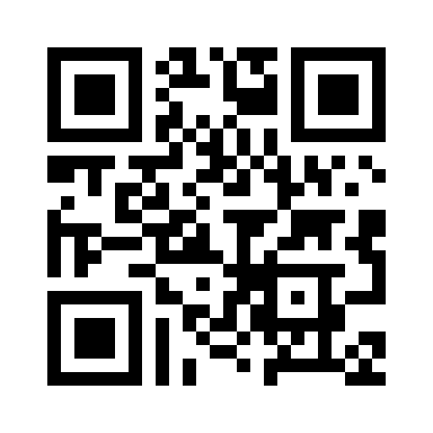
Patient-Centered Outcomes Research Institute
Get Involved
Several Ways to Get Involved with PCORI
Apply to serve on one of PCORI’s five Advisory Panels
Become a Merit Reviewer
Become a PCORI Ambassador
Become a Peer Reviewer
Participate in PCORI Events
Suggest a Patient-Centered Research Question
Scan Now
Notes:
There are many ways to get involved. You can apply to serve on our advisory panels, become a merit reviewer to review our research applications that are submitted, become an ambassador to spread the word about pcori, or become a peer reviewer who looks at our research findings at the end of our studies. We need scientists, healthcare stakeholders, and patients to get involved in all these important activities we do.

Slide 18

Patient-Centered Outcomes Research Institute
Get Involved
Apply or Nominate Someone Today for Open Seats on PCORI’s Five Advisory Panels:
Clinical Effectiveness & Decision Science
Clinical Trials
Healthcare Delivery & Disparities Research
Patient Engagement
Rare Diseases
Scan Now
Notes:
Here is a list of all our advisory panels—you’ll see the rare disease one at the bottom.

Slide 19

Patient-Centered Outcomes Research Institute
Stay Connected
Looking to Stay Current on All Things PCORI?
Sign up to receive our weekly email newsletter and alerts about:
Funding opportunities
Results from our funded research
Webinars, meetings and events
Our new strategic initiatives and more!
PCORI.org/Subscribe
Notes:
I encourage you to check out our website for more information on anything I mentioned today. And, sign up to get our weekly newsletters to keep current on what we have going on.
Interested in staying current on all things PCORI?
PCORI sends weekly emails about opportunities to apply for funding, newly funded research studies and engagement projects, results of our funded research, webinars, and other new information posted on our site.
Sign up to receive our weekly email at PCORI dot org backslash subscribe.

Slide 20
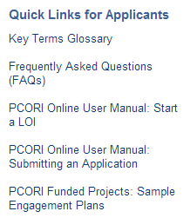


Resources
General
Visit pcori.org/funding-opportunities/applicant-and-awardee-resources
Funding Opportunities
Application Submission Instructions
FAQs
PCORI Online User Manuals
Sample Engagement Plans and other Engagement resources
Schedule a Call with a Program Officer
Submit a request at pcori.org/content/research-inquiry
Call 202-627-1884 (programmatic inquiries)
E-mail sciencequestions@pcori.org
Contact our Helpdesk
E-mail pfa@pcori.org
Call 202-627-1885 (administrative and technical inquiries)
Notes:
Here are some general links to find more information about the funding opportunities I mentioned. You can always submit a request to our helpdesk.
We have many other resources on our website, related to conducting research and engagement, that I encourage you to check out. I have links at the end of the presentation that I can share.

Slide 21
Thank you!
Notes:
Thanks again for the opportunity!

