Slide 1
Alternative Funding Opportunities for Newborn Screening Research
Zhanzhi Hu (Mike)
Co-founder, Project GUARDIAN

Slide 2
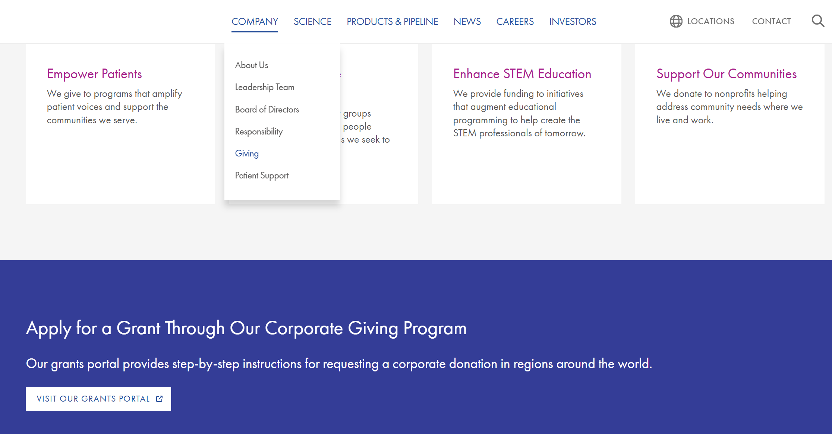
Commercial Funding
Many biopharmaceutical companies provides funding to the patient community via grants
For smaller companies without established grants channel, contact someone in Patient Advocacy roles via web contact or LinkedIn search
Identify an internal champion!

Slide 3
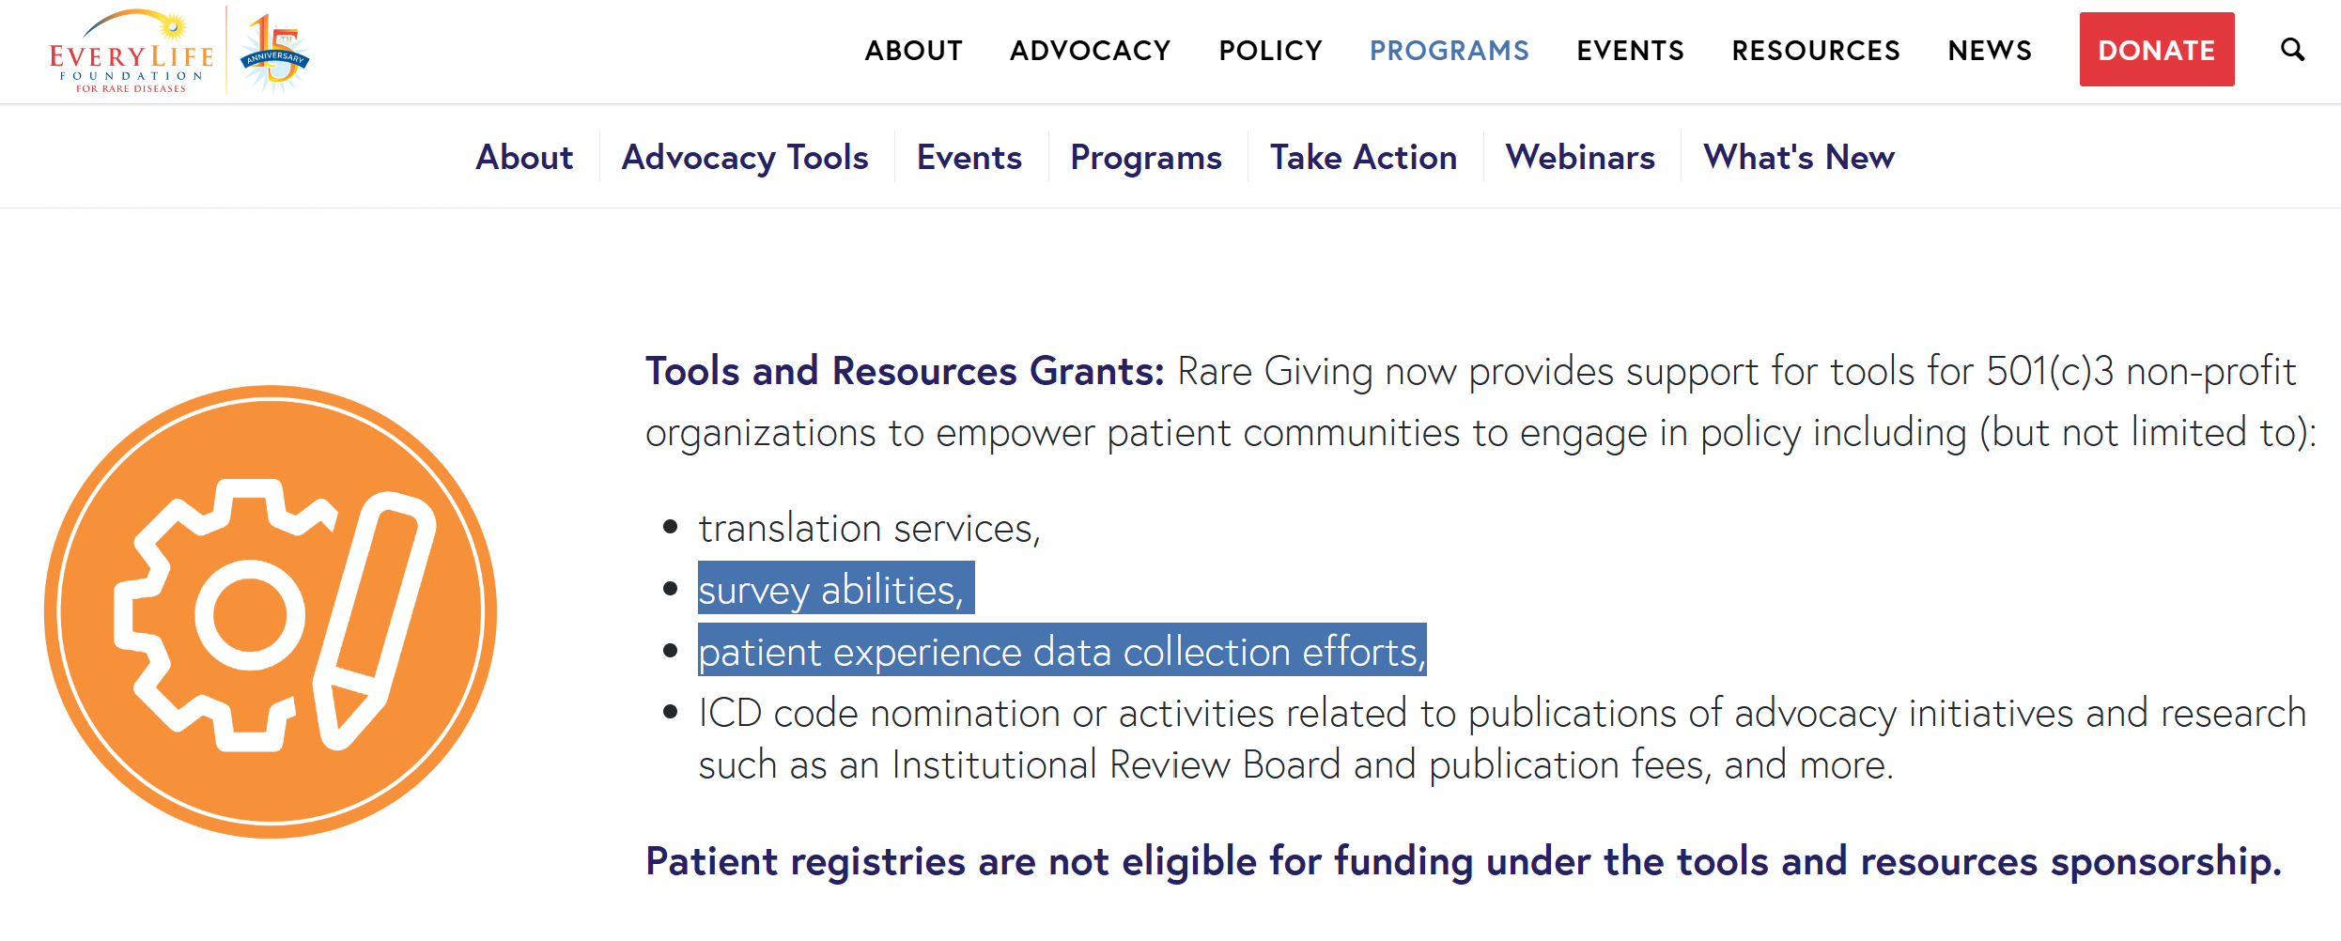
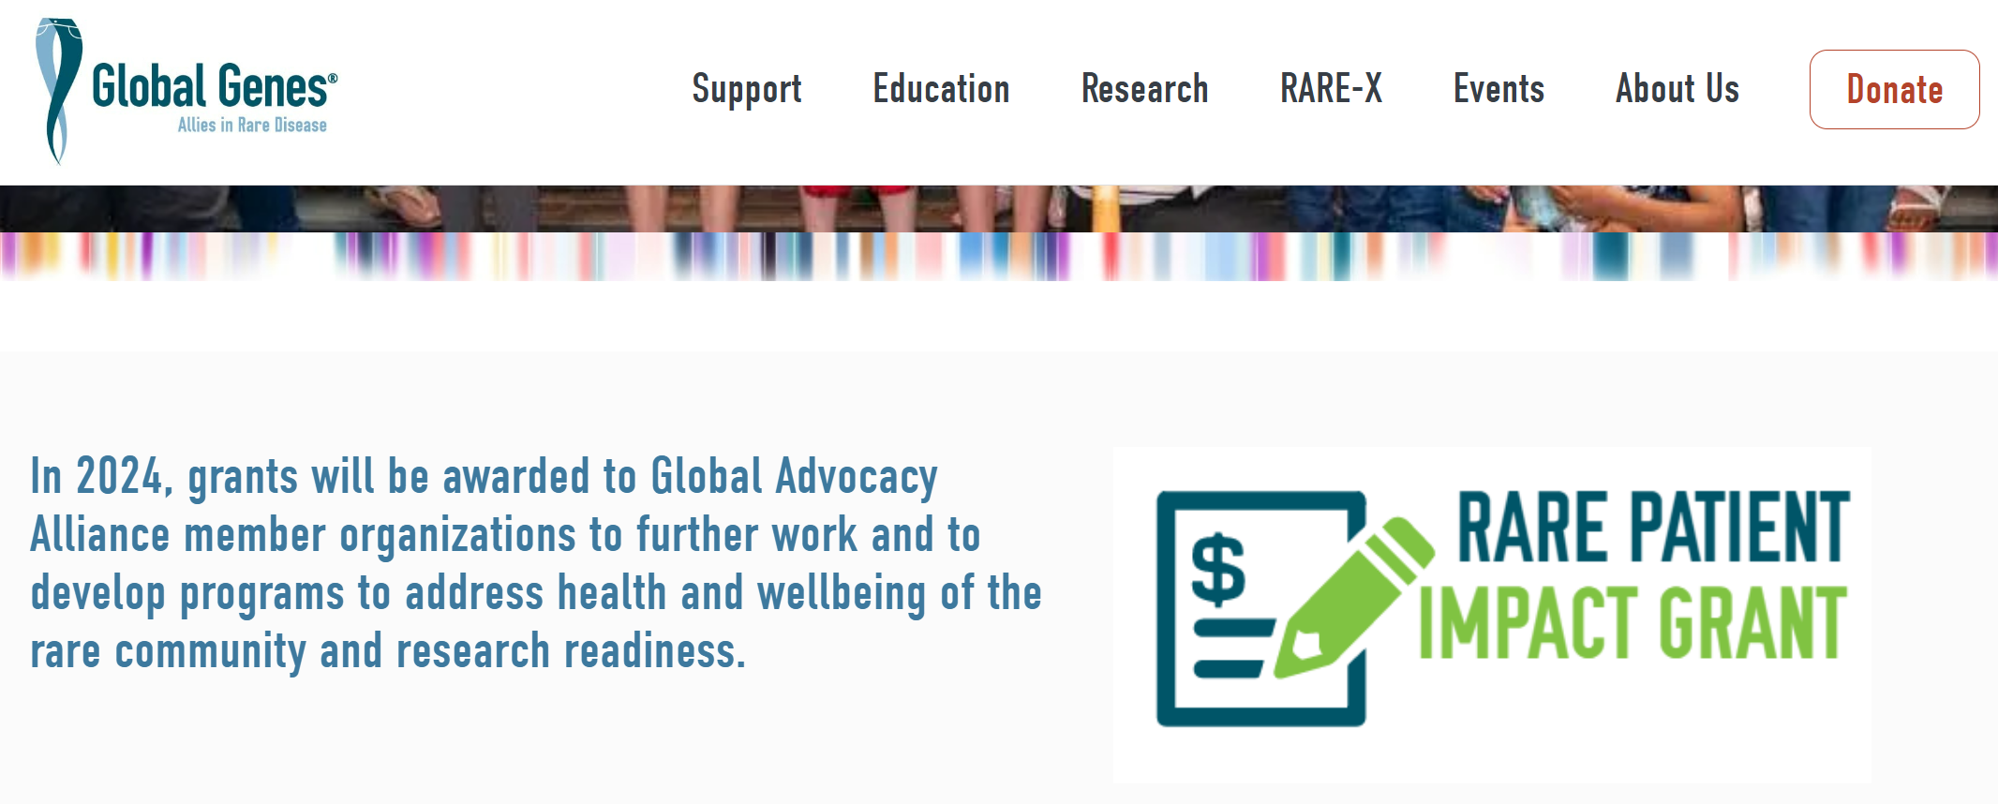
Advocacy Organization Grants
Large pan-disease advocacy organizations may provide funding or useful resources

Slide 4
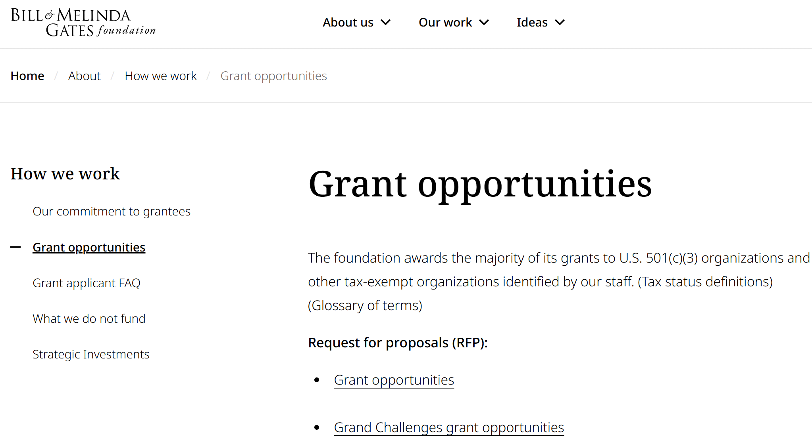
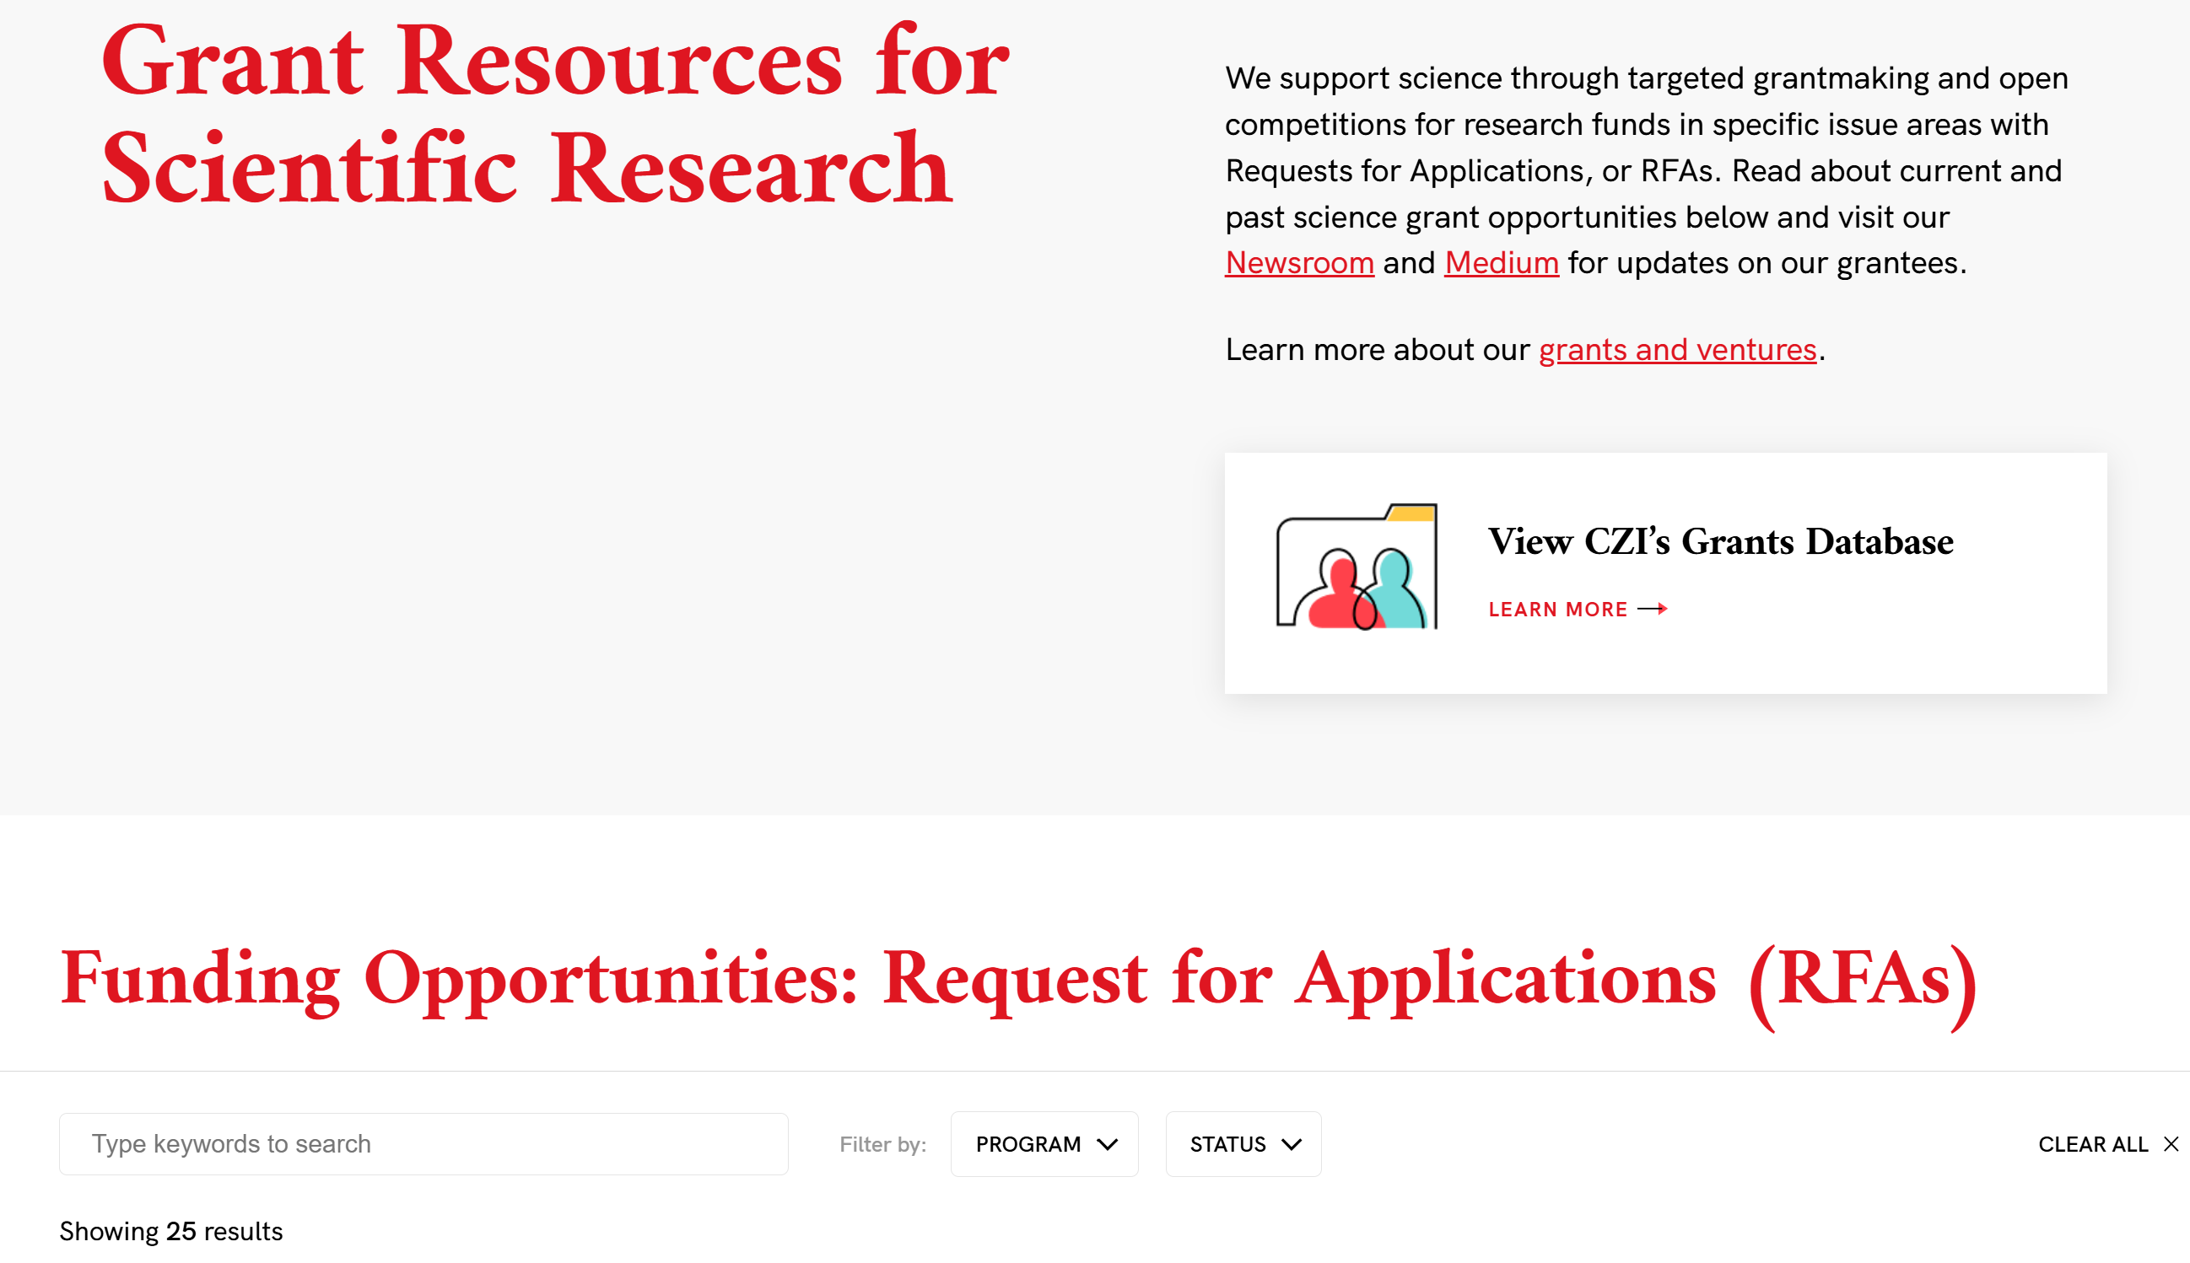
Philanthropic Foundation Grants
Philanthropic private foundations may be a great resource
In addition to established funding programs, private foundations may be flexible in funding projects related to their mission

Slide 5
Additional Funding Opportunities:
Lived Experiences Research
Targeted fundraising – Facebook group, GoFundMe campaign, fundraising events
Identify talents in NBS related programs – thesis work for programs such as genetic counselor, MPH, MS/PhD in areas such as bioethics, neurobehavior, development, etc
Do-It-Yourself
Systemic improvements for lived experiences research: tool kit development for capturing lived experiences, connecting researchers with advocates
Notes:
Self directed survey/interview with professional guidance (ie consultants), manuscript drafting & peer-reviewed journal publishing, not a huge cost

Slide 6
Funding Mix for Project GUARDIAN
Public agency – NIH grants
Biotech companies – in-kind contributions
Biopharmaceutical companies – research grants
Philanthropic grants and donations
Public fundraising
https://project-guardian.org/
https://guardian-study.org/

