Slide 1

Advisory Commission on Childhood Vaccines (ACCV) update
(March 2024 – June 2024)
Jay E. Slater, MD
Office of Vaccines Research and Review
Center for Biologics Evaluation and Research
U.S. Food and Drug Administration
11-12 July 2024

Slide 2
VRBPAC meeting
5 March: FDA's Vaccines and Related Biological Products Advisory Committee (VRBPAC) met to discuss and make recommendations on the selection of influenza viruses for the composition of influenza vaccines for the 2024-2025 U.S. influenza season. This follows the October 5, 2023, VRBPAC meeting during which FDA and the committee engaged in scientific discussion pertaining to the continued need for a quadrivalent formulation of seasonal influenza vaccine for the U.S. as there have been no confirmed detections of circulating B/Yamagata lineage viruses worldwide after March 2020. For the 2024-2025 influenza season, the U.S. will use trivalent influenza vaccines. FDA anticipates that there will be an adequate and diverse supply of approved trivalent seasonal influenza vaccines for the United States for the upcoming influenza season.

Slide 3
VRBPAC meeting
5 June: FDA’s VRBPAC met to publicly discuss and make recommendations on the selection of strain(s) to be included in the 2024-2025 formula for COVID-19 vaccines for use in the United States beginning in the fall of 2024. The committee unanimously voted to recommend a monovalent JN.1-lineage vaccine composition. Following the vote, the committee discussed considerations for the selection of a specific JN.1 lineage SARS-CoV-2 strain (e.g., JN.1 or KP.2) and expressed a strong preference for JN.1. Based on the totality of the evidence, FDA advised the manufacturers of the licensed and authorized COVID-19 vaccines that the COVID-19 vaccines for use in the United States beginning in fall 2024 should be monovalent JN.1 vaccines to more closely match currently circulating SARS-CoV-2 viruses.
Subsequently, on 13 June, FDA updated its advice to manufacturers of COVID-19 vaccines (2024-2025 Formula). The Agency further determined that based on the most current available data, along with the recent rise in cases of COVID-19 in areas of the country, that the preferred JN.1-lineage for the COVID-19 vaccines (2024-2025 Formula) is the KP.2 strain, if feasible. This change is intended to ensure that the COVID-19 vaccines (2024-2025 Formula) more closely match circulating SARS-CoV-2 strains. The FDA has communicated this change to the manufacturers of the licensed and authorized COVID-19 vaccines. The agency does not anticipate that a change to KP.2 will delay the availability of the vaccines for the United States.

Slide 4
mRESVIA
31 May: FDA approved mRESVIA (Respiratory Syncytial Virus Vaccine) for the prevention of lower respiratory tract disease (LRTD) caused by respiratory syncytial virus (RSV) in individuals 60 years of age and older. mRESVIA is administered intramuscularly as a single 0.5 mL dose and is manufactured by Moderna.

Slide 5
Arexvy
7 June: FDA approved Arexvy (Respiratory Syncytial Virus Vaccine, Adjuvanted) for the prevention of lower respiratory tract disease (LRTD) caused by respiratory syncytial virus (RSV) in individuals 50 through 59 years of age who are at increased risk for LRTD caused by RSV. Arexvy has been approved for the prevention of LRTD caused by RSV in individuals 60 years of age and older since May 2023. Arexvy is manufactured by GlaxoSmithKline Biologicals.

Slide 6
Capvaxive
17 June: FDA approved the vaccine, Capvaxive, for the following indications and use:
for the prevention of invasive disease caused by 22 different serotypes of Streptococcus pneumoniae covered by the vaccine for individuals 18 years of age and older.
for the prevention of pneumonia caused by 21 different serotypes of Streptococcus pneumoniae covered by the vaccine for individuals 18 years of age and older.
The vaccine is manufactured by Merck Sharp & Dohme LLC.

Slide 7
FDA COVID-19 Website
FDA has a website dedicated to its COVID-19 activities, including FDA’s pandemic response activities pertaining to vaccines, testing, therapeutics, and devices. The website is frequently updated and is a resource for the public, including healthcare providers and industry. https://www.fda.gov/emergency-preparedness-and-response/counterterrorism-and-emerging-threats/coronavirus-disease-2019-covid-19

Slide 8
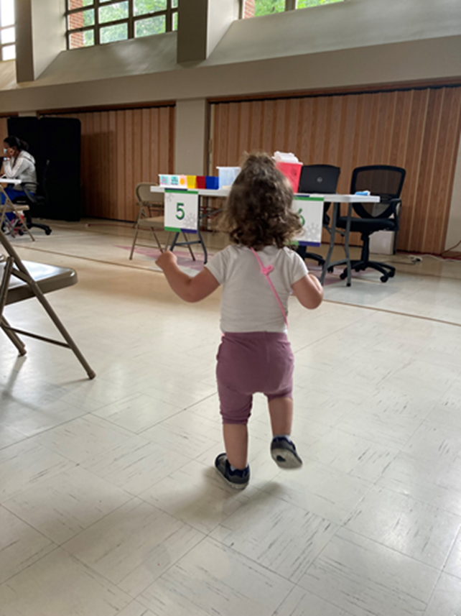
Questions?
The opinions expressed herein – especially in response to questions – are an informal communication and represent my best judgment. These comments/responses do not bind or obligate FDA.

