Slide 1
Immunization Information Systems Overview
National Center for Immunization and Respiratory Diseases
Lynn Gibbs Scharf, MPH
Chief, Informatics and Data Analytics Branch
July 12, 2024

Slide 2

Immunization Information Systems 101
1
Tools for Individual and Public Health
2
CDC’s Vision and Support for IISs
3
Wrap Up and Questions
2

Slide 3
Tools for Individual and Public Health
CDC |NCIRD | Immunization Services Division

Slide 4





Immunization Information Systems
What do they do?
When providers administer a vaccine, the immunization record is transmitted to the IIS. The IIS then consolidates, analyzes, and shares the data.
Where are the administration sites?
Information immunization systems (IISs) are confidential, population-based databases that record all vaccine doses administered by participating providers in a specific geographic area. IISs provide insights that inform and enable public health action.
Pharmacies | Workplaces | Federal Agencies
Public Health Departments | Hospitals, Clinics, and Doctor’s Offices
Who runs the IISs?
The IISs are run by jurisdiction immunization programs.

Slide 5
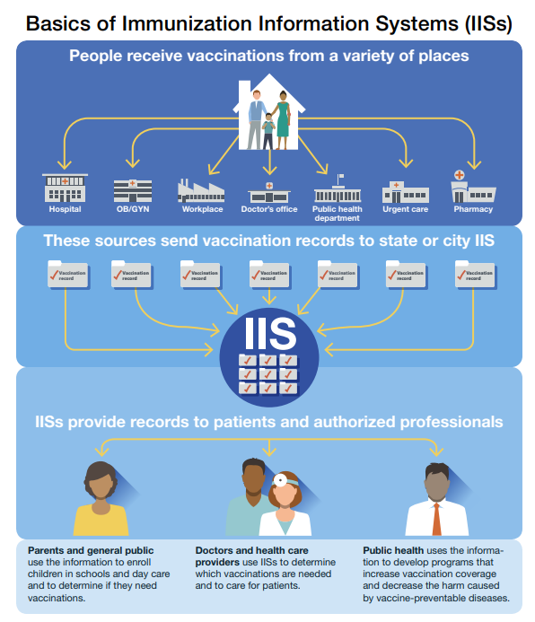










Overview
IISs enable immunization programs to:
Plan for emergency preparedness and pandemics
Monitor new vaccine uptake
Track and evaluate trends in coverage rates
Monitor outbreaks and disease levels
Collect insights from other electronic health information systems
Calculate vaccinations needed automatically
Consolidate immunization records
Generate vaccination reminder and recall notices
Support vaccine management at the provider and immunization program levels
Manage all operations of Vaccines for Children (VFC) program
Birth records  Death records  Data entered by providers 
Medicaid and insurance billing/claims  Electronic medical records
Primary IIS Data Sources

Slide 6
Overview
IISs enable immunization programs to:
Plan for emergency preparedness and pandemics
Monitor new vaccine uptake
Track and evaluate trends in coverage rates
Monitor outbreaks and disease levels
Collect insights from other electronic health information systems
Calculate vaccinations needed automatically
Consolidate immunization records
Generate vaccination reminder and recall notices
Support vaccine management at the provider and immunization program levels
Manage all operations of Vaccines for Children (VFC) program
Birth records  Death records  Data entered by providers 
Medicaid and insurance billing/claims  Electronic medical records
Primary IIS Data Sources
6
Notes:
(e.g., enrollment, inventory, compliance, coverage, forecasting)

Slide 7





Benefits and Health Outcomes
IISs collect, analyze, and share vaccination data to protect individuals and communities from vaccine-preventable diseases.
Communities have equitable protection from diseases that can be prevented by vaccine.
Public health departments are prepared for disease outbreaks and public health emergencies.
Eligible children who need it receive timely, free vaccines that protect them from preventable diseases.
Individuals receive timely vaccinations and experience better health.
7

Slide 8

History of IISs
IISs are based on a strong tradition of sharing across communities. The collaborative spirit emerged as IISs took shape, received support, and were nurtured over time.
1989-1991
Although the measles outbreak of 1989-91 spurred discussion about the need for a national immunization registry, the idea did not gain traction because of the lack of supporting federal policy, widespread concerns about the federal government having a single database with data from all citizens, and privacy concerns about the data.
2001
CDC developed the first set of common functional standards for registries.
2020
COVID-19 resulted in large investments for IISs, which equipped the nation with the ability to answer questions about national coverage and equitable vaccine distribution.
2005
Almost all jurisdictions had an IIS with standards development areas focused on data quality and sharing, privacy and confidentiality, clinical decision support, and immunization program operations.
1991
The All Kids Count initiative of the Robert Woods Johnson Foundation began funding registry development.
1992
CDC began awarding planning grants to focus on pediatric immunizations. Due to jurisdictional regulations and policies, awardee systems varied between commercial and homegrown.
8
Notes:
Speaker: Lynn

Slide 9


Immunization Data Reporting at the National Level
Pre-COVID-19
COVID-19 Response
Present
DUAs and Data Reporting
Jurisdictions use IISs to manage the Vaccines for Children (VFC) program and understand their jurisdiction’s vaccine coverage. ​
13 jurisdictions signed Data Use Agreements (DUAs)
Routine data reported quarterly and flu data reported monthly
Data use was limited
Federally provided vaccine, provider agreements, and a COVID-19-specific DUA superseded state reporting and data sharing laws to allow reporting to CDC.
New DUA allows reporting of routine vaccination data across the lifespan.
54 jurisdictions with DUAs
Line-level routine data reported quarterly
Aggregate RSV, flu, COVID-19 data reported monthly
64 jurisdictions with DUAs
COVID-19 data reported daily, then weekly
Latest Data Reporting
March Aggregate Jurisdiction Data Submissions ​ Submitted in April 2024 |  |  |  | Q1 2024 Routine Data Submission​ Submitted in April 2024 ​
Flu Data​ | RSV Data​ | COVID-19 All Data​ | COVID-19 Bridge Data​ | Record Level Routine Data​
54 | 48 | 53 | 50 | 51 16 PPRL
9

Slide 10
Opportunities After the COVID-19 Response
Aspects of IIS architecture and the ecosystem, that were stood up during the response, provided opportunities to advance CDC data modernization efforts and support future public health emergencies.
The response highlighted opportunities and achievements in improving data capture and quality. Specifically, it showed:
Core building blocks for data exchange, storage, and processing of large data in public health
A real-world example of the ability of CDC and its public health partners to use new technologies to support, process, and manage a nationwide surveillance data set
How novel technologies like secure exchanges enhance how state, local, tribal, and federal public health partners exchange and work with data
Greater interconnectedness across systems and communities
10
Notes:
Speaker: Lynn

Slide 11
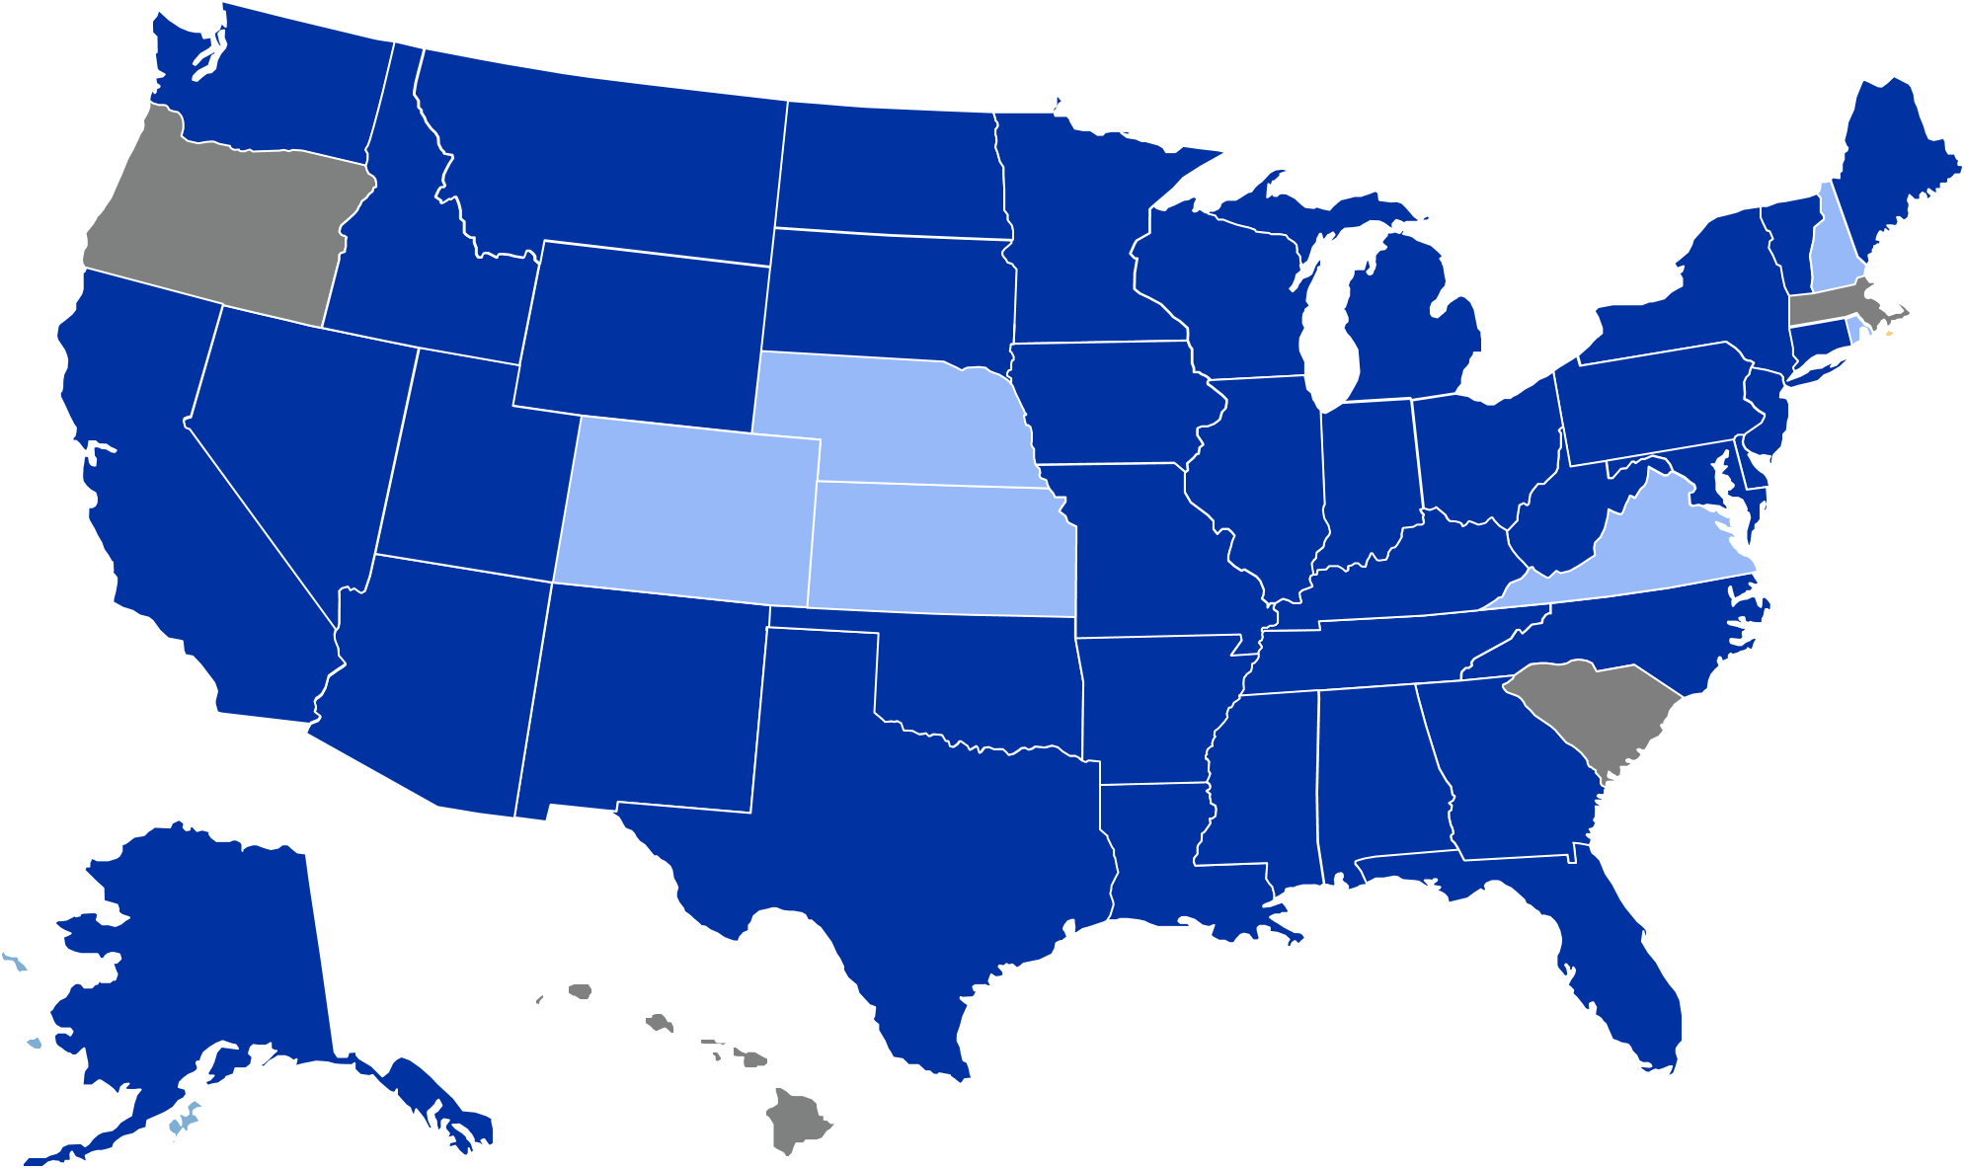
National Surveillance: IIS Data Give a National View of Immunization Coverage
Data Use Agreements Signed (N=64)
When we understand national trends for immunization, we can support needed interventions across the country and effectively prepare for emerging threats.
Not Shown on Map
 | American Samoa
 | Chicago*
 | Guam
 | Houston*
 | Marshall Islands
 | Micronesia
 | Northern Mariana Islands
 | NYC
 | Palau
 | Philadelphia
 | Puerto Rico
 | San Antonio*
 | USVI
 | Washington DC
Signed (n=54) | In process (n=6) | Not signed (n=4)
*Cities covered by state DUA
11

Slide 12


National Surveillance: Routine Data Architecture
IIS
Routine immunization data flows into CDC’s Data Lakehouse platform via SFTP or via the Immunization Gateway to CDC’s Enterprise Data Exchange (DEX) platform.
IZ Gateway
Distributor
CDC Data Lake Platform
NABIP*
Data StoreFront
*National Center for Immunization and Respiratory Disease Advanced Business Intelligence Platform (NABIP): Data platform that is used for processing and analysis of routine immunization data. The platform ingests data, runs it through multiple data pipelines, generates performance metrics, and then provides final analytical data sets for further analysis.
VTrcKS – Vaccine Tracking System; IIS – Immunization Information System; VAMS – Vaccine Administration Management System.
12

Slide 13

IIS Data Policy Landscape
Consent and provider reporting policies may limit a jurisdictions ability to collect, exchange, and report data. Most jurisdictions have a citable law, rule, or regulation that govern IIS data, while a few base policy on the Department of Health or programmatic policy.
Consent
Provider Reporting
Consent is whether an individual has the right to decide if their demographic and immunization data is included in the IIS. Parents or guardians give implicit or explicit consent for children under the age of 18.
Mandatory inclusion: Includes vaccine recipients in IIS with no possibility to opt out
Implicit consent: Includes vaccine recipients in IIS unless they choose to opt out
Explicit consent: Includes vaccine recipients in IIS only if explicit consent is obtained to opt in
Provider reporting requirements are mostly governed by policy that is a citable law, rule, or regulation. These requirements are unique to each jurisdiction and are based on various factors (e.g., age, vaccines)
13
Palau did not provide policy information.

Slide 14
CDC’s Vision and Support for IISs
CDC |NCIRD | Immunization Services Division

Slide 15

CDC’s Vision for Immunization Information Systems
Immunization Information Systems (IISs) support the standardized capture and exchange of high-quality, individual-level immunization data for all doses of Advisory Committee on Immunization Practices (ACIP) recommended vaccines.​
These data are linked across jurisdictions, providers, partners, and other individual-level data sources to inform public health actions.
15

Slide 16
CDC’s Focus Areas and Initiatives to Achieve the Vision
Data Collection & Management
Technology & Standards
Develop governance; policy and strategy; and data and quality standards in support of collecting, managing, and sharing national IIS data.
Identify and develop new systems, tools, and standards, and support and modernize existing systems to improve performance, ensure consistency, and achieve mission goals.
Informatics and Data Analytics Branch
Data Use
Community Engagement & Support
Assess, analyze, and use data to drive public health action across the IIS community, including jurisdictions, providers, and partners.
Accelerate the enhancement and performance of IISs by convening key stakeholders to develop guidance, identify best practices, and collaboratively solve problems.
16
Notes:
The Informatics and Data Analytics Branch (IDAB) identified 4 focus areas to support and advance IIS and high quality immunization data. They are data collection and management, data use, technology and standards, and community engagement and support. I am going to dive into each of these in more detail and share some of the major activities going on within each focus area.

Slide 17
Support for IISs
To help realize the vision for the IIS, CDC provides a variety of support.
Guidance & Best Practices
Data Quality Improvement
Technological Infrastructure
Funding & Direct Assistance
Tools
Functional Standards, Operational Guidance statements, and Immunization Program Operations Manual (IPOM) Chapter D help outline level of consistency in support of common clinical, programmatic, and public health immunization goals and drive IIS advancement.
To be effective, IISs must provide high-quality data. The IIS Data Quality Blueprint, IIS Dashboard, and Data Quality Reports support awardees in achieving high data quality standards.
Technological infrastructure such as clinical decision support (CDSi), code sets, and vocabulary support consistent IIS capability, high-quality immunization data, and interoperability of IISs with other systems.
Tools such as Vaccine Tracking Systems (VTrckS), Vaccine Administration Management System (VAMS),and IZ Gateway support vaccination allocation, distribution, administration, monitoring, and reporting.
CDC provides both financial and direct assistance to awardees to support IISs. The funding is non-competitive to ensure all awardees have necessary funding for activities and is calculated using a base plus population formula.
17

Slide 18
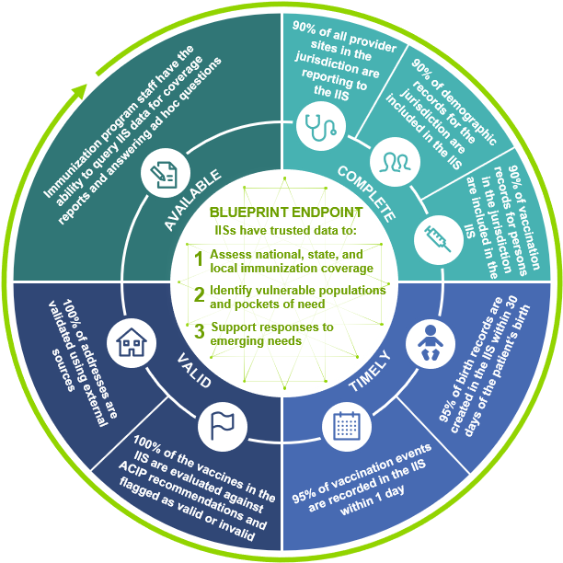
Data Collection and Management: IIS Data Quality Blueprint
The blueprint guides awardee activities to improve data quality by prioritizing a small set of meaningful, quantifiable measures.
IIS Data Quality Endpoint
IISs will be the trusted source for reliable immunization data
IISs will produce data to support:
Immunization coverage assessments
Identification of pockets of need
Responses to emerging needs
7 Data Quality Characteristics
Available | Complete | Timely | Valid | Accurate | Consistent | Unique
18

Slide 19

Data Use: Data Quality Support
CDC aims to provide jurisdictions with timely feedback and technical assistance to support data quality (DQ) improvements.
Types of Feedback
Validation Report
Provided when jurisdictions submit their quarterly data
Data quality monitoring and assistance
Provide jurisdictions with an assessment on the completeness and accuracy of IIS data along with targets and strategies to improve quality
Data quality in action
Q4 2023: 104 million demographic records submitted for PPRL. CDC could assign a Privacy-Preserving Record Linkage (PPRL) link ID to 94% of the records.
Goal: increase this percentage over time by making process improvements and highlighting patient IDs with missing values in the PPRL DQ Feedback Report.
Routine Vaccination DQ Report
Offers analysis of data quality trends over time and within population groups
PPRL DQ Feedback Report
Identifies potential duplicates and patient IDs with missing required values
Provides tracking sheet to ensure CDC receives a PPRL link ID for every routine vaccination demographic record
19
Notes:
Since this section is about data collection and management, consider including a version of this slide. Points to make are:
1. CDC values privacy and security of IIS data; CDC and awardees share responsibility for maintaining the privacy of individuals whose vaccination data are recorded in IISs.
2. Aggregate reporters will… (say something about their process and that the specs will be available…)
3. CDC is collecting a lot of data and is looking for ways to improve the efficiency of the process including only processing data that change between quarters and ultimately only requiring jurisdictions to report data that changed between quarters. (This could be where we say that by processing only data that changed since the last quarter, CDC reduced processing time for three pilot jurisdictions by 80%.)
4. Submitting data via the IZ Gateway enables CDC to take advantage of capabilities of the DMI front door.
Taking an integrated approach, this slide could also include PPRL findings for 4Q2023: CDC implements PPRL to assign a unique ID for ever routine immunization demographic record. The 11 jurisdictions that submitted PPRL data for 4Q2023 submitted 103,823,978 demographic records and CDC could assign a PPRL link ID to 94% of the records. CDC hopes to increase that percentage over time by making process improvements and by highlighting patient IDs with missing values in the PPRL DQ feedback report.
1.95% of the routine immunization demographic records CDC received appear to be duplicates​. CDC provided jurisdictions with data quality feedback to investigate. Fun facts: In 1,198,990 cases, two patient IDs matched a single PPRL ID. There were instances where between 25 and 250 patient IDs matched a single PPRL ID. Prior to this slide, there could be a slide that summarizes CDC's strategy for providing data quality feedback. That strategy begins with recognition that IISs own the data and that they are responsible for maintaining high quality data in their IISs. CDC aims to provide timely feedback. Jurisdictions receive three types of feedback: 1) a validation report (I'm not sure if that is the right name and don't have a copy handy to check the specific focus -- ) when they submit quarterly data; 2) PPRL DQ feedback to identify potential duplicates, patient IDs with missing required values, and a tracking sheet to be sure that CDC receives a PPRL link ID for every routine vaccination demographic record; and 3) the routine vaccination data quality report that focuses on data completeness.

Slide 20

Technology and Standards: Guidance
Functional and operational standards are developed in response to emerging needs and are developed with community inputs.
Functional Standards and Operational Guidance Statements (OGS)
These describe the underlying operations, data quality, and technology needed by IISs to support immunization programs, vaccination providers, and other immunization stakeholders and their immunization-related goals. They help IISs attain a level of consistency in support of common clinical, programmatic, and public health immunization goals.
HL7 v2.5.1 Implementation Guide for Immunization Messaging, Release 1.5
Guidance to help IISs comply with national standards, best practices, and the latest Health Level Seven (HL7) conformance methodology.
Measurement and Improvement Initiative
Measurement and Improvement (M&I) Initiative supports system testing to help guide an individual IIS in aligning with identified standards.
20

Slide 21



Technology: Immunization Gateway
Jurisdiction IISs
The Immunization (IZ) Gateway is a policy framework and cloud-based message routing system that facilitates data exchange among IISs, vaccine providers, direct-to-consumer applications, and data submission to CDC.
Consumer Access Applications
Message routing technology enables uniform application of data quality assurance, messaging, and security industry standards and best practices for all participants.
Multijurisdictional Vaccine Providers
VAMS
Policy framework ensures compliance with each jurisdiction’s data sharing laws and policies.
CDC via
IZ Data Lake
21
Notes:
Tags: process, current, future, changes

Slide 22
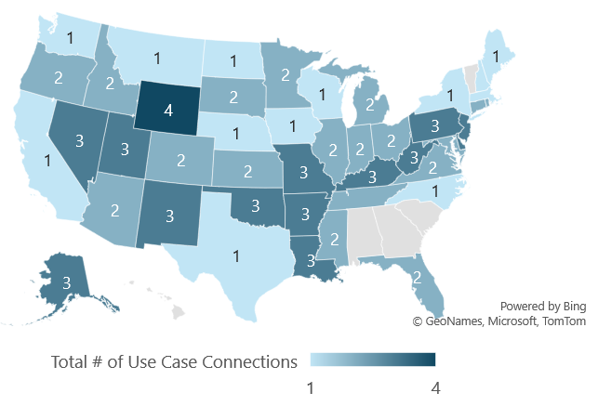
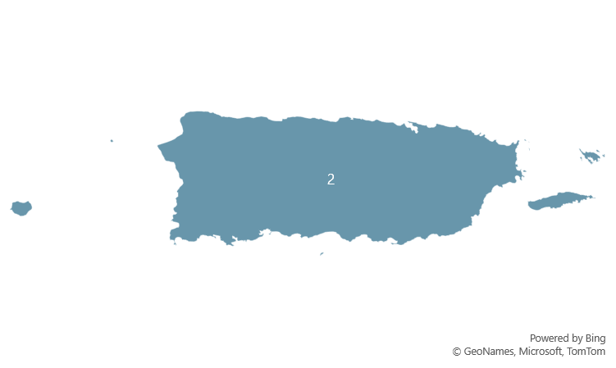
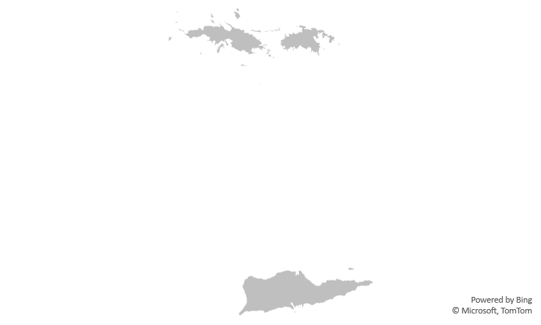
Technology: IZ Gateway Data Exchange Metrics
Jurisdictions Participating in the IZ Gateway
IZ Gateway Exchange Metrics
Completed Baseline Onboarding | 63 Jurisdictions
Participating in IIS-to-IIS Data Exchange | 36 jurisdictions with 205 active exchanges
IIS and Multijurisdictional Provider Data Exchange | 7 providers* with 4,220 facilities in 42 jurisdictions
Consumer Access System Exchange with IIS | 1 platform exchanging with 6 jurisdictions
IIS Data Exchange with CDC (data submission) | 20 jurisdictions submit routine vaccination data to DLP through DEX and NDLP storage container
Onboarded, Not Pictured
Washington D.C.
Philadelphia
NYC
Chicago
San Antonio
Houston
*Multijurisdictional Providers: Veterans Administration (VA) VistA, VAMS, DocStation, AZOVA, VA Oracle Health, Fond du Lac, Department of Defense
22
Updated 06/4/24
Notes:
Presenter: Weekly Lead
Slide owner: Priti
Source: Salesforce, this slide deck and Master Slide Deck Visuals.xlsx (sharepoint.com)
Visuals from Desktop Version of Master Slide Deck Visuals.xlsx (sharepoint.com)
Updates for the week of 10/17
- IL/KY go live
--IL first IIS-IIS exchange bringing total jurisdictions to 26
Updates the week of 8/22/22
NJ/NYC go live
Updates the week of 8/8/22:
USVI baseline connection completed in PROD
Update the week of 7/5/22:
NJ/PHIL and NJ/CT go live adding four new connections
Consumer access – Idaho went live, now four jurisdictions participating in consumer access
Total jurisdictions up to 31, and 50% of jurisdictions with any use case
NYC, FL, AZ live with VHA
Updates for the week of 6/20/22:
No Updates
Updates for the week of 6/6/22:
NYC/ CT, CO/OK go live
Up to 30 jurisdictions participating in any use case (added NYC, CT, CO)
30/62 = 48%
Updates for the week of 5/23/22:
Updated, data quality check on total number of jurisdictions participating in any use case. Up from 22 to 29.
Updated map
Updated text formatting and color
Updates for the week of 5/16/22:
No new updates
Updates 5/9/22:
NJ/DE go live bringing total jurisdictions for IIS-IIS exchange to 22 and total connections to 121
Updates for the week of 5/3/22:
No new updates
Updates for 4/25/22:
DC/MD go live bringing total number of connections to 119
4/18/22: No Change
Updates for 4/11/22:
Removed KY/WV connection per clarification from Envision. They are done testing in test, but not in prod. Removed from total bringing it back down to 117.
Updates for 4/11/22:
OK/PHI new connection, bringing total to 119 connections
Updates for the week of 4/4/22:
No new updates
Updates for the week of 3/29/22:
No new updates
Updates for the week of 3/22/22:
No new updates
Updates for the week of 3/14/22:
No new updates
Updates for the week of 3/07/22:
Oregon completed baseline onboarding (3/2)
Updates for the week of 2/28/22:
No new updates
Updates for the week of 2/21/22
New IIS-IIS connection: Philly/NV. Upping total to 117 total connections.
Updates for the week of 2/14/22
Three new connections: KY/DE, NV/NM, KY/NM bringing total connections to 115 (3% completion)
Updates for the week of 2/7/22
OK/NM go live bringing the count to 111 total connections across 21 jurisdictions.
Illinois completed baseline onboarding bringing total onboarded to 55
Updates for 1/31/22:
No new updates
Updates for 1/24/22:
Arkansas/KY connection and DE/NV validated
KY/DE go live and validated bringing total number of active exchanges to 109
Updates for the week of January 10th:
KY/Arkansas and KY/NV went live in production 1/7/22 raising the total number of connections from 99 to 103 (2.8% now).
Wisconsin completed baseline onboarding. Oregon is very close, but not quite completed yet.
Updates for the week of January 3rd:
Data quality check updated total data exchange partnerships from 101 to 99.
Several connection validations came in from Envision jurisdictions.
Updates for the week of December 20th:
Added HI and USVI to denominator raising it to 62. Impacted most percentages.
Recalculated total data exchange partnerships using formula: x = n(n-1) or x = 62(62-1) or x = 3,782
Data exchange between 20 IIS (up from 18)
Added eight new connections (CT/NV, NV/CT, CT/DE, DE/CT, NV/OK, OK/NV, NV/AR, AR/NV)
Michigan completed baseline onboarding bringing PROD connections to 87% complete
Update week of 12/13:
# IIS participating in IIS-IIS exchange dropped from 19 to 18. MO is not moving forward with signing updated MOU and does not want to participate in IIS-IIS data exchange at this time.
# active IIS-IIS exchanges dropped from 94 to 93 (MO)
Updated number of facilities to 68 from >43
Update week of 12/6: No update. Delaware was not filled in
Update 11/29: No changes from 11/23
No updates 11/23 (or last update added 11/23...)
Unclear of number of VAMS facilities, but will have when they return the form
Visual: Master slide deck visuals, tab: use case (any)
Data sources: MAT slides/master tracker for IIS-IIS; Zoho “IIS-IZG Onboarding Checklist Full Report,” “Provider by Jurisdiction Report,” “Consumer Access Report

Slide 23
















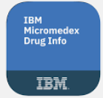



Infrastructure: Vaccine Development & Implementation Overview
STAGE 1: Manufacturers submit Structured Product Listing (SPL) to the FDA for Review.
(Timeline varies)
Manufacturers
Market Authorization Type & Date
Ingredients with Allergens / Sensitivities
Vaccine Formulation Platform
Structured Product Listing (SPL)
Manufacturer Name
Target Condition
Dosage Schedule
Formulation Class
Dosage Interval
Dose Strength
Dose Frequency
Formulation Subclass
Vaccine Type Detail
Route Body Site
Dose Volume
Preservatives
Target Population
Approved Age Range
Storage & Handling
Presentation
STAGE 2: FDA approves and publicly lists information on DailyMed.
(Timeline varies)
STAGE 3: Data partners create codes and aggregate all information needed for vaccine launch.
(At least 6 weeks)
Data Vendor Partners
Drug Compendium Partners
Each data partner has an established publication schedule though exceptions can be made in the event of a declared public health emergency.
STAGE 4: System vendors and health systems receive information and set up workflows.
(At least 6 weeks)
h
System Vendors
Health Systems
Electronic Health Records (EHR) Vendors
230+ Nationwide
Immunization Information Systems (IIS) Vendors
18 Nationwide
Scheduling Systems
Jurisdictional IIS
64 Nationwide
Provider EHRs
5000+ Nationwide
Payer Systems
23
Systems receive vaccine updates on varying schedules based on their subscription (e.g., monthly, biweekly)

Slide 24
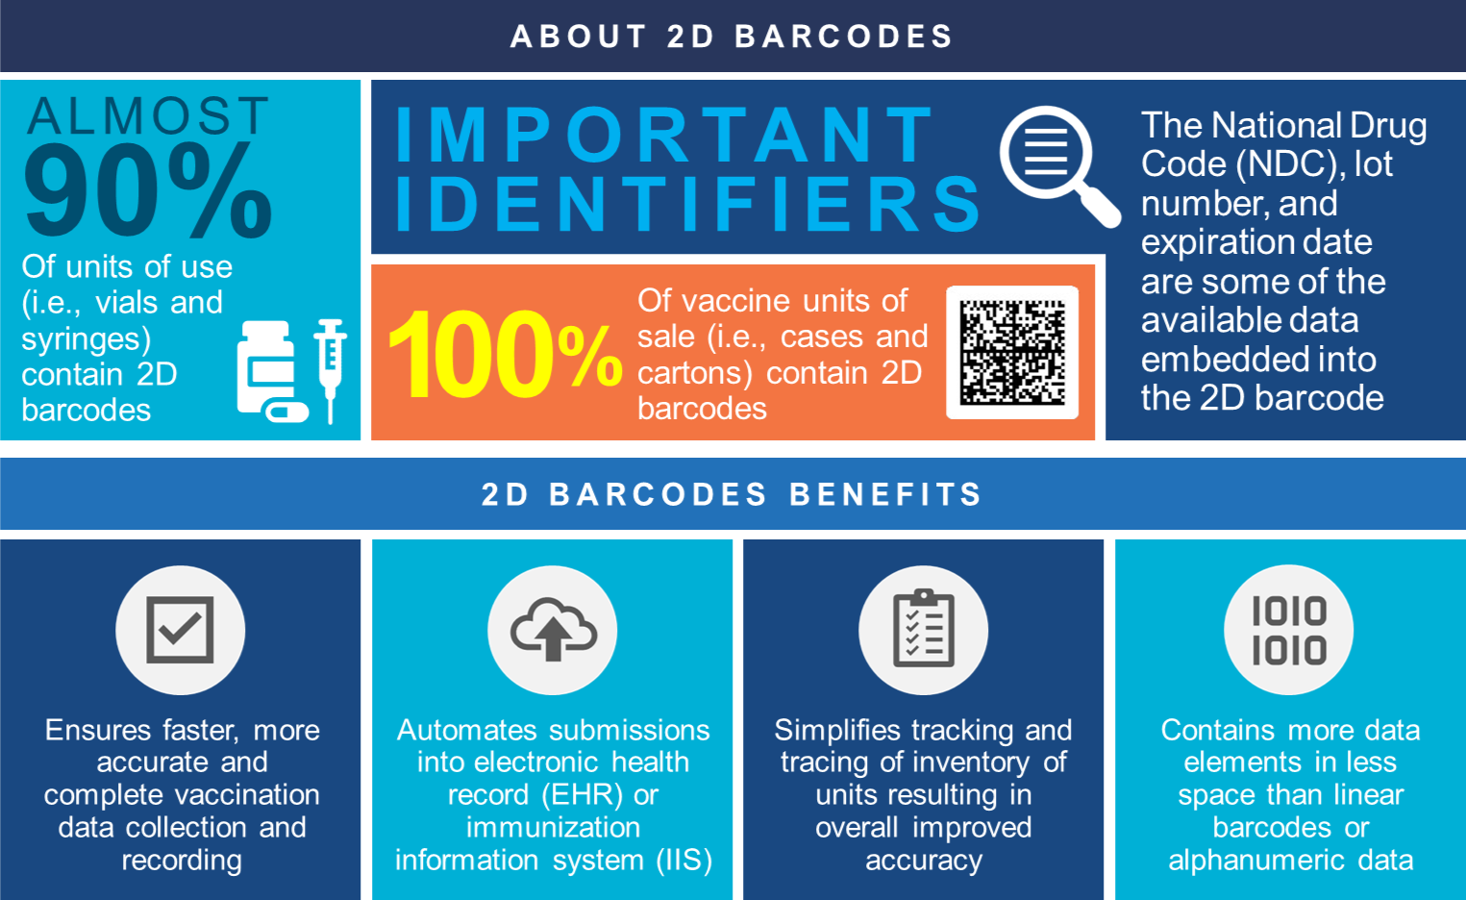
Technology & Standards: 2D Barcodes
2D Barcodes Improve Data Collection and Save Time
As part of the FDA’s on-going efforts to improve tracking and tracing vaccines, two-dimensional (2D) barcodes are required on vaccine units of sale. They help providers capture and submit accurate and complete vaccination data during administration and increase inventory management efficiency.
24

Slide 25




Vaccine Administration Management System
The Vaccine Administration Management System (VAMS) is a web-based, end-to-end vaccine scheduling, administration, and reporting system. VAMS provides users with the functionality below.
Vaccine Recipients can schedule appointments for themselves and dependents, receive notifications and alerts, register demographic and contact details, complete pre-vaccination questionnaires, document consent, and view vaccine administration details for appointments completed in VAMS.
Clinic Users can setup and operate clinics, schedule and check-in appointments, log inventory, query the recipient’s immunization history, and record vaccine administrations.
Jurisdiction Users can onboard and manage clinic accounts, review inventory requests, and access data reports within their respective areas.
System Integration with jurisdiction IISs via the Immunization Gateway allows for near-real time reporting of vaccination administrations as well as querying recipient immunization history and forecast data. All data is configured to jurisdiction IIS HL7 messaging specifications.
25

Slide 26
Community Engagement and Support: Funding and Assistance
CDC provides funding and assistance to the IIS community. CDC regularly engages with awardees and technology partners to support IIS activities. CDC also supports awardees and technology partners by providing funds and direction to the American Immunization Registry Association (AIRA) and the Public Health Informatics Institute (PHII) for developing guidance, identifying best practices, and collaboratively solving problems.
CDC
CDC regular communicates and engages with stakeholders to provide relevant, timely information and guidance.
CDC Communication Resources
IIS Information Brief
SharePoint sites
Awardees
Technology Partners
Implement IISs and ensure capacity to advance prioritized IIS capabilities.
CDC Engagement
IIS-All Awardee Forum
Platform-based consortia sessions
Dedicated CDC SME
CDC- and partner-provided technical assistance
On behalf of awardees, implement IISs and ensure capacity to advance prioritized IIS capabilities.
CDC Engagement
Technology Partner call
Direct vendor contracts
AIRA
PHII
Technical assistance
Workgroups
Technical trainings and educational activities
Technical assistance
Workforce trainings and educational activities
Competencies model
26
Notes:
CDC provides resources to partners to support immunization programs and IIS. This includes funding to AIRA who provides direct technical assistance to jurisdictions for onboarding and data exchange between providers and IISs, manages the Measurement and Improvement Initiative, convenes workgroups to solve problems, and collaboratively defines best practices.
It also includes the Public Health Informatics Institute who
Develops and maintains the IIS competencies model and
develops role specific training curriculum
Collaborates with CDC and other partners to address IIS topics of national interest including facilitating the IIS Functional Standards updates, developing national IIS requirements, and convening a collaborative to assist jurisdictions with the adoption and implementation of a new IIS platform.
One way that we engage the community is through a variety of communication vehicles including the weekly IIS Information Brief, monthly IIS All awardee forum, IIT technology partner calls, and sharepoint sites.
CDC has engaged with IIS technology partner-based consortia as needed, such as the consortium-specific meetings held during the 2023 AIRA National Meeting. However, we have heard from jurisdictions that you want regular engagement with your consortium in order to develop uniform strategies to advance IIS, share successes and challenges, and collaboratively identify priorities.
We have assigned a point of contact for each consortium who will help facilitate ongoing engagement through quarterly meetings (or more frequent, if needed), cross-consortium sharing, and collaboration tools.
We also fund and engage regularly with IIS technology partners to advance prioritized capabilities.

Slide 27

IISs Are Essential Tools for Public Health
CDC drives the vision and provides financial and technical support to enable IISs to collect, analyze, and share high-quality data for clinical, individual, and public health decision making.
IISs ensure that details of the Vaccines for Children program are implemented to effectively provide vaccine to children who otherwise cannot afford vaccines.
Populations at risk of vaccine-preventable disease
Areas of low vaccination coverage
Characteristics of populations with high/low coverage
Vaccination coverage at the jurisdiction and national level
IIS Data Provides Valuable Insights
Quality of data
(i.e., available, timely, complete, valid, accurate, consistent, unique)
27
Notes:
Tags: statement, quote, callout

Slide 28
Discussion and Questions

