Slide 1
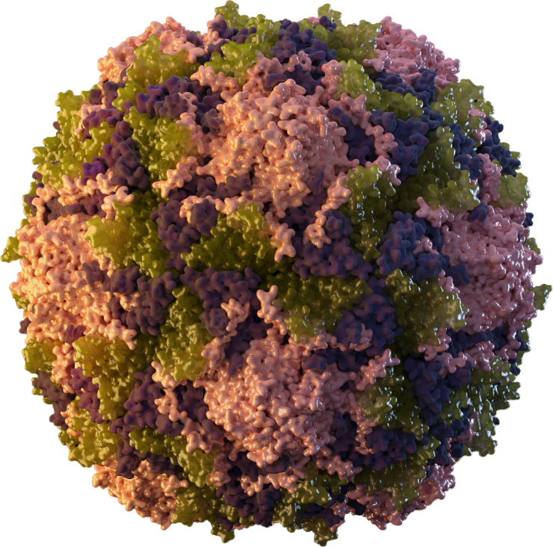
Poliovirus and Polio Vaccination
Sarah Kidd, MD, MPH
HRSA ACCV Meeting
July 12, 2024

Slide 2

Poliovirus
RNA genome enclosed in capsid
Slight differences in capsid → three poliovirus serotypes: type 1, type 2, and type 3
Immunity to one serotype does not result in significant immunity to other serotypes
Nathanson N, Kew OM. Am J Epidemiol 2010;172:1213–29.

Slide 3
Poliovirus is highly infectious
Person-to-person spread of poliovirus occurs via the fecal-oral or oral-oral routes
Fecal-oral is the most important transmission pathway in settings with suboptimal hygiene and sanitation
Patients are most infectious during days immediately before and after onset of symptoms, but virus may remain present in stool for up to 6 weeks, sometimes longer
Individuals with minor symptoms or no illness can shed virus

Slide 4
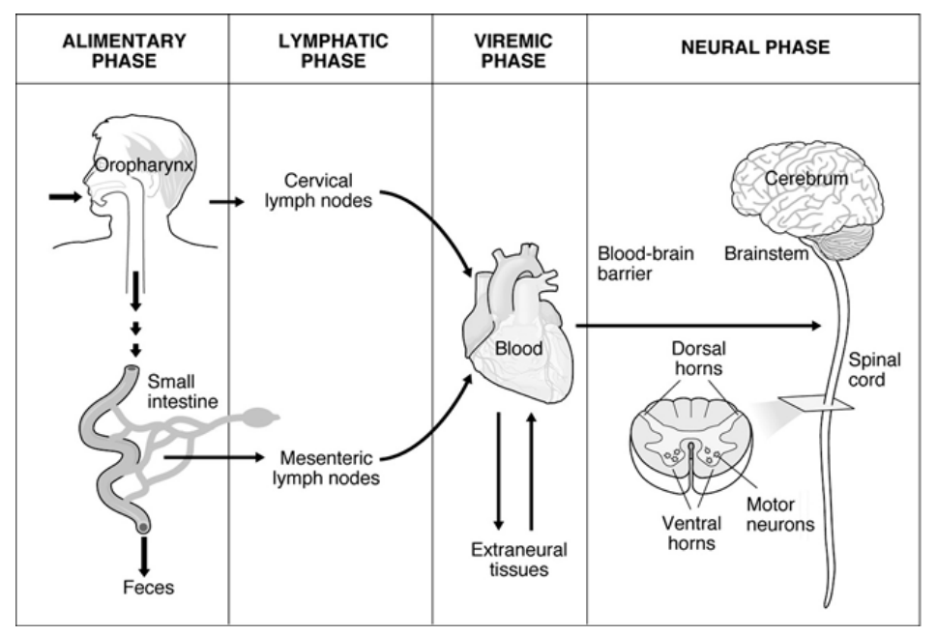
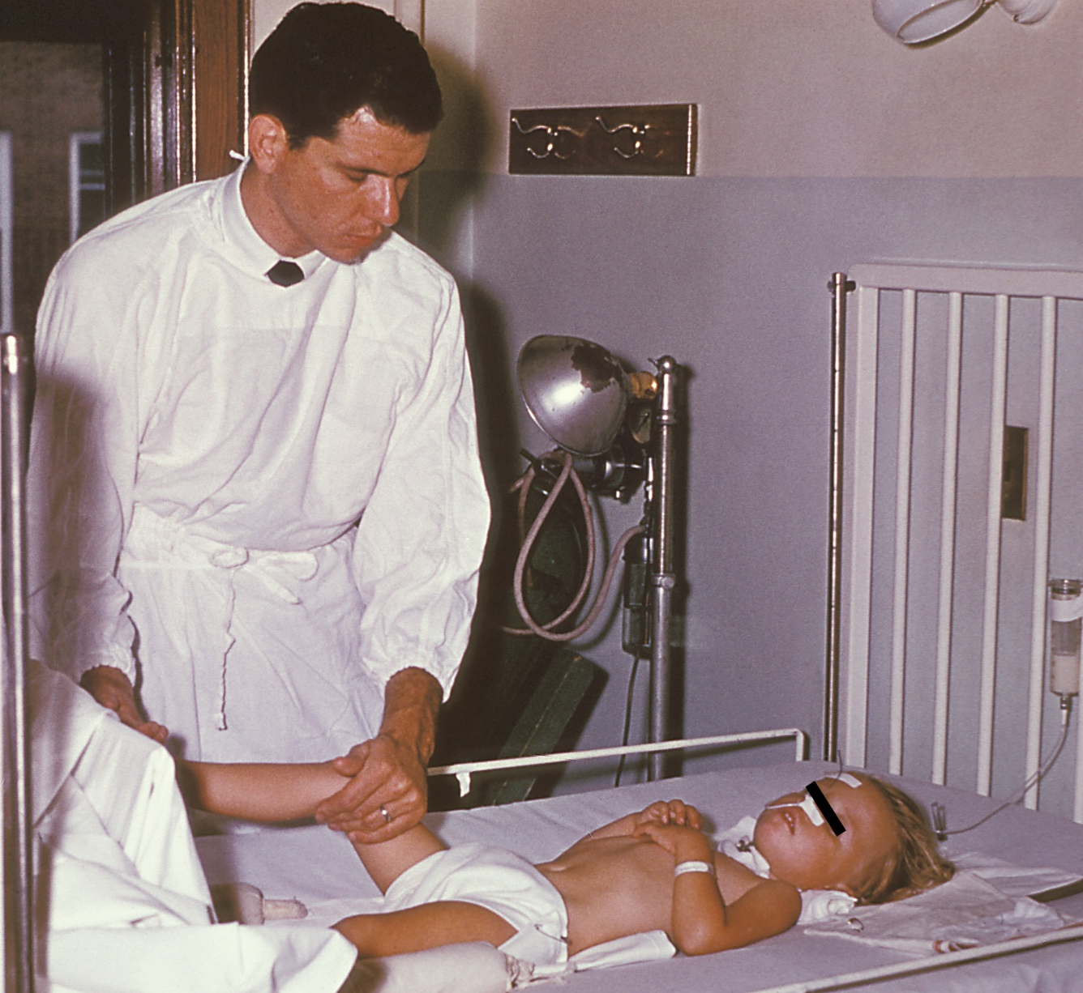
Poliovirus infection can cause poliomyelitis and lifelong paralysis
Blondel et al. Poliovirus, Pathogenesis of Poliomyelitis, and Apoptosis. In: Current Topics in Microbiology and Immunology 289:25-56 DOI:10.1007/3-540-27320-4_2
Notes:
The virus enters through the mouth and multiplies in the oropharynx and gastrointestinal tract. The virus is usually present in nasopharyngeal secretions for 1 to 2 weeks and can be shed in stools for several weeks after infection, even in individuals with minor symptoms or no illness.
During intestinal replication, the virus invades local lymphoid tissue and may enter the bloodstream, and then infect cells of the central nervous system. Poliovirus-induced destruction of motor neurons of the anterior horn of the spinal cord and brain stem cells results in distinctive paralysis.

Slide 5
Paralytic disease occurs in <1% of infections
Paralytic polio (<1%, varies by serotype)
1 paralytic case indicates an outbreak
Clinical illness, no paralysis ( ̴25%)
Asymptomatic infection ( ̴75%)
Infected persons

Slide 6

Inactivated Polio Vaccine (IPV)
Only polio vaccine used in the US
Contains inactivated polioviruses types 1, 2, and 3 polioviruses
Cannot replicate, infect, or cause polio
Induces effective humoral immunity → prevents paralysis
≥95% seroprotection after 3 doses
Induces some nasopharyngeal mucosal immunity, but limited intestinal immunity

Slide 7


Oral Polio Vaccine (OPV)
Live attenuated vaccine (Sabin)
Trivalent OPV (tOPV): contains types 1, 2, and 3
Bivalent OPV (bOPV): contains types 1 and 3
Monovalent OPV (mOPV#): contains single type (#=1, 2, or 3)
Replicates in gut, is shed in stool
Induces humoral and mucosal immunity
Prevents paralysis and transmission of poliovirus
Historical vaccine of choice for countries with outbreaks
Attenuated virus can revert to a neurovirulent form that causes paralysis
1
2
3

Slide 8
Paralytic polio decreased rapidly in the US after introduction of polio vaccine
1955: Salk IPV
1979: Last indigenous
wild-type case in US
Number of poliomyelitis cases
1997: Sequential enhanced-potency
IPV followed by OPV
1961: Sabin OPV
2000: IPV only
Year

Slide 9
Milestones in Global Polio Eradication
1988:
Global Polio Eradication Initiative (GPEI) established
Present:
Only 2 countries with endemic wild poliovirus 1; numerous vaccine-derived poliovirus outbreaks
2016:
Sabin Type 2 virus withdrawn from OPV
2015:
Wild poliovirus 2 eradicated
2019:
Wild poliovirus 3 eradicated

Slide 10
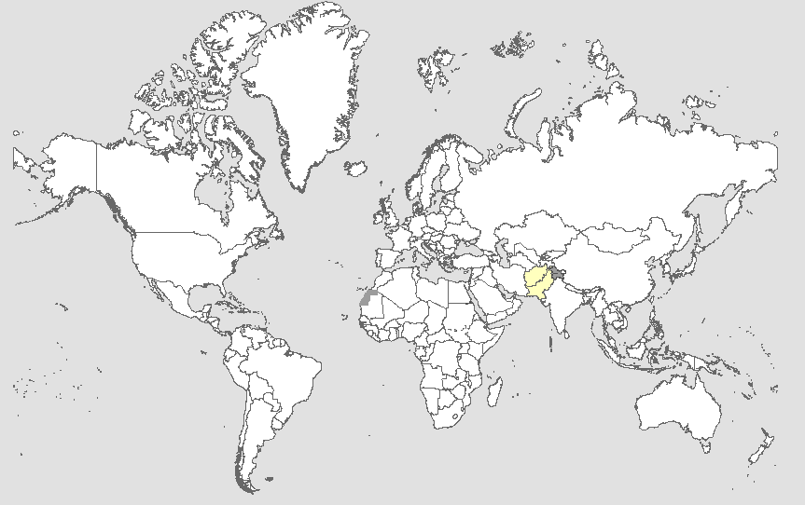
Global Paralytic WPV1 and cVDPV Cases¹, Previous 12 Months²
Endemic country (WPV1)
https://polioeradication.org/polio-today/polio-now/
¹Excludes viruses detected from environmental surveillance; ²Onset of paralysis: 26 Jun. 2023 to 25 Jun. 2024
Data in WHO HQ as of 25 Jun. 2024

Slide 11
Paralytic Polio Case in New York State, July 2022 Case Presentation
Unimmunized, immunocompetent young adult living in Rockland County
Developed fever, neck stiffness, back pain, abdominal pain, constipation
3 days later developed lower extremity weakness
2 days after weakness began, presented to an ED and admitted to the hospital with flaccid weakness
As part of the differential diagnosis, worked up for Acute Flaccid Myelitis (AFM)

Slide 12
Paralytic Polio Case in New York State, July 2022 Diagnostic Evaluation
MRI showed longitudinally extensive lesions in spinal cord gray matter, spanning multiple vertebral segments
Stool specimens positive by enterovirus PCR (other specimens negative)
Subsequent sequencing identified vaccine-derived poliovirus, type 2 (VDPV2)
Confirmed by CDC polio laboratory
10 nucleotide changes in region encoding viral capsid protein (VP1) compared to Sabin 2 strain
Genetically linked to polioviruses collected in wastewater in Israel, United Kingdom, and Canada

Slide 13
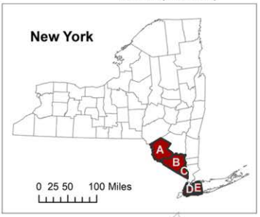
Wastewater Testing for Poliovirus in New York
Poliovirus type 2 genetically linked to the case detected in wastewater samples in New York (Rockland, Orange, Sullivan, and Nassau counties and New York City) during summer 2022
Retrospective testing detected poliovirus as early as April 2022
Transmission in multiple locations the NY metropolitan region, persisting over months → circulating VDPV2 (cVDPV2)
https://www.health.ny.gov/diseases/communicable/polio/docs/waste_water_surveillance_report.pdf

Slide 14
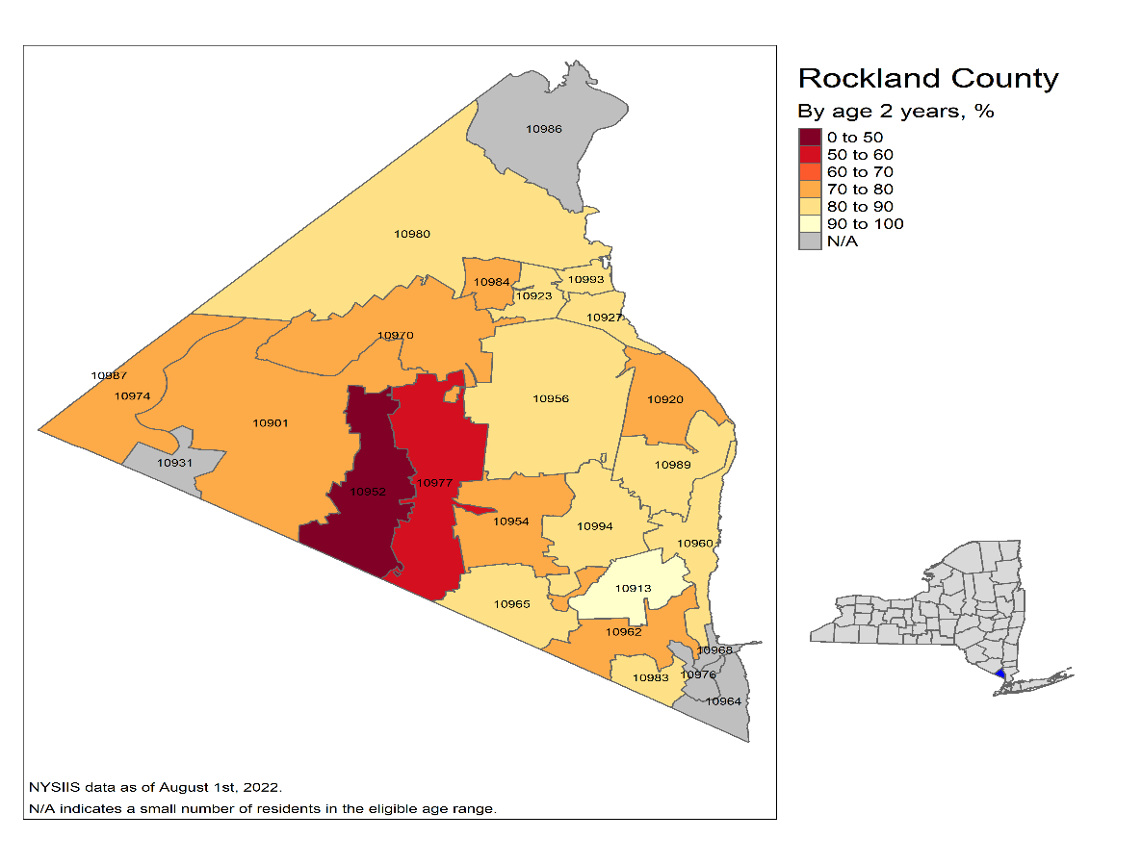
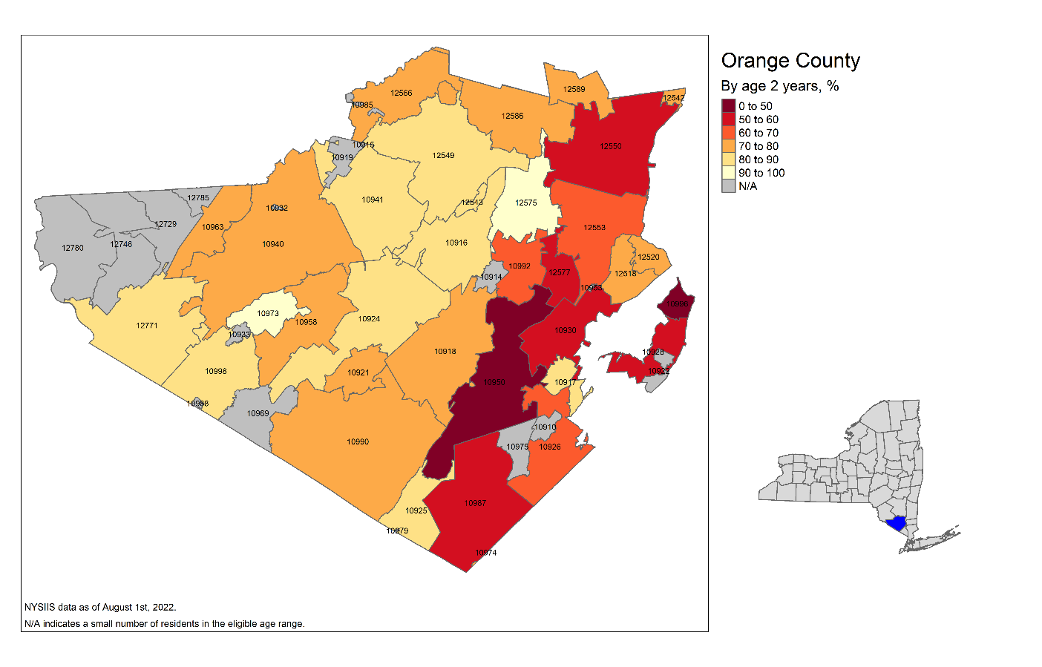
3-Dose Polio Vaccination Coverage Among Children Aged 2 Years Rockland and Orange Counties, Summer 2022
Rockland County
Orange County
As of August 1, 2022, Rockland and Orange counties had several zip code areas with ≤70% 3-dose polio vaccination coverage among children aged 2 years
Source: NYSIIS data provided by NYSDOH

Slide 15
Outbreak Response and Outcomes
Community and partner outreach and advisories
Enhanced surveillance for persons with acute flaccid paralysis
Wastewater surveillance
Catch-up vaccination with IPV
Temporary vaccination clinics
Discussions with community leaders and organizations about vaccination
Collaborations with clinicians to identify undervaccinated children in their practice and recall for vaccination
Last poliovirus detection in wastewater was February 2023
No additional paralytic cases identified (total = 1)

Slide 16
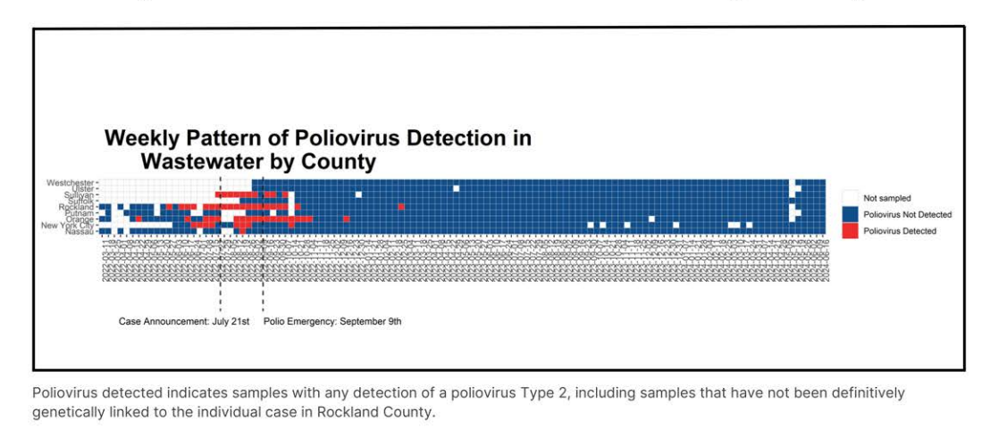

Wastewater testing for poliovirus is ongoing in New York
https://www.health.ny.gov/diseases/communicable/polio/docs/waste_water_surveillance_report.pdf

Slide 17
US Polio Vaccination Recommendations

Slide 18
ACIP Polio Immunization Recommendations Routine Childhood Schedule
IPV Dose | Routinely Recommended Age
1 | 2 months
2 | 4 months
3 | 6–18 months
4 | 4–6 years
For catch-up vaccination, 4th dose not needed if 3rd dose given on or after 4th birthday and ≥6 months after 2nd dose.

Slide 19
ACIP Polio Immunization Recommendations for Undervaccinated Adults
Before June 2023:
Routine vaccination of undervaccinated adults not recommended.
Catch-up vaccination only recommended if at increased risk of poliovirus exposure.
New (current) recommendations, as of June 2023:
Adults who are known or suspected to be undervaccinated should complete a 3-dose polio vaccination series with IPV.
Note: Adults born and raised in US can assume they received polio vaccination as children unless there are specific reasons to believe otherwise.

Slide 20
ACIP Polio Immunization Recommendations for Adult Booster Doses
Adults who are at increased risk for exposure to poliovirus may receive a single lifetime booster dose of IPV
Travelers to countries where polio is epidemic or endemic
Laboratory and health care workers who handle specimens that might contain polioviruses
Health care workers or other caregivers who have close contact with patients in a community with a polio outbreak
Other adults who are identified by public health authorities as being part of a group or population at increased risk for exposure to poliovirus because of an outbreak

Slide 21
Polio-Containing Vaccine Products
Vaccine name | Vaccine components | Age indication | Dose in polio series | Injection route
Ipol (SP) | IPV | 6 weeks and older, any dose in the series | Any | IM or SC
Pentacel (SP) | DTaP-IPV/Hib | 6–4 yrs | 1, 2, 3, 4 | IM
Vaxelis (Merck) | Dtap-IPV-Hib-HepB | 6 wks–4 years | 1, 2, 3 | IM
Pediarix (GSK) | DTaP-HepB-IPV | 6 wks–6 yrs | 1, 2, 3 | IM
Kinrix (GSK), | DTaP-IPV | 4–6 yrs | 4 | IM
Quadracel (SP) | DTaP-IPV | 4–6 yrs | 4, 5 | IM
IM = Intramuscular; SC = Subcutaneous; All vaccines in the table above are non-live

Slide 22
IPV Safety continued
Contraindications
Severe allergic reaction (e.g., anaphylaxis) after a previous dose or to a vaccine component
Precautions
Pregnancy
Moderate or severe acute illness with or without fever
IPV Adverse Reactions
Local reactions (pain, redness, swelling) - 3-18%
Severe reactions - rare
Notes:
NOTES
Contraindications
Severe allergic reaction, such as anaphylaxis, to a vaccine component, or following a prior dose of vaccine, is a contraindication to further doses of that vaccine.
Since IPV contains trace amounts of streptomycin, neomycin, and polymyxin B, there is a possibility of allergic reactions in persons sensitive to these antibiotics. Persons with allergies that are not anaphylactic, such as skin contact sensitivity, may be vaccinated.
Precautions
Pregnancy is a precaution to IPV vaccination. Although no adverse effects of IPV vaccine have been documented among pregnant women or their fetuses, vaccination of pregnant women should be avoided on theoretical grounds. However, if a pregnant woman is at increased risk for infection and requires immediate protection against polio, IPV vaccine can be administered in accordance with the recommended schedule for adults.
Persons with a moderate or severe acute illness normally should not be vaccinated until their symptoms have improved.
IPV Adverse Reactions
In pre-licensure trials, minor local reactions such as pain and redness, most commonly occur following IPV.
Severe reactions are rare.

Slide 23
Topics in Global Polio Vaccination: Novel Type 2 OPV (nOPV2) Fractional Dose IPV (fIPV)

Slide 24
Background: Global OPV Switch in 2016
Wild poliovirus type 2 eradicated in 2015
Global switch and withdrawal of Sabin type 2 virus from OPV in April 2016:
Replaced all trivalent OPV (tOPV; types 1, 2, and 3) with bivalent OPV (bOPV; types 1 and 3)
≥1 dose IPV recommended as part of routine immunization in all countries using bOPV

Slide 25
Global Paralytic WPV1 and cVDPV Cases¹, Previous 12 Months²
Endemic country (WPV1)
https://polioeradication.org/polio-today/polio-now/
¹Excludes viruses detected from environmental surveillance; ²Onset of paralysis: 26 Jun. 2023 to 25 Jun. 2024
Data in WHO HQ as of 25 Jun. 2024

Slide 26
Novel Type 2 Oral Polio Vaccine (nOPV2)
Novel, next-generation version of monovalent type 2 oral polio vaccine (nOPV2)
Designed to be more genetically stable, less likely to revert to neurovirulent form
March 2021–December 2023:
Almost 1 billion doses administered in 35 countries under WHO Emergency Use Listing (EUL) approval
December 2023: Earned WHO prequalification
Preferred tool to stop type 2 poliovirus outbreaks in countries that still use OPV in routine childhood vaccination

Slide 27
Reduced Risk of Vaccine-Associated Paralytic Polio (VAPP) Following nOPV2 Compared to Sabin OPV2
nOPV2 more genetically stable than Sabin OPV2, less likely to regain neurovirulence
Risk of VAPP in recipients
nOPV2: estimated 0.07 cases per million recipients (1 per 14.3M recipients)
Sabin OPV: 0.25–4 cases per million recipients (1 per 0.25M–4M recipients)
Risk highest in unimmunized children receiving 1st dose of OPV or in immunocompromised persons
Bandyopadhyay and Zipursky. Lancet ID 2023;23:e67–71.

Slide 28
Risk of Introducing a New Circulating Vaccine-Derived Poliovirus (cVDPV) Following nOPV2
>700 million nOPV2 doses administered worldwide in 32 countries since March 2021
At least 7 separate emergences of new cVDPV2 linked to nOPV2 (cVPDV2-n)
At least 61 detected paralytic cases associated with cVDPV2-n
Estimates: nOPV2 is 80% less likely than mOPV2 to seed new cVDPV2
Risk of new cVDPV is highest when campaign coverage is low in a population with low immunity against polioviruses
Davlantes et al. MMWR 2023;72(38):1041–1042.
https://polioeradication.org/wp-content/uploads/2024/01/GPEI-nOPV2-Factsheet-20240105.pdf

Slide 29
Fractional Dose IPV (fIPV)
2 fractional doses of IPV (1/5 full dose IPV) given intradermally in place of single full IPV intramuscular dose
2 fIPV doses associated with higher rates of seroconversion vs. single full IPV dose
WHO supports the use of 2 fIPV doses in place of 1 IPV dose as an IPV conservation strategy
Currently used in 6 countries (~20% of global birth cohort)
Bangladesh, Cuba, Ecuador, India, Nepal, Sri Lanka
All use 2 fIPV doses + ≥3 bOPV doses in routine childhood immunization schedule

Slide 30
CDC Guidance on Polio Vaccination Doses Administered Outside the US
Only trivalent OPV (tOPV) and IPV doses count towards the US polio vaccination schedule
Bivalent OPV (bOPV) doses do not protect against type 2 poliovirus and should not be counted
OPV doses administered after the global switch on April 1, 2016 should be assumed to be bOPV
2 fractional doses of IPV (fIPV) should be considered valid and counted as 1 full intramuscular dose of IPV towards the US vaccination schedule.
If a person received only 1 dose of fIPV, this dose should not be considered valid or counted towards the US vaccination schedule

Slide 31
Thank you
CDC recommends that children get four doses of polio vaccine (IPV). They should get one dose at each of the following ages:
2 months
4 months
6 through 18 months
4 through 6 years
Questions?

