Slide 1
Tips for Implementing Your Health Center Quality Improvement Program
Bureau of Primary Health Care
Health Resources and Services Administration
Department of Health and Human Services
March 31, 2011

Slide 2
Introduction
Quality is a focus area nationally and at HRSA
Assessment of QI plans showed areas for improvement
Invest in your QI infrastructure
  Clinical quality and beyond
Focus on implementation
  This work never ends

Slide 3
Benefits of an Effective QI Plan
Roadmap for HC organization
  Leadership, focus, & prioritization
  Efficient coordination of staff & resources
  Better outcomes
Satisfy external requirements
  HRSA, State
  Third-party quality accreditation and recognition

Slide 4
How Can HRSA Help?
Support for planning and implementation of Quality Improvement strategies
  QI Plan Learning Series
  Further guidance
  Resources and technical assistance
  Third-party quality recognition
How else can we help you with your QI plan and other quality efforts?

Slide 5
Office of Quality & Data Activities
Federal Tort Claims Act deeming
  Health centers and free clinics
  ECRI resources
Data collection and analysis
  UDS, patient survey, EHB
Health Information Technology
  Adoption, meaningful use, health info exchange
Quality
  Third party quality recognition
  Aligning technical assistance for PCMH transformation
  CMS

Slide 6
Accreditation
Effort to gain 3rd party recognition by TJC/AAAHC to ensure quality in the HCs
In January 2011, 291 centers (25.7%) were accredited

Slide 7
PCMH
The Bureau is committed to harnessing the known benefits of the patient centered medical home
Currently, two major PCMH activities are being conducted:
  Patient Centered Medical Health Home Initiative or PCMHHI (HRSA)
  Advanced Primary Care Practice Medicare demo in FQHCs (CMS)

Slide 8
PCMHHI
351 NOIs, 341 are 1st time (through 2/17/11)
NCQA has 1st 100, preparing to enter into survey recognition process
Single application for grantee for single or multiple sites within organization
NCQA to provide T.A. to guide through survey process
5 percent on-site follow up

Slide 9
Medicare Demo:
Advanced Primary Care Practice
Run from CMS with HRSA support
Rolling application for up to 500 HCs, having seen >200 unique Medicare beneficiaries in past 12 months
Will be required to achieve NCQA level III in 3 years

Slide 10
Technical Assistance
To promote transformation, HRSA is working with CMS on a T.A. strategy
Readiness assessment and gap analysis critical first step
T.A. could include practice coaching, peer to peer learning, data/evaluation and knowledge management
PCAs and states will have high stake, be well situated to craft T.A. delivery for grantees

Slide 11
Using HIT and Data in Your QI Program
Different types of measures: clinical, patient experience, staff satisfaction, and financial domains
UDS, patient experience surveys, dental and oral health measures, and other data sources
Tips on useful EHB reports
Involving Health Information Exchange goals in your QI plan

Slide 12
Tips for Implementing
Your Quality Plan
HRSA Quality Series #3
Jan Wilkerson, RN, CPHQ, GAPHC

Slide 13

“Quality is never an accident;
It is always the result of high intention, sincere effort, intelligent direction, and
SKILLFUL EXECUTION.
It represents the wise choice of many alternatives.”
William A. Foster

Slide 14
Objectives
Participants will be able to:
Evaluate the FQHC’s current Quality Plan
Identify quality policies needed to develop and support the quality infrastructure
Determine the best skillful execution for your FQHC’s Quality Plan
Develop a formal process for quality communication including reporting and staff training

Slide 15
Quality Plan
Assessment

Slide 16
Assessment Criteria
HRSA→ FQHC program requirements http://bphc.hrsa.gov/about/requirements.htm
HRSA→ Scope of Project; defines the capacity of services provided by the FQHC http://bphc.hrsa.gov/policiesregulations/policies/index.html
HRSA→ KEY HEALTH CENTER PROGRAM REQUIREMENTS http://bphc.hrsa.gov/about/requirements.htm
FTCA requirements (42 CFR 51c.303(c)(1-2)
http://bphc.hrsa.gov/policiesregulations/policies/index.html
(Section 330(k)(3)(C) of the PHS Act, 45 CFR Part 74.25 (c)(2), (3) and 42 CFR Part 51c.303(c)(1-2))
The Health Care Quality Improvement Act of 1986, as amended 42 USC Sec. 11101 01/26/98
  STATE Georgia Code #3910 (GA. L. 1975)
Accreditation requirements

Slide 17
Other Considerations
Measures should include:
Required measures
Deficient goals/ benchmarks
New/ revised processes
Business Plan & Health Care Plan measures
High volume
High risk
Problem-prone
Satisfaction survey
The FQHC’s mission and Strategic Plan
Sub-committees and workgroups
Quality methodology
Quality Policies
HRSA GRANT→ Your Business Plan & Health Care Plan

Slide 18
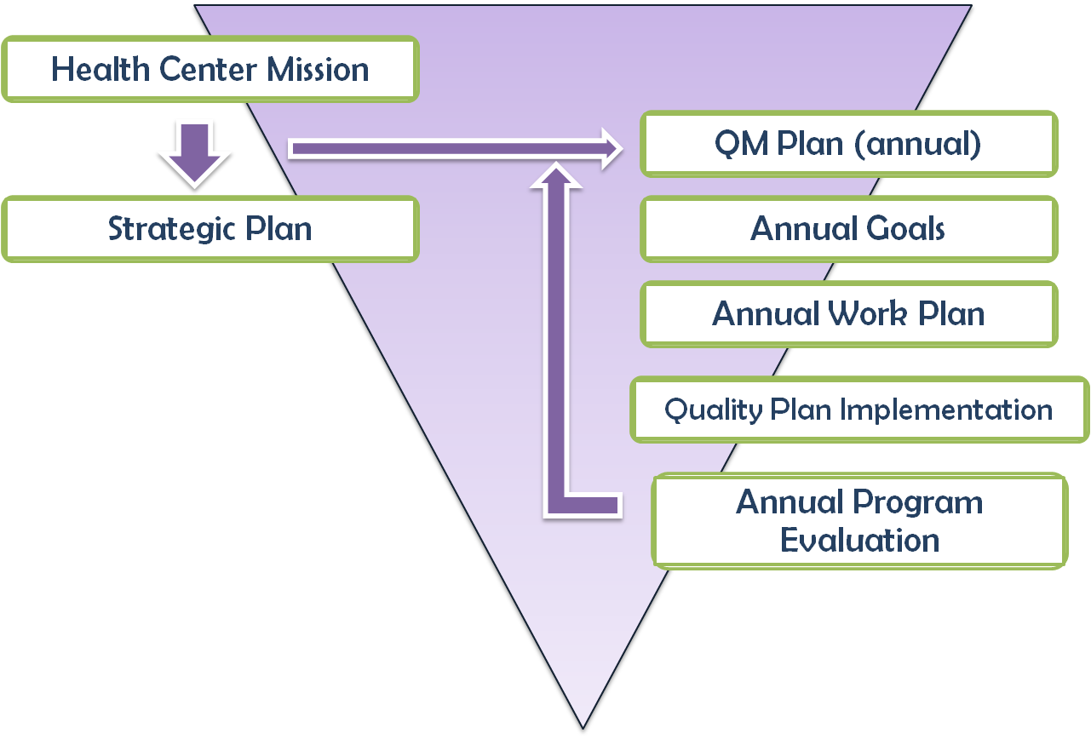
Quality Management Plan Design

Slide 19
Quality Management Plan Design – diagram description
This quality management plan design depicts a triangular background with the health center mission and strategic plan flowing into the annual quality management plan. An annual program evaluation consisting of annual goals, the annual work plan, and quality plan implementation also feeds into the annual quality management plan.

Slide 20

“…we're on our way We've only just begun …” The Carpenters

Slide 21
Planning for Success
Infrastructure

Slide 22
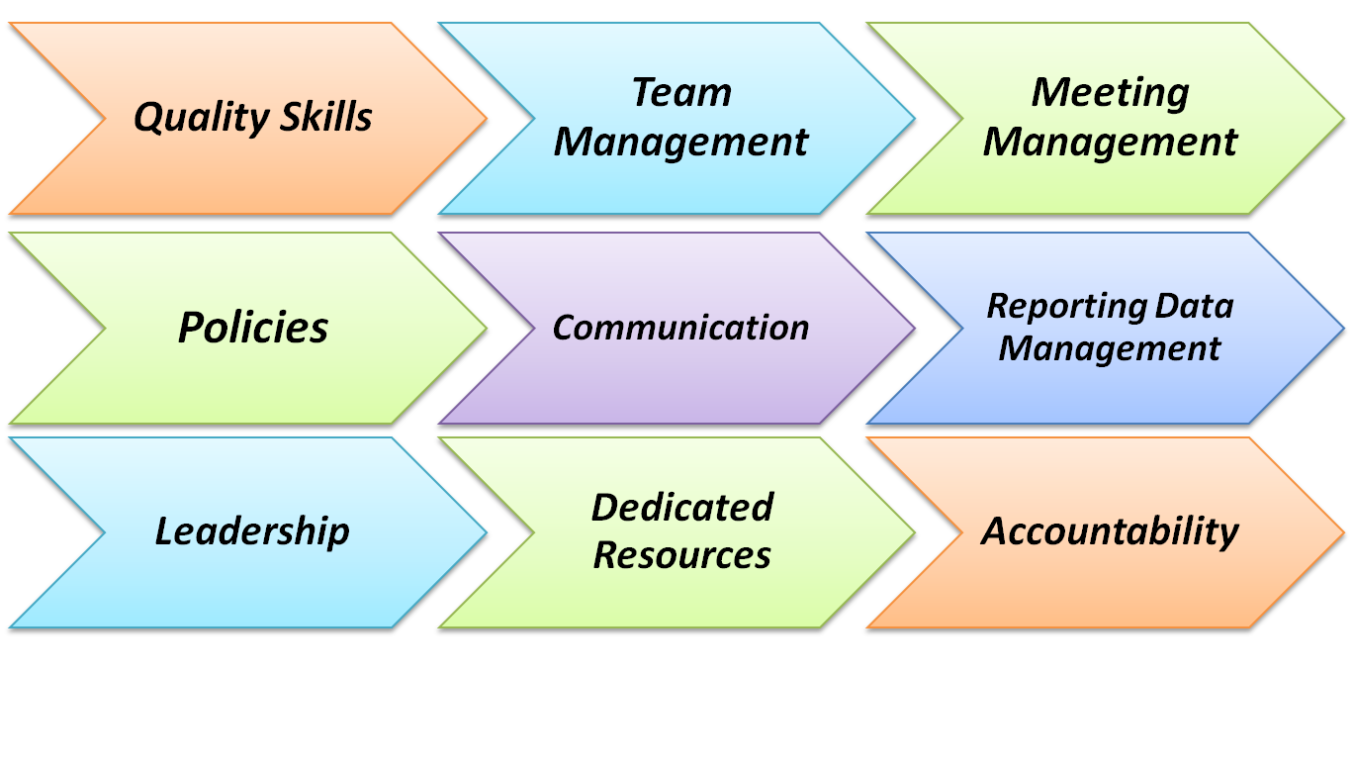
Quality Infrastructure

Slide 23
Quality Infrastructure – diagram description
This flowchart depicts three horizontal layers, each with three components flowing from left to right. The top row consists of, from left to right, quality skills, team management, and meeting management. The middle row consists of policies, communication, and reporting/data management. The bottom row consists of leadership, dedicated resources, and accountability.

Slide 24
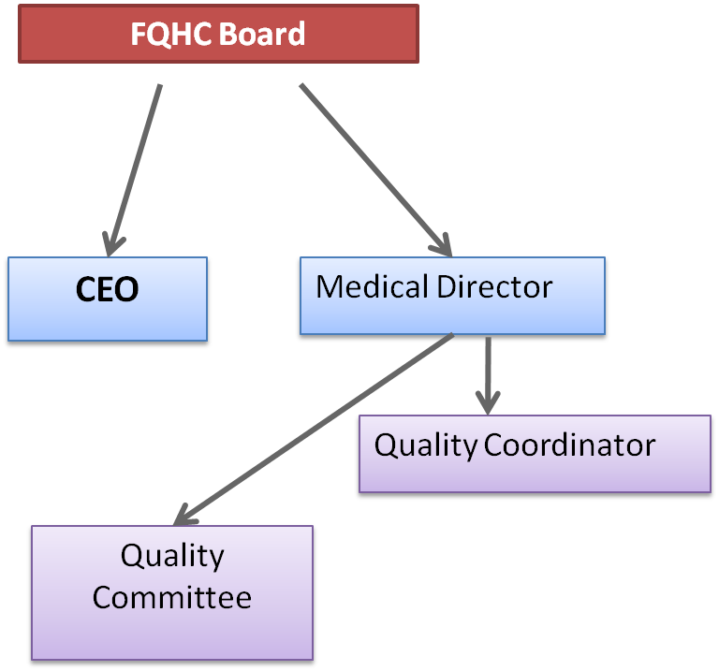
Quality Accountability & Authority
Responsibility for Quality begins with Board
Board authorizes CEO to provide resources to support quality program
Board assigns responsibility for quality program to Medical Director & Quality Committee
Day-to-day activities usually assigned to Quality Coordinator

Slide 25
Quality Function
      Ongoing [continuous]:
        monitoring,
        evaluation, and
        improving processes.
      It is a patient-driven philosophy and process that focuses on
      preventing problems and
      maximizing quality of care.

Slide 26
Quality Committee Members
Chair – Medical Director or Physician designee
QI Coordinator (facilitator)
Risk/ Compliance-Safety Coordinator
Medical Staff
Clinical Staff
Finance
Front Office
Medical Records
In-house Lab Staff
All departments / services represented
All sites represented

Slide 27
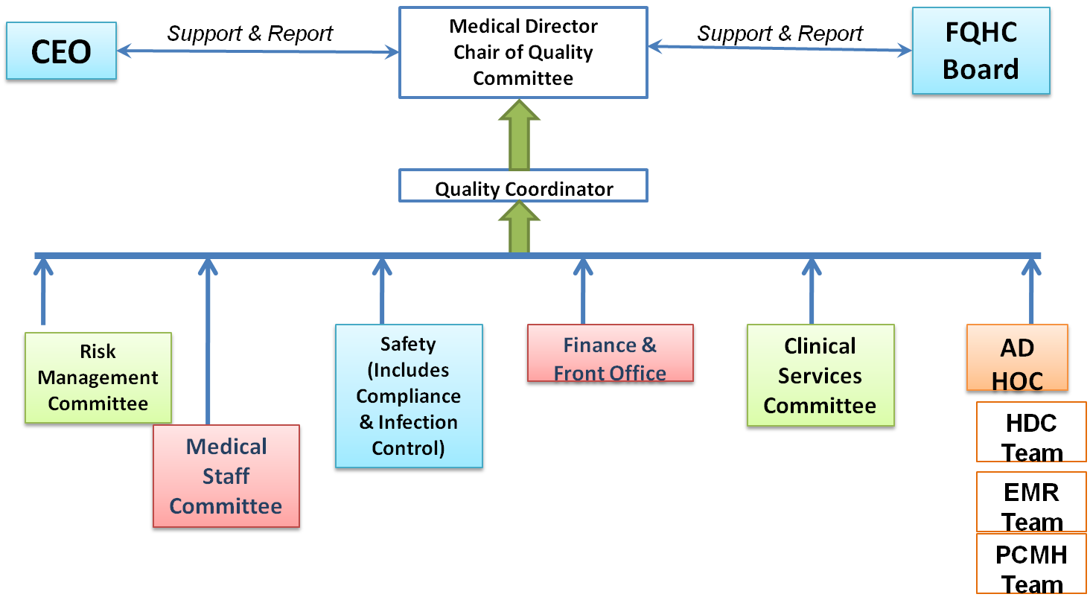
Quality Committee:
Sub-Committees/Workgroups

Slide 28
Quality Committee:
Sub-Committees/Workgroups
Hierarchy Diagram Description
Top Level: there is support/reporting responsibility between the Medical Director(Chair of the Quality Committee) and both the CEO and FQHC Board.
Middle Level: Quality Coordinator supports the Medical Director)
Bottom Level: Supporting the Quality Coordinator is the Risk Assessment Committee, the Medical Staff Committee, Safety (Including the compliance and infection control), Finance & Front Office, the Clinical Services Committee, and Ad Hoc (HDC team, EMR team, PCMH team)

Slide 29
Quality Committee:
Sub-Committees/ Workgroups
⇨ Medical Staff Committee – privileging, peer review
Safety
Compliance
Infection Control
⇨ Risk Management
Utilization Management
⇨Finance (Business Plan)
⇨Work groups – HDC Teams or other Quality Initiatives
EMR Work group
Clinical Work group
Ad Hoc work groups
⇨ Indicates necessary regardless of FQHC size

Slide 30
Quality Committee
Role & Responsibility

Slide 31
Expectations of the Quality Committee
      Prioritizing current quality initiatives and activities
      Quality assessment and planning and annual program evaluation
      Subcommittee and team chartering, with accountability & reporting followed up by the QC
      The ongoing monitoring, evaluation, and improvement of processes and system.
      With a patient-driven philosophy and process that focuses on preventing problems and maximizing quality of care.

Slide 32
Key Aspects & Functions of
Quality Management
Policies & Procedures
Medical Record
Clinical Protocols
Tracking Systems
Trend identification that impact systems and processes
Quality Planning
Credentialing
Peer Review
Privileging
Compliance
Safety
Risk Management

Slide 33
Overlapping Functions
Quality Improvement
Quality Measures
Benchmarking
Best Practice/ Clinical Guidelines
Provider Performance & Competency
Accreditation Coordination
Patient Satisfaction
Improvement Projects
Risk Management
Risk Identification
Risk Control
Claims Management
Patient Relations & Disclosure
Safety
Compliance
Mandatory Event Reporting
Worker’s Compensation
Overlapping Functions
Root Cause Analysis
Peer Review
Staff Training
Provider Credentialing
Feedback to Staff & Providers
Board Reports
Patient Safety Initiatives
Patient Complaints
Risk Assessment
Trend Analysis
Adapted from ECRI Institute

Slide 34
Overlapping Functions – diagram description
Left Oval “ Risk Management”
  Risk Identification
  Risk Control
  Claims Management
  Patient Relations & Disclosure
  Safety
  Compliance
  Mandatory Event Reporting
  Worker’s Compensation
Right Oval “Quality Improvement”
  Quality Measures
  Benchmarking
  Best Practice/ Clinical Guidelines
  Provider Performance & Competency
  Accreditation Coordination
  Patient Satisfaction
  Improvement Projects
Center Square/Overlap
Overlapping Functions
Root Cause Analysis
Peer Review
Staff Training
Provider Credentialing
Feedback to Staff & Providers
Board Reports
Patient Safety Initiatives
Patient Complaints
Risk Assessment
Trend Analysis

Slide 35
Skills for Quality Teams
Confidential nature of quality improvement
Understanding of the Quality Plan and policies to support the quality program
Know their role and responsibilities as a team member and as a leader/ cheerleader of quality
Engaged as process “owners” for the organization…not just my corner of it
PDSA methodology & Care Model understanding
Understanding data and measurement
Knowledge of process improvement
Basic toolkit – graphs, auditing, required measures

Slide 36
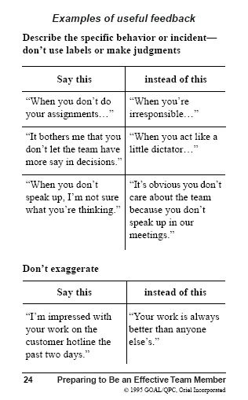
Team Skills
Team ground rules
Patient focus – NOT personal focus
Working together to improve the processes of the organization
Communicating in an effective manner
Willingness to learn and grow

Slide 37
Examples of Useful Feedback Picture Description
Describe the specific behavior or incident- don’t use labels or make judgments:
Say “When you don’t o your assignments…” instead of “When you’re irresponsible…”
Say “It bothers me that you don’t let the team have more say in decisions” instead of “When you act like a little dictator…”
Say “When you don’t speak up, I’m not sure what you’re thinking” instead of “It’s obvious you don’t care about the team because you don’t speak up in our meetings.”
Don’t exaggerate
Say “I’m impressed with you work on the customer hotline the past two days” instead of “Your work is always better than anyone else’s.”
From Preparing to Be an Effective Team Member, © 1995 GOAL/QPC, Oriel Incorporated

Slide 38
Meeting Skills
Agendas
Minutes (no PHI – ever)
Staying on point
Start and end on time – regardless of who is/isn’t there
100-mile rule (no interruptions/ cell phones)
Accountability from the group for assigned tasks
Templates and examples available upon request and in GAPHC Quality Manuals- http://www.gaphc.org

Slide 39
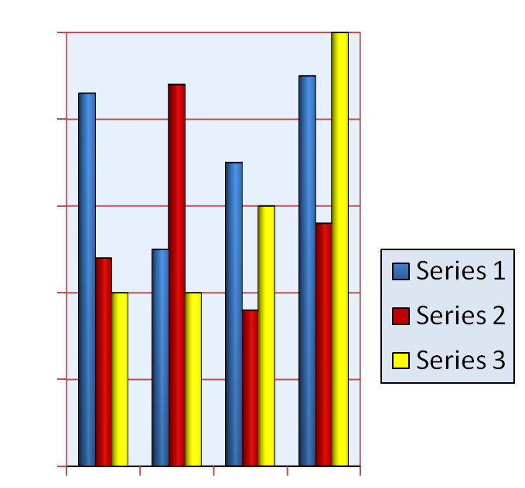

Quality Methodology
Data Management & Analysis

Slide 40
Brainstorming

Slide 41
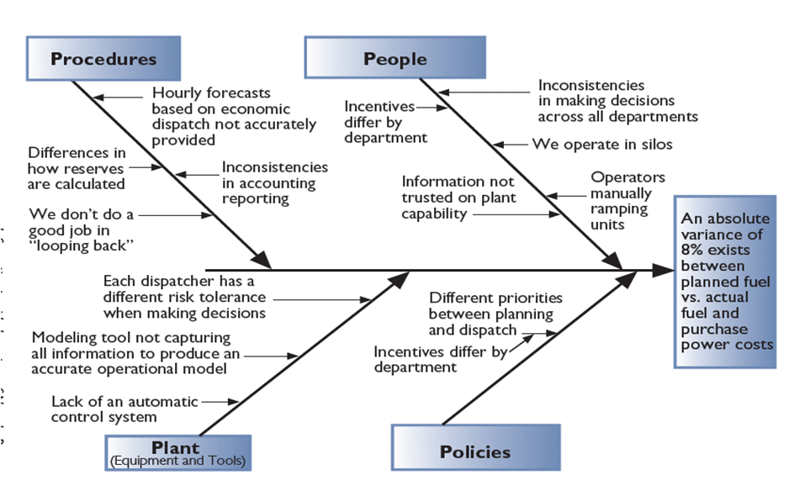
Cause & Effect/Fishbone
Variance to Plan
From GOAL/ QPC Memory Joggers

Slide 42
Fishbone Diagram/Cause and Effect Schematic – diagram description
The issue being examined in this example is “an absolute variance of 8% exists between planned fuel vs. actual fuel purchase power costs.” There are four main branches that feed into the overall process that leads to the outcome of interest, the variance between planned versus actual fuel purchase costs. At the top left, there are procedures of interest: hourly forecasts based on economic dispatch not accurately provided, inconsistencies in accounting reporting, differences in how reserves are calculated, and we don’t do a good job in ‘looping back.’ The next main branch at the top right is people, which includes inconsistencies in making decisions across all departments, we operate in silos, operators manually ramping units, information not trusted on plant capacity, and incentives differ by department. At the bottom, the branch called “plant” (equipment and tools) includes lack of an automatic control system, modeling tool not capturing all information to produce an accurate operational model, and each dispatcher has a different risk tolerance when making decisions. The last branch is policies, which includes incentives differ by department, which feeds into different priorities between planning and dispatch.

Slide 43
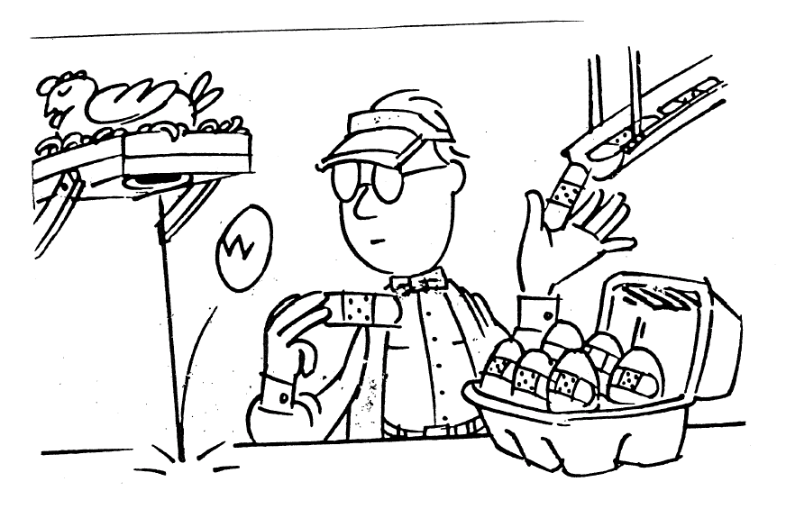
Improving Processes
From The Team Handbook

Slide 44
Benchmarking & Goals
National Benchmark
State Benchmark
http://www.hrsa.gov/data-statistics/health-center-data/StateData/index.html
FQHC previous year(s)
FQHC previous audits current year
Performance Goal
Pre-set Trigger?

Slide 45

Using and Managing Data
Reporting

Slide 46
Confidentiality
Protected & Privileged
The Health Care Quality Improvement Act of 1986, as amended 42 USC Sec. 11101 01/26/98. Note each state has legislation defining confidentiality and protection for individuals carrying out quality improvement activities
Specific requirements for maintaining confidentiality in the organization Signed Attestation = Policy
Excellent way to remind everyone of the importance of protecting Confidentiality
Some accreditation agencies require it
At minimum, Board, QI staff and Quality Committee members, place in HR file

Slide 47
Quality Infrastructure
Policies & Processes

Slide 48
Policy Templates available as part of GAPHC Quality Manuals http://www.gaphc.org
Policy Number | Policy Name | Summary | Regulatory or Standard Related to Policy | Rev. Date
QM-101 | QM Program | Describes the organization’s quality program to comply with organizational needs, regulatory requirements and accreditations. | HRSA, FTCA http://bphc.hrsa.gov/policiesregulations/policies/index.html
QM- 102 | Quality Committee | Describes the organization’s Quality Committee roles and responsibilities. | HRSA, FTCA http://bphc.hrsa.gov/policiesregulations/policies/index.html O.C.G.A. § 31-7-15 [Ga. Code #3910 (GA. L. 1975)]
QM-103 | Quality Minutes | Defines the content, format and storage of quality committees’ agenda and minutes, and QM staff responsibilities. | O.C.G.A. § 31-7-15 [Ga. Code #3910 (GA. L. 1975)]
QM-104 | Conflict of Interest | Defines conflict of interest for quality activities and provides an attestation sheet.
QM- 105 | Confidentiality | Defines confidentiality for quality activities and provides and confidentiality agreement. | O.C.G.A. § 31-7-15 [Ga. Code #3910 (GA. L. 1975)]
QM-106 | Chartering Sub-Committees | Defines the process for chartering sub-committees and ad hoc committees/ teams from the Quality Committee

Slide 49
Chart description
The headings of the columns are policy number, policy name, summary, regulatory or standard related to policy, and rev. date. The row labels are QM-101, QM-102, QM-103, QM-104, QM-105, and QM-106. The corresponding policy names for these categories, from beginning to end, are QM program, quality committee, quality minutes, conflict of interest, confidentiality, and chartering sub-committees. The corresponding summary comments in the summary column for these categories, from beginning to end, are describes the organization’s quality program to comply with organizational needs regulatory requirements and accreditations, describes the organization’s quality committee roles and responsibilities, defines the content format and storage of quality committee’s agenda and minutes and QM staff responsibilities, defines conflict of interest for quality activities and provides an attestation sheet, defines confidentiality for quality activities and provides and confidentiality agreement, and defines the process for chartering sub-committees and ad hoc committees/teams from the quality committee. The corresponding regulatory or standard related to policy for these categories, from beginning to end, are HRSA FTCA http://bphc.hrsa.gov/policiesregulations/policies/index.html, HRSA FTCA http://bphc.hrsa.gov/policiesregulations/policies/index.htmlO.C.G.A. § 31-7-15 [Ga. Code #3910 (GA. L. 1975)] , O.C.G.A. § 31-7-15 [Ga. Code #3910 (GA. L. 1975)] , blank cell, O.C.G.A. § 31-7-15 [Ga. Code #3910 (GA. L. 1975)] , and the bottom cell is blank. The revised date column is blank.

Slide 50
Policy Templates available as part of GAPHC Quality Manuals http://www.gaphc.org
Policy Number | Policy Name | Summary | Regulatory or Standard Related to Policy | Rev. Date
QM-107 | QM Plan (Program Description) | Defines the process, timeline, approvals of the Quality Plan and provides a template. | HRSA, BPHC & FTCA; BPHC PIN 98-23, PIN 2001-16, & PIN 2002-22; (42 CFR 51c.303(c)(1-2)
QM-108 | QM Program Workflow | Defines the workflow and approval process for the quality management program. | HRSA, BPHC & FTCA; BPHC PIN 98-23, PIN 2001-16, & PIN 2002-22; (42 CFR 51c.303(c)(1-2)
QM-109 | QM Work Plan Development | Defines the process, timeline, approvals of the Quality Work Plan and provides a template. | HRSA, BPHC & FTCA; BPHC PIN 98-23, PIN 2001-16, & PIN 2002-22; (42 CFR 51c.303(c)(1-2)
QM-110 | Quality Methodology | Defines and describes the method QM staff will use/ direct during all quality projects and programs.
QM-111 | System Improvement: Care Model | Provides the template and defines the components for developing these programs using a tested model. | http://www.ihi.org
QM-112 | QM Program Evaluation | Provides template, rationale for annual development, provides for annual review & required approvals
QM-113 | Policy Development, Review & Approval | Defines how policies will be developed, reviewed, revised and approved, with templates.

Slide 51
Chart Description
The headings of the columns are policy number, policy name, summary, regulatory or standard related to policy, and revised date. The row labels are QM-107, QM-108, QM-109, QM-110, QM-111, and QM-112. The corresponding policy names for these categories, from beginning to end, are QM plan (program description), QM program workflow, QM work plan development, quality methodology, system improvement care model, QM program evaluation, and policy development review and approval. The corresponding entries in the summary column for these categories, from beginning to end, are defines the process timeline approvals of the quality plan and provides a template, defines the workflow and approval process for the quality management program, defines the process timeline approvals of the quality work plan and provides a template, defines and describes the method QM staff with use/direct during all quality projects and programs, provides the template and defines the components for developing these programs using a tested model, provides template rationale for annual development provides for annual review and required approvals, and defines how policies will be developed reviewed revised and approved with templates. The corresponding regulatory or standard related to policy for these categories, from beginning to end, are HRSA BPHC & FTCA BPHC PIN 98-23 PIN 2001-16 & PIN 2002-22 (42 CFR 51c.303(c)(1-2), HRSA BPHC & FTCA BPHC PIN 98-23 PIN 2001-16 & PIN 2002-22 (42 CFR 51c.303(c)(1-2), HRSA BPHC & FTCA BPHC PIN 98-23 PIN 2001-16 & PIN 2002-22 (42 CFR 51c.303(c)(1-2), blank cell, http://www.ihi.org, and the bottom two cells are blank. The revised date column is blank.

Slide 52
Implementation
Skillful Execution

Slide 53
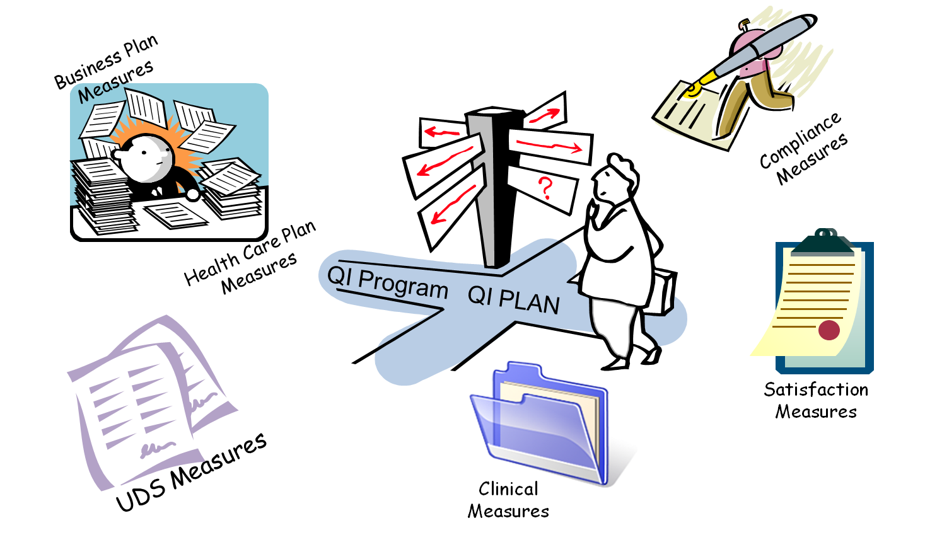
Closing The Measure Loop

Slide 54
Closing The Measure Loop – Diagram Description
This grouping of illustrations is titled ‘closing the measure loop.’ At the top left are business plan measures and a drawing of a man at a desk piled high with stacks of paper. At the bottom left are UDS measures with a drawing of two pieces of paper with writing on them. In the bottom center is a picture of a folder titled clinical measures. At the bottom right is a clipboard with a piece of paper on it called satisfaction measures. At the top left is a picture of a person holding an oversized pen and signing a piece of paper; it is called compliance measures. In the center is a person at a crossroads of QI program and QI plan considering which way to go.

Slide 55
Performance Measurement
This section defines the technique (process of HOW) the organization improves quality. In order to be effective, the process must be systematic with continuous activities that lead to measureable improvement. Included here is:
Indicates who will collect and analyze data
Indicates who is accountable for collecting, analyzing and reviewing performance data results and communicating findings
Includes strategies on how to report and disseminate results and findings; communicate information about quality improvement activities
Describe the process to use data to develop new QI activities and address identified gaps
This section will stimulate several Quality Policies to be developed to support this document.

Slide 56
Performance Measurement
Performance measurement is necessary to track progress towards the end goal of improvement.
Steps to measure performance:
  First, identify the critical aspects of the care and services provided
  Second determine care and services that are:
    High Risk
    High Volume
    Problem Prone
Identify indicators to measure these important aspects of care and service to determine organizational performance and identify areas for improvement

Slide 57
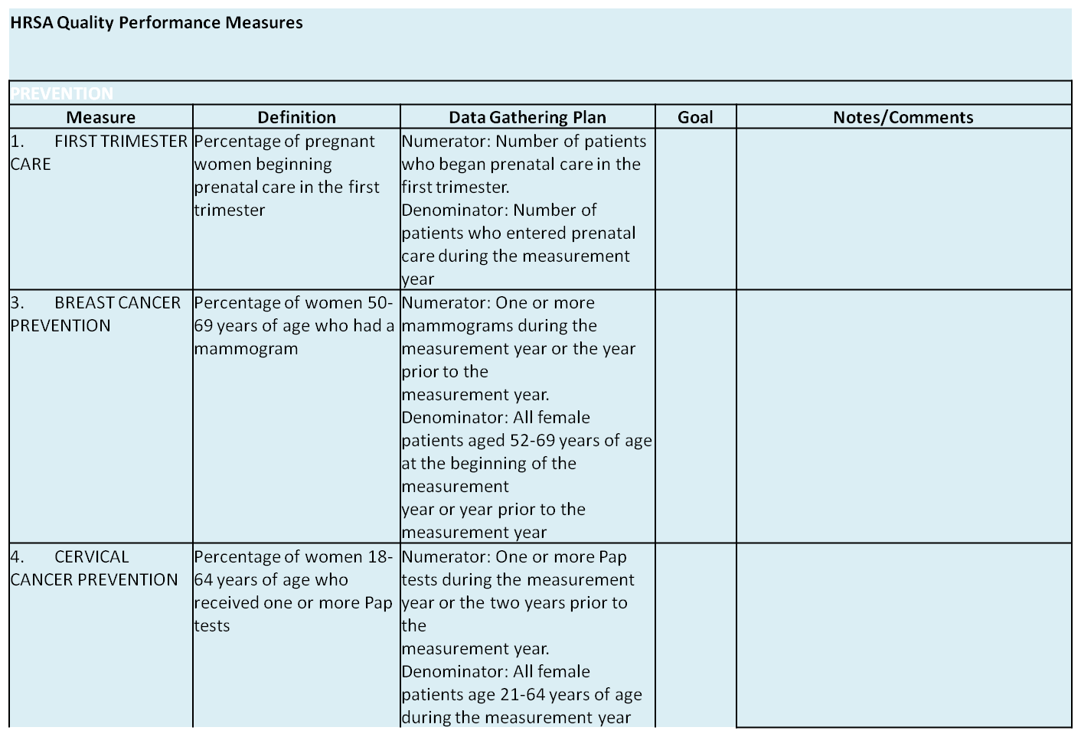
Quality Measures Workplan

Slide 58
Quality Measures Workplan – chart description
This slide is a quality measures workplan It lists HRSA quality performance measures: first trimester care, breast cancer prevention, and cervical cancer prevention in three rows. The columns are titled measure, definition, data gathering plan, goal and notes/comments. The last two columns are blank. The definitions of the measures, in order, are Percentage of pregnant women beginning prenatal care in the first trimester, Percentage of women 50-69 years of age who had a mammogram, and Percentage of women 18-64 years of age who received one or more Pap tests. The data gathering plans are Numerator Number of patients who began prenatal care in the first trimester Denominator Number of patients who entered prenatal care during the measurement year; Numerator One or more mammograms during the measurement year or the year prior to the measurement year Denominator All female patients aged 52-69 years of age at the beginning of the measurement year or year prior to the measurement year; and Numerator One or more Pap tests during the measurement year or the two years prior to the measurement year Denominator All female patients age 21-64 years of age during the measurement year.

Slide 59
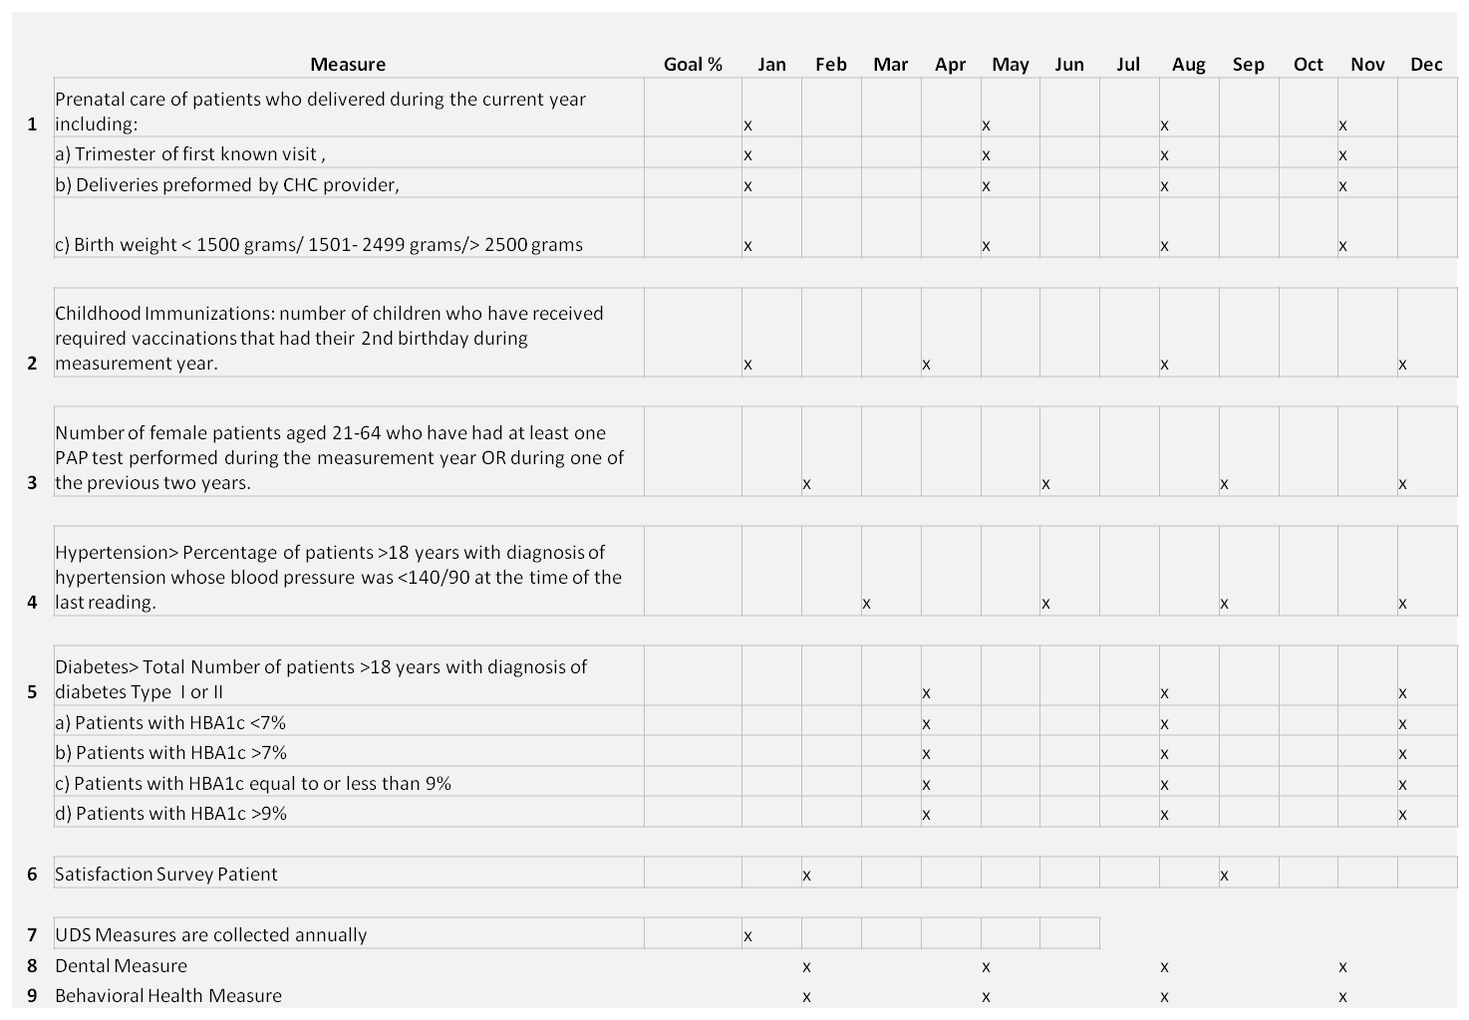
Quality Calendar

Slide 60
Quality Calendar – chart description
This slide depicts a chart that is a quality calendar. The columns are measure and goal percentage, followed by each month of the year in order. The measures are Prenatal care of patients who delivered during the current year including a) Trimester of first known visit, b) Deliveries preformed by CHC provider, and c) Birth weight < 1500 grams/ 1501- 2499 grams/> 2500 grams. Childhood Immunizations: number of children who have received required vaccinations that had their 2nd birthday during measurement year. Number of female patients aged 21-64 who have had at least one PAP test performed during the measurement year OR during one of the previous two years. Hypertension> Percentage of patients >18 years with diagnosis of hypertension whose blood pressure was <140/90 at the time of the last reading. Diabetes> Total Number of patients >18 years with diagnosis of diabetes Type I or II, a) Patients with HBA1c <7%, b) Patients with HBA1c >7%, c) Patients with HBA1c equal to or less than 9%, d) Patients with HBA1c >9%. Satisfaction Survey Patient, UDS Measures are collected annually, dental measure, and behavioral health measure. There are x marks placed in various months to indicate when each measure will be used.

Slide 61
Quality
Communication

Slide 62
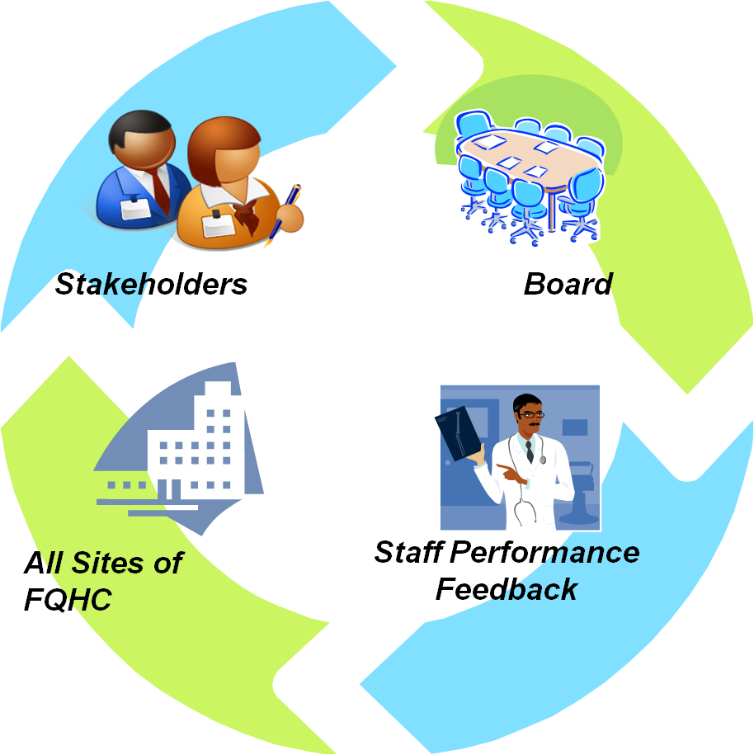
Quality Communication

Slide 63
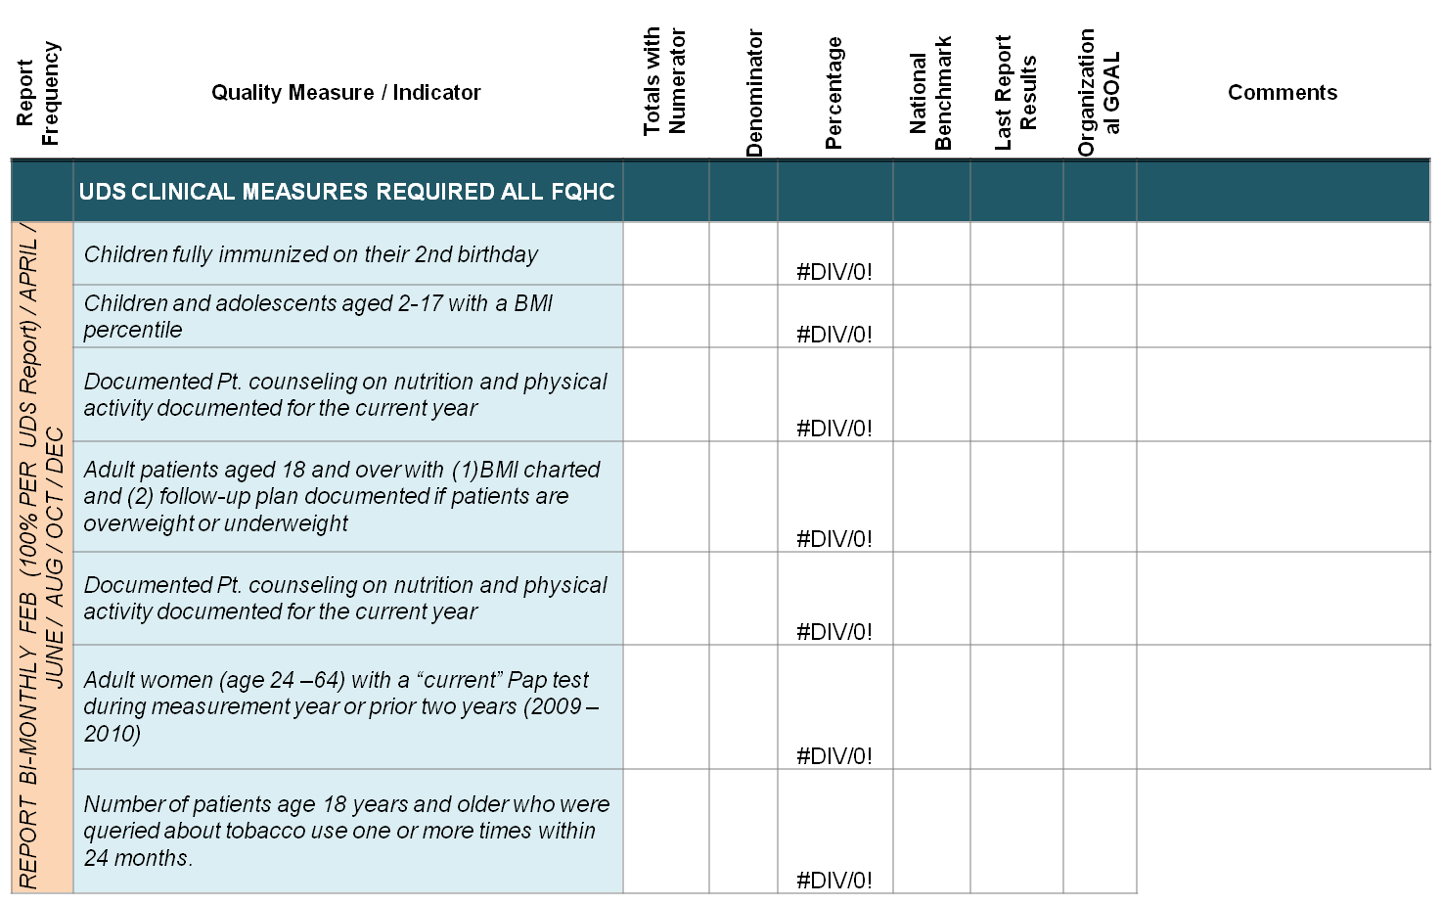
Quality Measure/Indicator Chart
Template available upon request jwilkerson@gaphc.org

Slide 64
Quality Measure/Indicator Chart -chart description
This slide depicts a chart to fill in for each quality measure/indicator. The UDS clinical measures required for all FQHC are the rows: Children fully immunized on their 2nd birthday, Children and adolescents aged 2-17 with a BMI percentile, Documented Pt. counseling on nutrition and physical activity documented for the current year, Adult patients aged 18 and over with (1)BMI charted and (2) follow-up plan documented if patients are overweight or underweight, Documented Pt. counseling on nutrition and physical activity documented for the current year, Adult women (age 24 –64) with a “current” Pap test during measurement year or prior two years (2009 –2010), Number of patients age 18 years and older who were queried about tobacco use one or more times within 24 months. The columns are totals with numerator, denominator, percentage, national benchmark, lab report, organizational goal, and comments. They are all blank except the percentage column, which is filled with #DIV/0!.

Slide 65
3rd Available Appointment

Slide 66
3rd Available Appointment - graph description
This slide is a line graph depicting the time until the third available appointment. The y axis is days and ranges from zero to 12. The x axis is months and ranges from zero to 6. The values for each month in sequence are: 10, 4, 9, 7, 4, and 3.

Slide 67
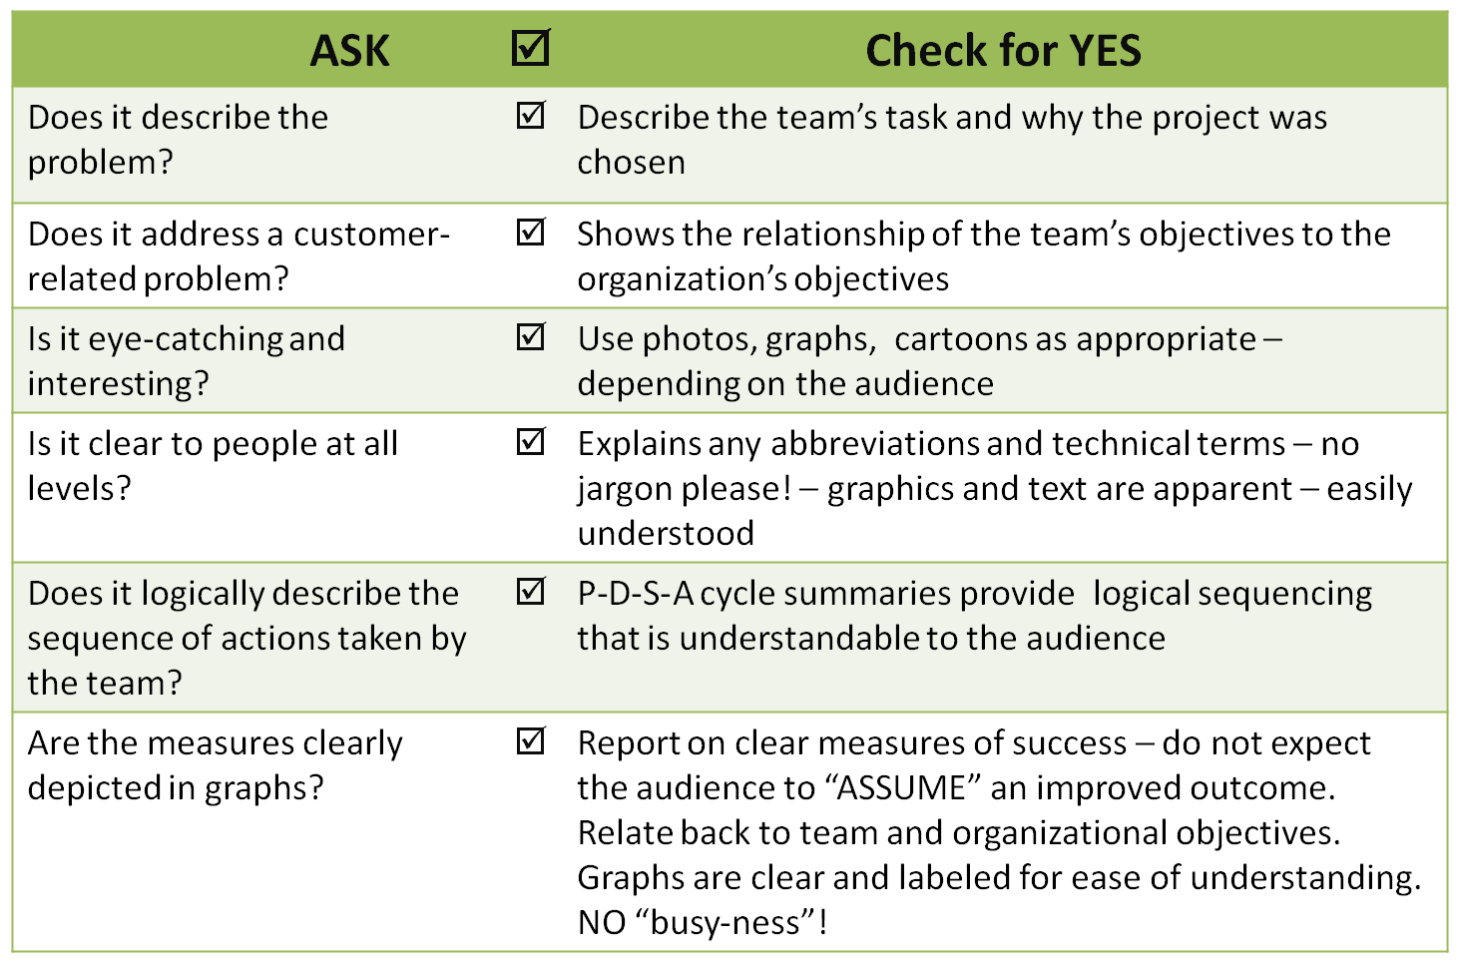
Checklist for Creating An Effective Storyboard
Adapted from GOAL/QPC Problem Solving Memory Jogger pgs 121-134

Slide 68
Checklist for Creating An Effective Storyboard – chart description
Ask: Does it describe the problem?
Check for YES: Describe the team’s task and why the project was chosen
Ask: Does it address a customer-related problem?
Check for YES: Shows the relationship of the team’s objectives to the organization’s objectives
Ask: Is it eye-catching and interesting?
Check for YES: Use photos, graphs, cartoons as appropriate – depending on the audience
Ask: Is it clear to people at all levels?
Check for YES: Explains any abbreviations and technical terms – no jargon please! – graphics and text are apparent – easily understood
Ask: Does it logically describe the sequence of actions taken by the team?
Check for YES: P-D-S-A cycle summaries provide logical sequencing that is understandable to the audience
Ask: Are the measures clearly depicted in graphs?
Check for YES: Report on clear measures of success – do not expect the audience to “ASSUME” an improved outcome. Relate back to team and organizational objectives. Graphs are clear and labeled for ease of understanding. NO “busy-ness”!

Slide 69
“Data is a lot like garbage.
You have to know what you are going to do with the stuff BEFORE you start collecting it.”
Mark Twain

Slide 70
Next
Steps

Slide 71
Annual Program Evaluation
Reference policy and format
Summary description of mechanism
Reporting process
Who is responsible for developing, reviewing and approving
Frequency – usually annually

Slide 72
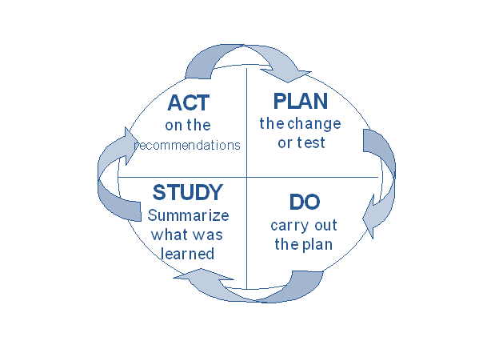
Back to PDSA: WORK THE PLAN
Step 1:
Develop the Quality Improvement Plan; development/ revisions are based on:
The organization (system)
Population & services provided
External requirements (HRSA, accreditation)
Step 2:
Implement the Quality Improvement Plan
Use the QI Plan as the roadmap for implementing an integrated quality program system-wide
Step 3:
Evaluate the Quality Improvement Plan
Did you do what you said you were going to do?
Why? Why not?
What were the results?
How can next year be better?
Step 4:
Act on the lessons learned to revise the Quality Improvement Plan for the next year

Slide 73
Quality Resources
The Team Handbook – 3rd Edition; Scholtes/ Joiner/ Streibel : Amazon.com → http://www.amazon.com/Team-Handbook-Third-Peter-Scholtes/dp/1884731260
GOAL/ QPC Memory Joggers http://www.goalqpc.com/shop_products.cfm?ProductShopBy=7
NAHQ Guide to Quality Management, 8th edition, Handbook for Improvement, 1997 ; http://www.nahq.org/
HRSA Quality Matrix – Performance Measures
  http://www.hrsa.gov/healthit/coremeasures.html
GAPHC Quality Management Plan Template & Manuals , Jan Wilkerson, RN, CPHQ; http://www.gaphc.org

Slide 74
Quality Resources
NCQA- http://www.ncqa.org/tabid/1196/Default.aspx
IHI http://www.ihi.org/IHI/Results/WhitePapers/
AHRQ http://www.ahrq.gov/clinic/epcix.htm
Institute for Clinical Systems Improvement http://www.icsi.org/
UDS Manual, -HRSA; http://www.hrsa.gov/data-statistics/health-center-data/reporting/2010manual.pdf
NACHC – http://www.nachc.org ; Information Bulletin #15: Using Information Technology to Improve Quality
UDS Benchmark National & State: http://bphc.hrsa.gov/healthcenterdatastatistics/index.html

Slide 75
Measures Resources
Use nationally [standardized] developed measures, rather than developing your own
  HRSA Clinical Quality Performance Measures
  http://www.hrsa.gov/healthit/coremeasures.html Healthy People (2010 & 2020) http://www.healthypeople.gov/About/
  National Forum http://www.qualityforum.org/
  Agency for Healthcare Quality & Research http://www.ahrq.gov/
  NCQA HEDIS® Measures http://www.ncqa.org/tabid/59/Default.aspx

Slide 76
Resources
FTCA for Health Centers: http://bphc.hrsa.gov/FTCA/
FQHC PIN & PALS: http://bphc.hrsa.gov/policiesregulations/policies/index.html

Slide 77
Investigating An Out Of Control Process: Questions to Ask
Was a new collection tool/ method used?
Were all staff consistent in collection method?
Is process affected by new or significant change in environment?
Is process affected by predictable conditions?
Any new or untrained staff involved in the process during measurement period?
Change in resource for input to the process?
Is process affected by employee fatigue?
Has there been a change in policy/procedure?
Is process adjusted frequently?
Did sample come from different parts of the process?
Are new employees afraid to report?

Slide 78
Discussion and Questions
Please share your quality improvement successes, challenges, and training and technical assistance needs
Contact your HRSA Project Officer or the Office of Quality and Data at OQDcomments@hrsa.gov or
(301) 594-0818
78

